Slide 1

DTC Information Day
DARPA Triage Challenge
CDR Jean-Paul Chretien, M.D., Ph.D., MC, USN
Program Manager
Biological Technologies Office (BTO)
November 29, 2022
Distribution Statement ‘A’ (Approved for Public Release, Distribution Unlimited)

Slide 2

Ground Rules
Purpose of this meeting:
  Discuss DTC objectives and structure
  Provide opportunity for teaming prior to proposal deadline
Until the deadline for receipt of proposals:
Open communications between proposers and the program manager are encouraged
Information given to one proposer will be made available to all proposers
The best way to get a question answered is to submit it by email and retrieve the response from the Frequently Asked Questions (FAQ) list via the DARPA Opportunities webpage or DTC webpage (see “Resources” at the end of this presentation)
Note that any question that contains distribution restrictions, such as “company proprietary,” will not be answered
Questions:
triagechallenge@darpa.mil
Distribution Statement ‘A’ (Approved for Public Release, Distribution Unlimited)
Notes:
Approved DISTAR case 36443

Slide 3
DTC Information Day Agenda
Start | End | Duration | Description
9:00 | 9:30 | 0:30 | Sign-In
9:30 | 9:35 | 0:05 | Welcome and Meeting Logistics CDR Jean-Paul Chretien, Program Manager, DARPA/BTO Renee Besanson, Strategic Analysis, Inc.
9:35 | 10:00 | 0:25 | DARPA Triage Challenge (DTC) Program Overview CDR Jean-Paul Chretien, Program Manager, DARPA/BTO
10:00 | 10:10 | 0:10 | BTO Overview Dr. Kerri Dugan, Director, DARPA/BTO
10:10 | 10:15 | 0:05 | Break Proposers submit questions for Q&A via email to triagechallenge@darpa.mil
10:15 | 10:50 | 0:35 | Working with DARPA DARPA/BAA Inbox & Submission - Mr. David Swan, BAA Coordinator, DARPA/BTO (10 min.) Doing Business with DARPA - Ms. Lydia Richards, Contracting Officer, DARPA/CMO (15 min.) DARPA/HSR Use - Ms. Tammy Saleck, Human Subjects Research Action Officer, DARPA/I2O (10 min.)
10:50 | 11:10 | 0:20 | Outside Speakers TBD
11:10 | 11:30 | 0:20 | Outside Speakers TBD
END GOVERNMENT PRESENTATIONS
11:30 | 11:35 | 0:05 | Break Proposers submit questions for Q&A via email to triagechallenge@darpa.mil
11:35 | 12:15 | 0:40 | Lightning Round Talks Session 1 Proposer Introductions and Teaming Presentations (3 min. each)
12:15 | 12:30 | 0:15 | DARPA Q&A Session 1
12:30 | 13:00 | 0:30 | Break for Lunch
13:00 | 13:40 | 0:40 | Lightning Round Talks Session 2 Proposer Introductions and Teaming Presentations (3 min. each)
13:40 | 14:00 | 0:20 | DARPA Q&A Session 2
END GENERAL SESSION
14:00 | 14:05 | 0:05 | Break
14:05 | 17:05 | 3:00 | Networking
14:05 | 17:05 | 3:00 | Sidebars
Distribution Statement ‘A’ (Approved for Public Release, Distribution Unlimited)

Slide 4
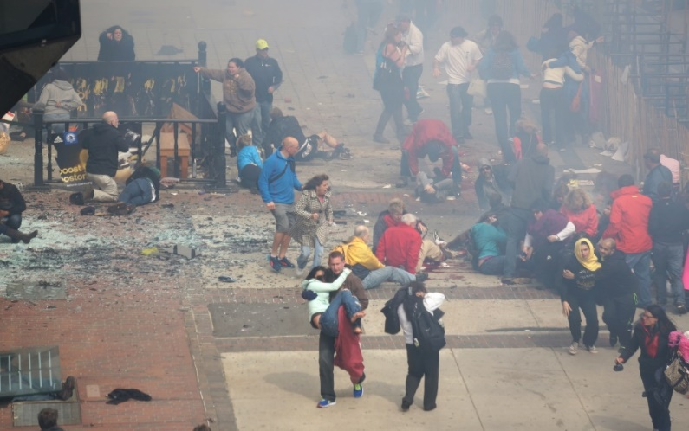











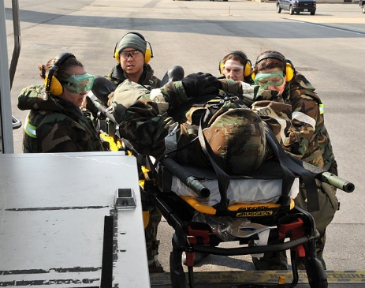

DARPA Triage Challenge (DTC)
DoD Problem: Current triage approaches are inadequate for mass casualty incidents and have limited value for predicting need for life-saving medical interventions.
Primary Triage Competition
Secondary Triage Competition
DARPA Research Infrastructure for Trauma with Medical Observations (RITMO) program
Complex de-identified medical data from trauma patients
Novel database of multi-modal sensor data and outcomes
Stand-off capture of signatures to identify casualties who need life-saving interventions
Capture of complex signatures in non-invasive data streams to predict need for life-saving interventions
  Vision: Scalable, timely, accurate capture of novel injury signatures to enhance triage decision-making in austere, complex, and mass-casualty settings.
Distribution Statement ‘A’ (Approved for Public Release, Distribution Unlimited)
Notes:
The goal of the Medical Triage Challenge is to drive breakthrough innovations in identification of physiological features of traumatic injuries that will enable scalable, timely, and accurate triage, ultimately saving lives in both military and civilian settings. MTC focuses on mass casualty incidents (MCIs), where medical resources are limited and a capability for rapid and anticipatory assessment is critically important. The Challenge includes 2 domains, Primary Triage, or initial casualty assessment, and Secondary Triage, which is monitoring that follows primary triage and initial stabilization. In the Primary Triage Competitions, teams will face physical simulations of MCIs, such as battlefield and natural disasters, and will employ multi-modal stand-off sensors (with or without delivery platforms, such as UAVs) and algorithms for autonomous identification of casualties who most urgently need life-saving interventions (LSIs). Teams will be evaluated on speed and accuracy of classifications. In the Secondary Triage Competitions, teams will use de-identified, multi-modal clinical monitoring data from trauma patients in diverse settings to predict need for LSIs over the next several hours (these data will be provided by the Research Infrastructure for Trauma with Medical Observations [RITMO] program). Teams will be evaluated on accuracy of predictions. MTC includes training opportunities for competitors during each year and competition events at the end of each year, which become increasingly complex over the 3 years. Both DARPA-funded and self-funded teams may participate in MTC. Prizes will be awarded to the top-performing teams in each triage Domain.
Creative commons images
https://commons.wikimedia.org/wiki/File:2013_Boston_Marathon_aftermath_people.jpg
https://commons.wikimedia.org/wiki/File:Airmen,_Soldiers_team_up_during_dust-off,_medevac_140212-F-FM358-144.jpg

Slide 5

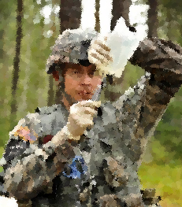

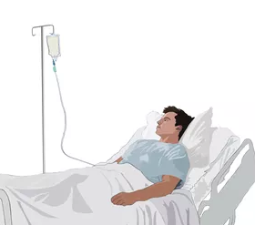

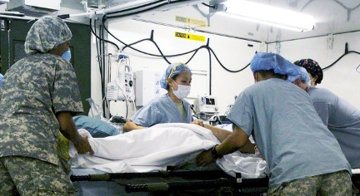
Timeline of lifesaving interventions (LSIs)
CUI
Primary Triage: Initial assessment & immediate life-saving interventions
Secondary Triage: Deeper assessments and additional interventions
Control Massive External Bleeding
Transfuse
Blood
Use Prolonged Care Capabilities
<30 minutes Golden Hour 4 hours
Chance of survival
stabilizes after 4 hours
with ongoing care
Clear Airway
Ensure Breathing
Damage Control Surgery
Adapted from: Shackelford et al. J Trauma Acute Care Surg 2022.
Interventions delivered too late do not improve survival.
Distribution Statement ‘A’ (Approved for Public Release, Distribution Unlimited)
Notes:
Approved DISTAR case 36443
--creative commons
https://openclipart.org/detail/21748/tourniquet-
"Field surgery-4_140926" by Joint Base Lewis McChord is licensed under CC BY-NC-SA 2.0. To view a copy of this license, visit https://creativecommons.org/licenses/by-nc-sa/2.0/?ref=openverse.-
This image was released by the United States Army with the ID 130913-A-BS310-093
DataBase Center for Life Science (DBCLS)/Wikimedia Commons

Slide 6
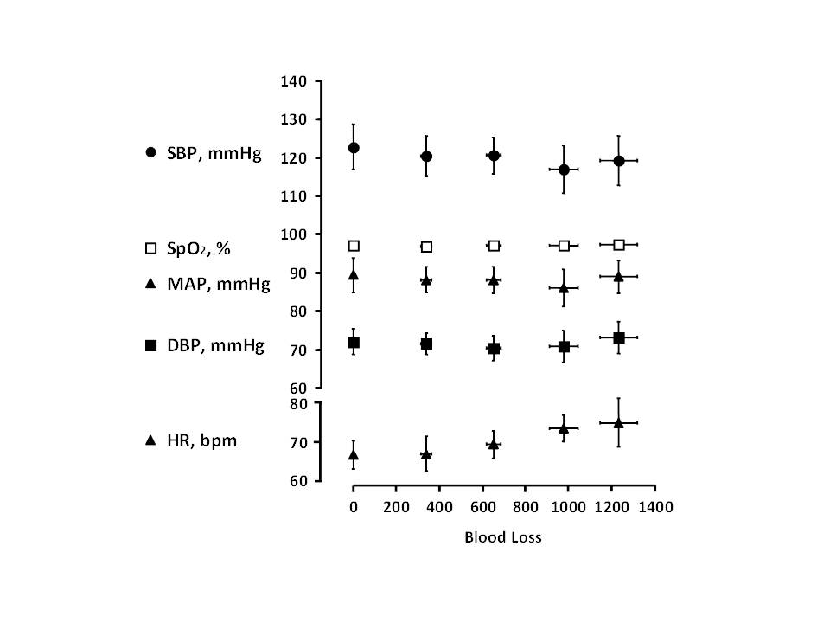
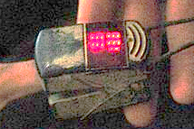
Limitations of current triage data
CUI
Human Compensatory Reserve
High subjectivity
Low-moderate predictive values
Poor scalability
Increased difficulty in austere conditions
Limited foundation of data for innovation and discovery
Most combat medics carry no tools to assist with triage assessments.
One pulse oximeter at best.
Little change in standard vital signs even with controlled loss of ~20% blood volume (human subjects).
Schauer et al. J Spec Ops Med 2020.
Convertino et al. Shock 2016.
New triage data approaches are needed that anticipate medical needs and scale to large numbers.
Distribution Statement ‘A’ (Approved for Public Release, Distribution Unlimited)
Notes:
Approved DISTAR case 36443
--cc—
https://commons.wikimedia.org/wiki/File:U.S.,_Afghan_forces_medically_assist_wounded_insurgent_DVIDS187390.jpg

Slide 7
Challenge Tracks
Problem Domain | Competitions | Description | Track
Primary Triage Signature Competitions | Real World Competition | Competitors use robotic platforms with stand-off sensors to capture physiological data in physical simulations. Competitors’ algorithms identify injury patterns for triage. | Track A DARPA-funded
 |  |  | Track B Self-funded
 | Virtual Competition | Competitors use stand-off sensor data taken by the IV&V team. Competitors’ algorithms identify injury patterns for triage. | Track C Self-funded
Secondary Triage Signature Competition | Virtual Competition | Using sensor data provided by RITMO via IV&V team, Competitors’ algorithms predict life-saving interventions. | Track D DARPA-funded
 |  |  | Track E Self-funded
Distribution Statement ‘A’ (Approved for Public Release, Distribution Unlimited)

Slide 8
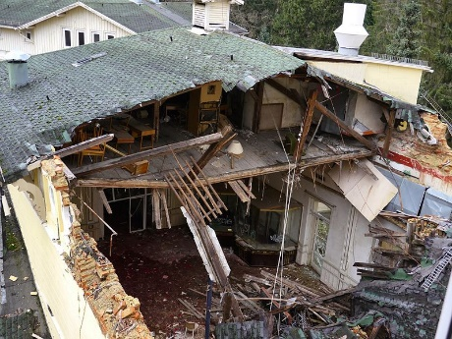
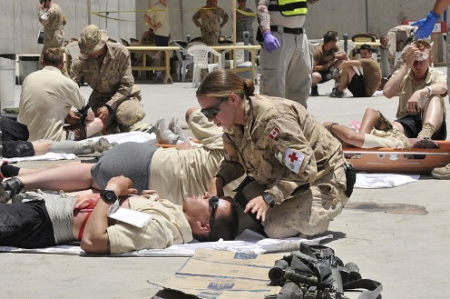
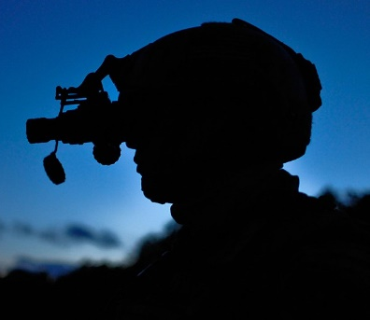
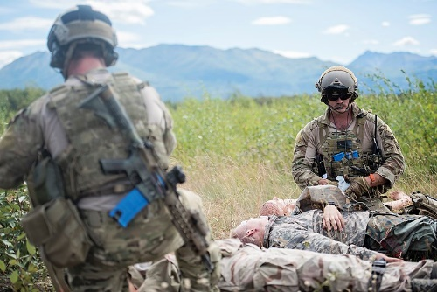
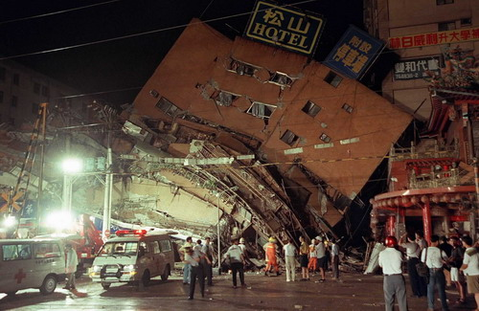
Primary Triage Competitions
Develop algorithms to identify injury patterns in stand-off sensor data for primary triage in mass casualty incidents (MCIs)
Real World Competition
Platforms + Sensors + Algorithms
Competitors develop algorithms for stand-off data from their sensor platforms in physical simulations of MCIs
Virtual Competition
Algorithms
Competitors develop algorithms for stand-off data provided by the IV&V team from physical simulations of MCIs
Year 1:
Small MCI
Year 2:
Moderate MCI
Operational challenges
Year 3:
Large MCI
New operational challenges
Distribution Statement ‘A’ (Approved for Public Release, Distribution Unlimited)

Slide 9





Primary Triage – Real World System Requirements
Real-World systems will use stand-off sensors on platforms to locate and triage casualties in the field
Sensor packs
Multi-modal approach – minimum of 2 modes example sensors include:
  Lidar, acoustic, RGB, RF, IR, UV, radar, gravity, compass/magnetic, GPS, and chemical.
Skin- and eye-safe.
Minimum distance of 1 meter
Recommended but not required
  COTS or near-COTS sensors
User interface
Laptop or handheld device
Provide the situational awareness that a medic would need during primary triage in the early moments of an MCI, such as the locations and status of most urgent casualties
Signature-identification algorithms and processing hardware
Algorithms may run on either the user interface, the autonomous platform or an additional workstation that does not enter the course
Must classify injury patterns in near-real time
Autonomous / Teleoperated Platforms
All platforms
Maximum 5 platforms per team
Expected diameter less than 1.5 M
Untethered
1 operator / platform (phase 1)
1 operator / system (phases 2 + 3)
Drones
Expected maximum weight 9kg
Must be NDAA compliant
Expected maximum altitude = 30 meters
Total system fits in a single vehicle
Distribution Statement ‘A’ (Approved for Public Release, Distribution Unlimited)

Slide 10


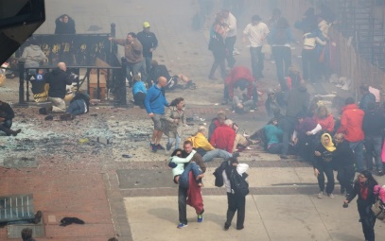

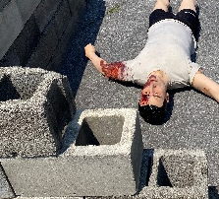
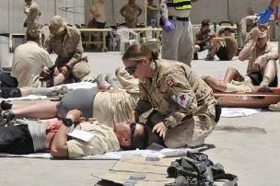

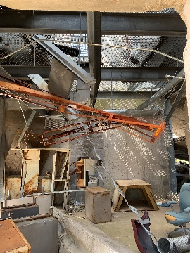



Primary Triage – Technical Challenge Elements
Degraded Sensing: Dust, fog, mist, smoke, talking, night, flashing light, hot spots, and gunshot and explosion sounds
Obscuring Obstacles: fully visible to partially obscured to completely obscured. Casualties may also be grouped with limbs overlapping, or may be interacting with live responders.
Dynamic Obstacles: Live responders, “walking wounded”, or other physical changes to the environment.
Dynamic Casualties: Some treatable injuries may rapidly become fatal, delays in finding and assessing casualties may result in missing the window for effective LSI. Casualties who are not evaluated within an appropriate timescale may have a change in status (for example, progression of untreated hemorrhage or airway injury).
Sensor Packs
Autonomous Platforms
Terrain Obstacles: The competition scenarios will be held in realistic environments that may include natural or human-made materials; structured or unstructured clutter; and intact or collapsed structures and debris. Robotic mobility is not the focus of this challenge and it is expected that widely available outdoor robotic platforms will be capable of navigating the competition environments. In some cases, more robust platforms may benefit from more direct navigation paths or closer approach paths to casualties.
Endurance Limits: Teams may make battery changes but should consider the implications on time.
Distribution Statement ‘A’ (Approved for Public Release, Distribution Unlimited)
Notes:
All images are open source

Slide 11


Secondary Triage Competition
Year 1:
RITMO standard-of-care
sensors
CHALLENGE
Prediction of LSIs within 24 hours of medical contact
Novel Database
  Sensor data
  Medical interventions
  Patient outcomes
Year 2:
RITMO new Sensors
Complex medical data from trauma patients
Year 3:
Technical challenge elements
To avoid potential organizational conflicts of interest (OCI) or the appearance of an OCI, performers in RITMO or entities with access to data collected for RITMO are not permitted to participate as competitors in the secondary triage competition unless they meet criteria specified in the RITMO BAA.
Distribution Statement ‘A’ (Approved for Public Release, Distribution Unlimited)

Slide 12

Secondary Triage – Technical Challenge Elements
Inherent challenges
Multiple data sources: With varied source populations, patient demographics, types of injury, and standard clinical operating procedures. Each data set may have a different standard set of sensor readings, with different added sensors in each phase of MTC.
Multiple data inputs: Includes static data (e.g., mechanism of injury or anatomical injury pattern); multiple simultaneous, continuous streams of high-frequency waveforms; and potentially point-of-care imaging data.
Raw data: Data as it comes from the sensors (i.e., without any post-sensor cleaning), with the noise, aberrant values, and dropouts that occur in clinical environments.
Additional Challenges
Degraded data: DARPA may inject additional challenges that can be expected in battlefield and civilian pre-hospital settings, such as noisy, aberrant values, severe degradation or total loss of a particular sensor, to test the robustness of competitor strategies to such plausible scenarios.
Distribution Statement ‘A’ (Approved for Public Release, Distribution Unlimited)

Slide 13
Scoring and Metrics
Primary Triage
Candidate scoring criteria:
Percent of casualties identified
Accuracy in reporting casualty locations
Accuracy of casualty injury classification
Time to complete casualty assessments
Identification of urgent casualties before the opportunity to address LSIs would have closed
Secondary Triage
Candidate scoring criteria:
Accuracy of LSI prediction (for any LSI and for more specific classifications, such as hemorrhage or airway interventions)
Lead-time for LSI predictions
Duration of monitoring and processing needed to generate LSI predictions
Distribution Statement ‘A’ (Approved for Public Release, Distribution Unlimited)

Slide 14
Timeline
 |  |  | Phase 1 (12 Mo) |  |  | Phase 2 (12 Mo) |  |  | Phase 3 (12 Mo)
Primary Triage | Real- World
 | Virtual
Secondary Triage | Virtual
Track A:
Track B:
Track C:
Track D:
Track E:
Program kick-off Challenge 1 Challenge 2 Final Challenge
Legend:
DARPA funded |  | Live workshop
Self-funded |  | Virtual workshop
Challenge Event
Distribution Statement ‘A’ (Approved for Public Release, Distribution Unlimited)

Slide 15
Funding (DARPA-funded competitors) and prizes
Funding
Track |  | Phase 1 | Phase 2 | Phase 3
A: Primary triage Real World | # Teams | Up to 7 | Up to 5 | Up to 4
 | Funding | ≤$750K per team | ≤$750K per team | ≤$750K per team
D: Secondary triage | # Teams | Up to 6 | Up to 5 | Up to 4
 | Funding | ≤$500K per team | ≤$500K per team | ≤$500K per team
Kick-off
Fall 2023
First Competition
Fall 2024
Prizes
Domain | Tracks | Phase 1: | Phase 2: | Phase 3 Finals:
Primary Triage | Track A DARPA-Funded | (not eligible) | (not eligible) | Up to $2.5M prize pool
 | Track B Self-Funded | Up to $200k prize pool | Up to $500k prize pool
 | Track C Self-Funded | Up to $100k prize pool | Up to $500k prize pool | Up to $1M prize pool
Secondary Triage | Track D DARPA-Funded | (not eligible) | (not eligible) | Up to $1.5M prize pool
 | Track E Self-Funded | Up to $200k prize pool | Up to $500k prize pool
Second Competition
Fall 2025
Final Competition
Fall 2026
Distribution Statement ‘A’ (Approved for Public Release, Distribution Unlimited)

Slide 16


Proposal Evaluation Criteria
All Criteria Must Be Addressed
Overall Scientific and Technical Merit
Technical approach is innovative, feasible, achievable, complete and supported by a proposed technical team that has the expertise and experience to accomplish the proposed tasks.
Potential Contribution and Relevance to the DARPA Mission
DARPA’s mission is to make pivotal early technology investments that create or prevent strategic surprise for U.S. National Security. The goal of this program is to promote advancements through the development of a database of pre-hospital trauma data. The potential impact may be greatly expanded by making these resources available more broadly.
The proposer clearly outlines their long-term plans to support the goal of the program through sharing with the research, industrial, and/or operational military communities. In addition, the evaluation will take into consideration the extent to which the proposed intellectual property (IP) rights will potentially impact the ability to share the data.
Distribution Statement ‘A’ (Approved for Public Release, Distribution Unlimited)

Slide 17



Proposal Evaluation Criteria
All Criteria Must Be Addressed
Cost Realism
Costs are realistic for the technical and management approach and accurately reflect the technical goals and objectives of the solicitation.
Schedule Realism
The proposed schedule aggressively pursues performance metrics in an efficient manner that accurately accounts for that timeframe. The proposed schedule identifies and mitigates any potential schedule risk.
Additional requirements:
Ethical, Legal, and Societal Implications (ELSI)
Proposers should address potential ethical, legal, and societal implications of the proposed technologies. Program developments will be discussed with a group of expert external advisors with expertise in bioethical issues.
Distribution Statement ‘A’ (Approved for Public Release, Distribution Unlimited)

Slide 18
Final Comments
Robotics and autonomy are not the focus, this challenge is focused on discovery of novel traumatic injury signatures to enhance triage decision-making
Hardware development is acceptable but should not be your main focus
Sensor development is not out of scope but teams using COTS or near-COTS solutions may have an advantage because of the tight timeline
Form complete teams with comprehensive expertise & capabilities
The challenge crosses many fields including medicine, AI, robotics and autonomy, and sensors
Teaming is strongly encouraged
Industry expertise desirable
Teams are encouraged to have a program coordinator/project manager
There is no bias for teams internal to one institution or across multiple institutions, but effective communication and collaboration between teams is key
Competitors may use data beyond that provided by DARPA
Examples of usable data types include synthetic data, virtual environments, and pre-existing datasets
However, DARPA will not fund competitors to conduct human or animal research
Distribution Statement ‘A’ (Approved for Public Release, Distribution Unlimited)

Slide 19
Proposal timeline and resources
BAA Released
November 17, 2022
Tips for Successful Submission
Read the BAA carefully
Email questions to triagechallenge@darpa.mil
FAQ: https://www.darpa.mil/work-with-us/opportunities
DTC website: https://triagechallenge.darpa.mil
DTC Broad Agency Announcement (BAA):
  https://sam.gov/opp/9f3fdae8285e44aabdeb0a9c3dfd6c17/view
Information Day
November 29, 2022
Abstracts Due
December 20, 2022
Full Proposals Due
February 13, 2023
Distribution Statement ‘A’ (Approved for Public Release, Distribution Unlimited)

Slide 20
CUI
Distribution Statement ‘A’ (Approved for Public Release, Distribution Unlimited)

