Slide 1


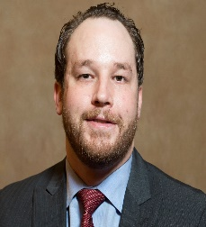





University of Pittsburgh Team
Project Title: Sensor observed Treatment, Annotation and Timing (STAT)
University of Pittsburgh Prime Team
PI: Francis X. Guyette
Areas of expertise: prehospital
resuscitation and data systems
Co-PI: David Salcido
Areas of expertise: signals analysis, device development, and EMS systems
Co-I: Joshua Brown
Areas of expertise prehospital trauma triage, epidemiology, and statistics
Co-I: Leonard Weiss
Areas of expertise: prehospital care and data acquisition and storage.
Co-I: Christian Martin-Gill
Areas of expertise: prehospital data systems and will assist in data acquisition, curation, and contextualization
Co-I: Michael R Pinsky
Areas of expertise: physiology and has developed ML tools to identify artifact in the waveform data
Co-I: Ron Poropatich
Areas of expertise: telemedicine and ML
Co-I: Raquel Forsythe
Areas of expertise: trauma systems and hospital data systems
Notes:
G

Slide 2













RITMO Project Overview
Unclassified
Addition of in-flight video for time-stamped LSIs
Prospective collection ventilator and POC lab data
Time-stamped LSIs
Dataset will include comprehensive, high-fidelity data for triage and LSI as close as possible to the point of injury
Addition of trauma-bay waveform monitor data and video recording
Highly complex dataset with granular prehospital and early in-hospital data
Trauma patients transported to 4 trauma centers in Pennsylvania
Waveform data linked to granular prehospital and inpatient records
Phase 0
Phase 1
Phase 2
Phase 3

Slide 3
Inclusion / Exclusion
Inclusion: All patients evaluated, treated, and/or transported by STAT MedEvac arriving at UPMC facilities for trauma evaluation.
Exclusion Criteria:
  Age<18 or >65
  Known Pregnant
  Known Prisoner
Final Pruned Dataset
  >500 Variables
  14 Signal Channels
  17 trends

Slide 4
Data Cleaning and Quality Assurance
EMS Charts
  Extensive training of crews for charting standardization
  Validation rules to mitigate entry error
  Direct download from SQL
  NEMSIS Compliant
Zoll Waveform Files
  Direct upload
  Artifact detection
  Annotation informed by EMS Charts
Cerner Linkage
  Most deterministically linked
  Robust probabilistic linkage for cases that don’t link deterministically
Registry Data
  Collection by full-time certified registrars with extensive training in data collection, validation, & management
  Validation of other data streams (blood bank records, procedures)

Slide 5
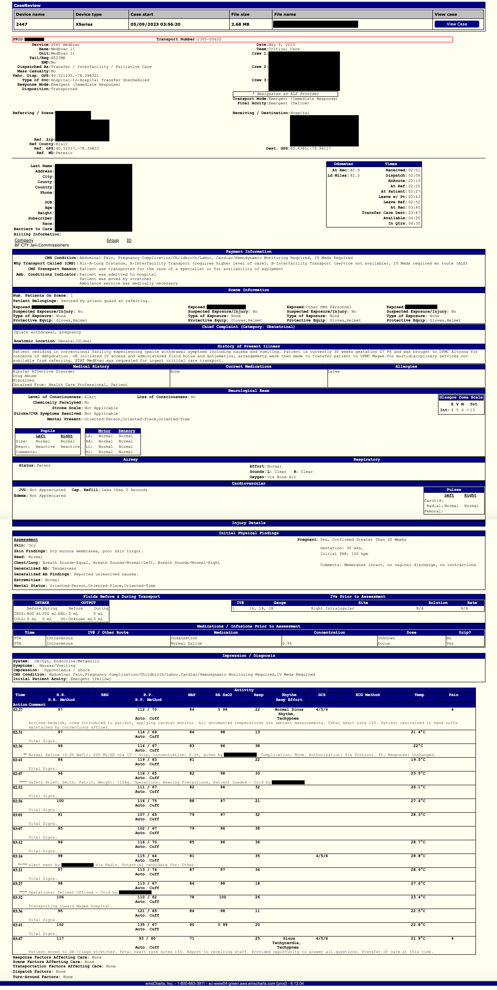
Wide Data
Long Data
PHI of Addendums
PHI of Main Demographic
PHI of Events
PHI of Receiving Status
PHI of Procedures
PHI of Prior IVs
PHI of Billing
PHI of Patient Followups
IPFDrainTubes
IPFAssessmentsGen
IPFAssessmentsSpc
Main Demographic Table
IPFBurns
IPFPregancy
IPFComments
IPFMisc
ID key: PRID
Addendums
Prior Meds
Past Medical History
Events
Imaging
Allergies
Prior IVs
Patient Follow ups
Labs
Procedures
CMSConditionCodes
Fluids
Receiving Status
Factors
P Meds
Crew
IABP
Chart Summary
Billing

Slide 6
Retrospective In-hospital Data
In-patient Data
~685+ primary and derived variables
DI Report Writer
Demographic Data Outcome Data Calculated Scores
Prehospital Data Anatomical Diagnoses PTSF Elements
Referring Facility Data Procedures NTDB Elements
Acute Care Payor
Clinical Data Receiving Facility Dx
Encounter
Trauma Registry
Trauma number (encounter-level)
FIN (encounter-level)
MRN (pt-level)
EHR feeds registry through certified registrar abstraction
Electronic Health Record
FIN (encounter-level)
MRN (pt-level)
Cerner/Clinical Analytics
Emergency Department Data Procedure Data
Anesthesia Data Clinical Notes/Documentation
Laboratory Values
Supplement registry data
(e.g. time-stamped blood product administration)

Slide 7
Trauma Registry Data
Digital Innovations Report Writer Software:
  Inclusion – any patient with documented injuries
  Extract wide patient level CSV file with >500 variables (including PHI/identifiers)
    Combination of typical string & integer formats
  Example data – PUH 2022: 4017 patients, 961 patients transported by Stat MedEvac
  Size <500,000 KB
Preprocessing in Stata - 682 variables
Trim strings
LSI creation
Wide & long formats with timing in minutes
Optional additional pre-processing
Vital sign outliers (negative values, high outliers, GCS)
Format numeric values (e.g. drop “N/A” values)
Create categorical/binary variables & labels from strings (e.g. mortality, discharge disposition)
Parse list variables (e.g. ICD-10 diagnosis codes, procedures codes)
Convert data/times, creating time elapsed variables (e.g. procedure timing)
Categories based on ICD-10 PCS procedure codes
Registry specific flags/variables – surgery for hemorrhage control, craniotomy, ED blood transfusion, IR procedure
Injury Score outliers

Slide 8
In-hospital LSI
LSI within 4 hours | Proportion (%)
Endotracheal intubation | 14.0
Supraglottic airway placement | 1.2
Cricothyrotomy | 0.6
Tube thoracostomy | 16.0
Blood product transfusion | 10.8
Vasopressor initiation | 0.2
ED Resuscitative thoracotomy | 1.5
Right thoracotomy | 0.2
Exploratory laparotomy | 8.2
Surgery for hemorrhage control | 9.3
Craniotomy | 2.2
Interventional radiology procedure | 2.6
REBOA | 0.2
Overall LSI rate in-hospital at 4 hours:
26.3%

Slide 9
Yearly Patient Data
1000 Pts (200 LSI)
Helicopter Video Recording
EHR (Cerner/EMSCharts) Zoll
Hamilton
Phase 0 and 1
500 Pts
Trauma bay video analysis for injuries
Phase 2 and 3
185 Pts
Video of LSI
70 Pts
Prehospital Point of Care Labs (iSTAT)

Slide 10
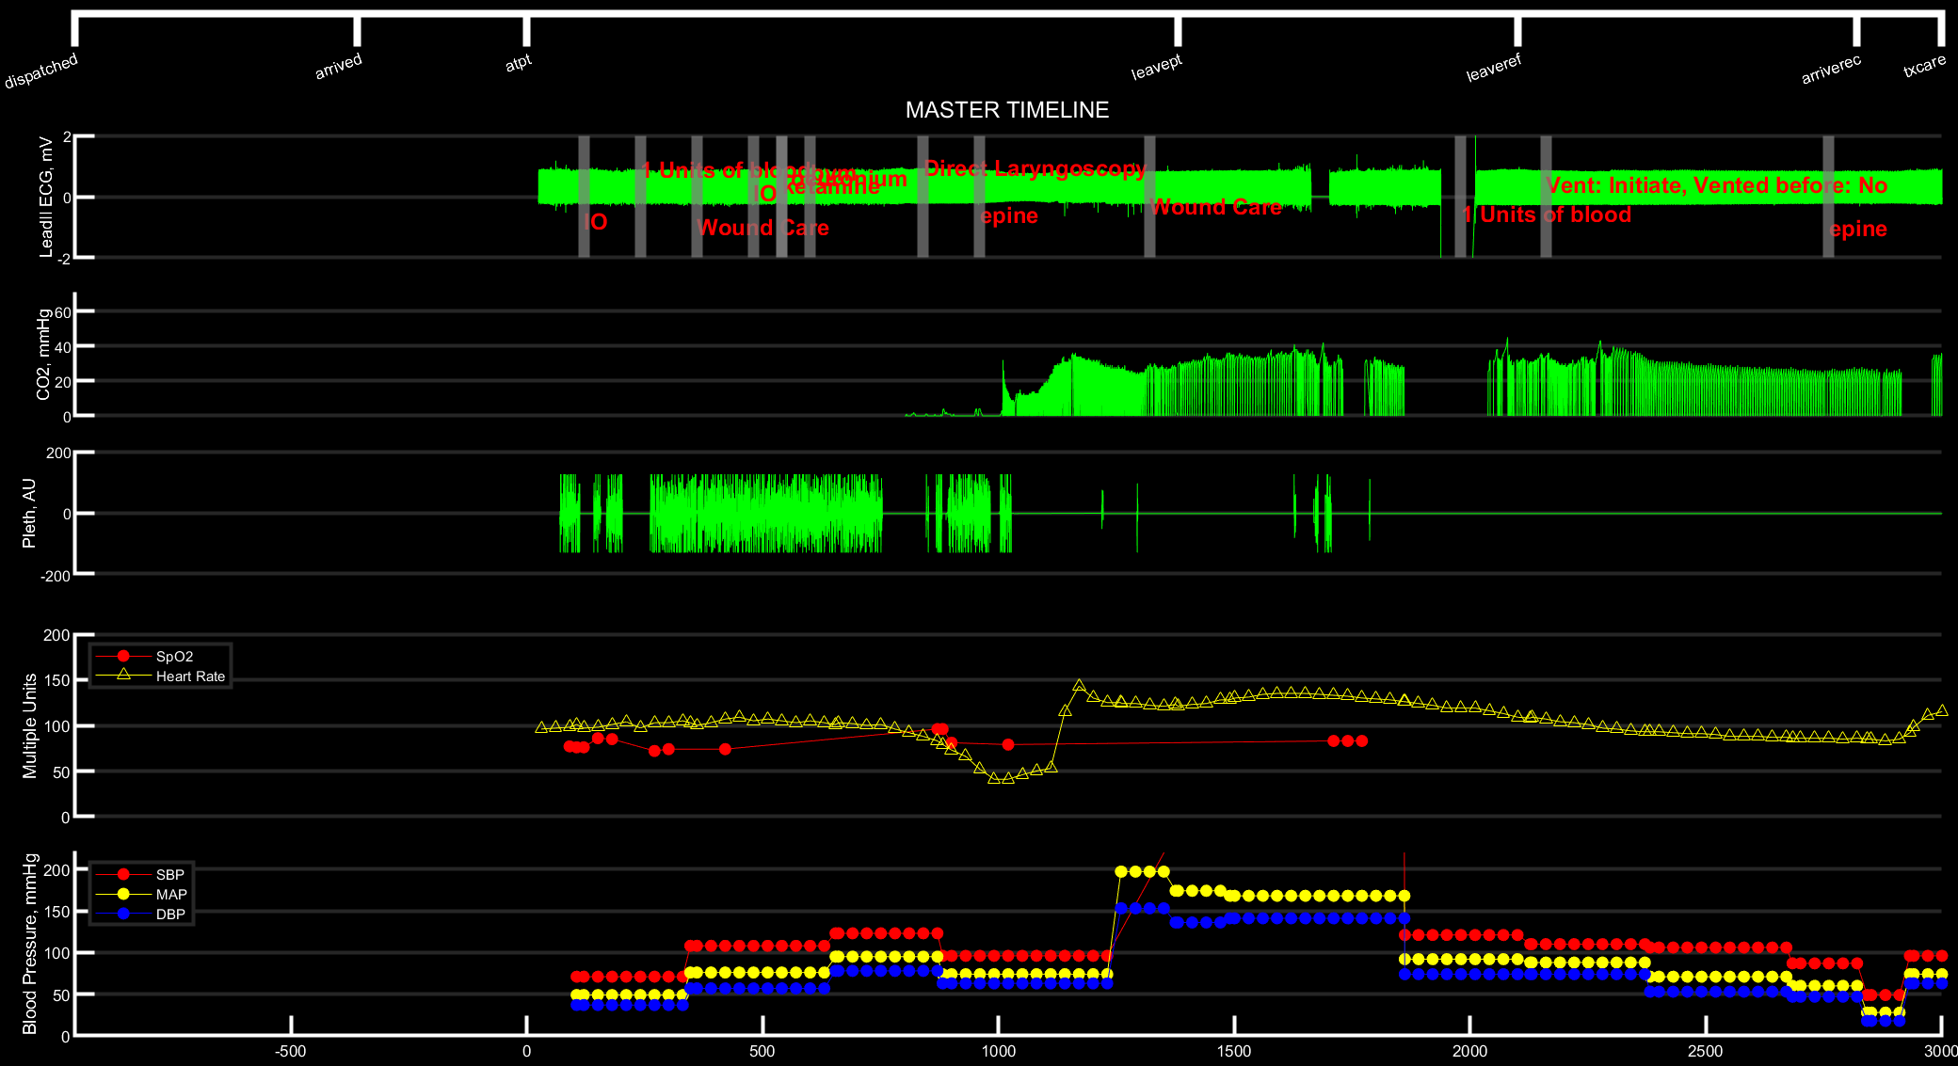
LOS: 45 Days
Dispo: Alive / Rehab

Slide 11
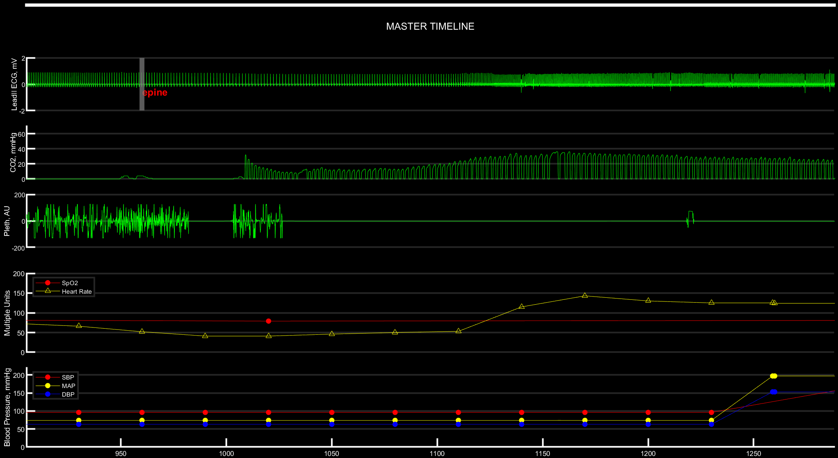

Slide 12
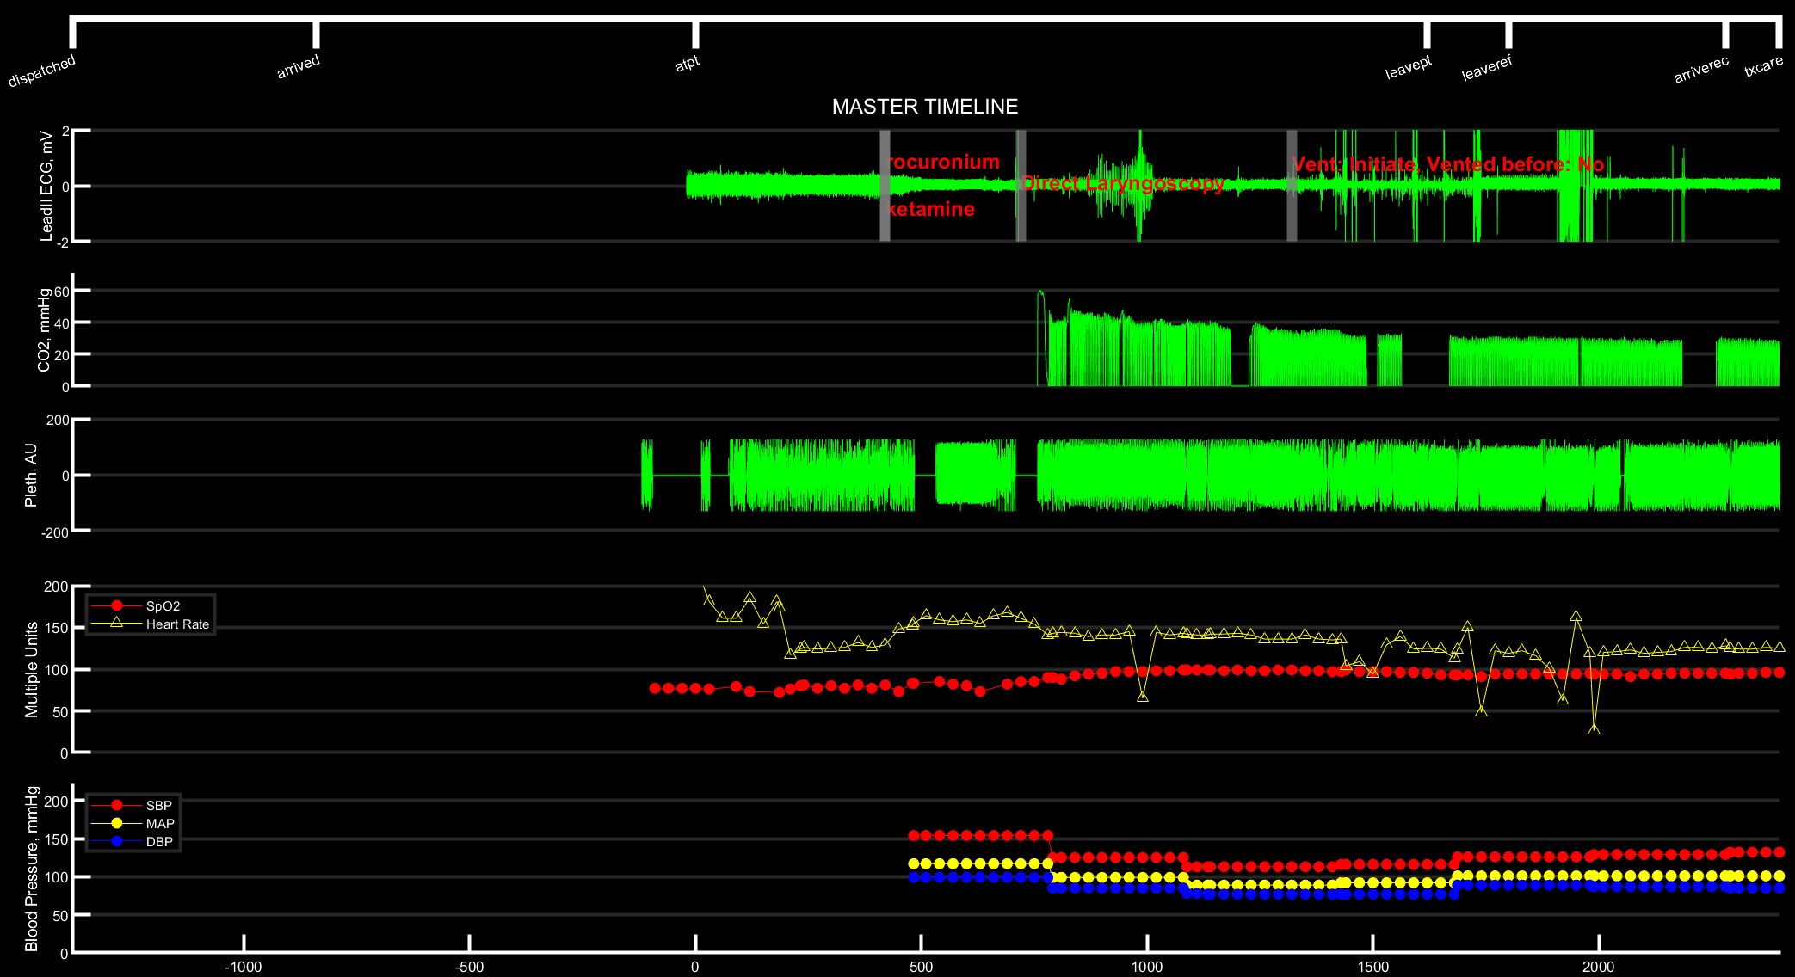
LOS: 8 Days
Dispo: Alive / Psych

Slide 13
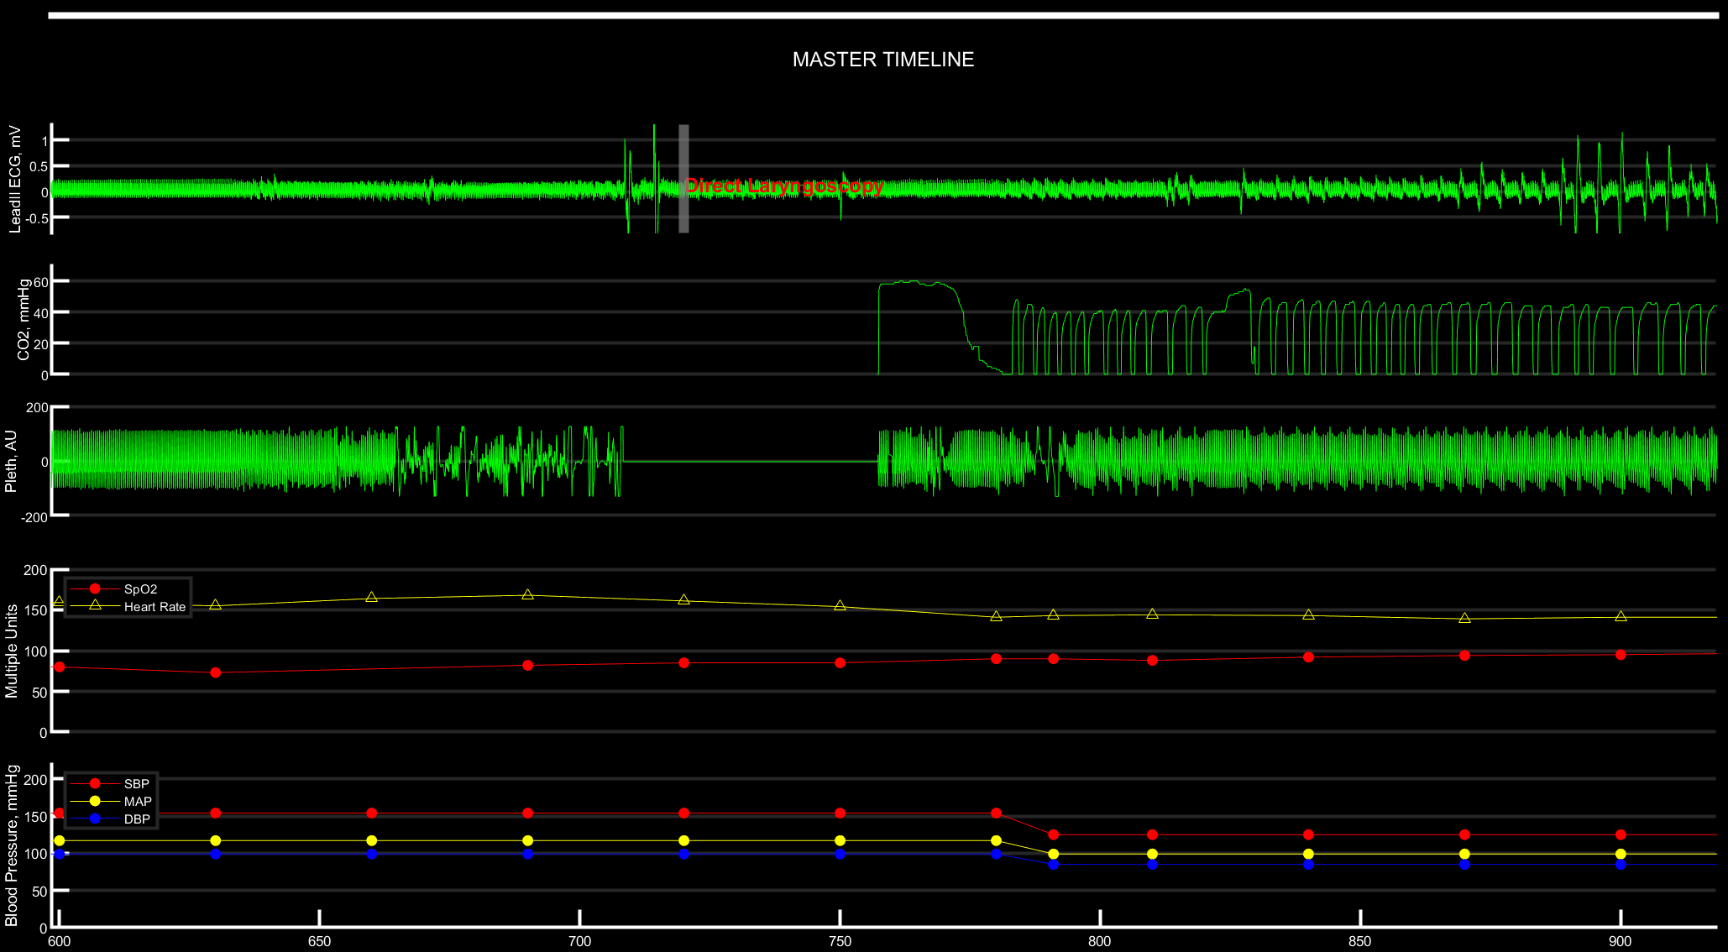

Slide 14
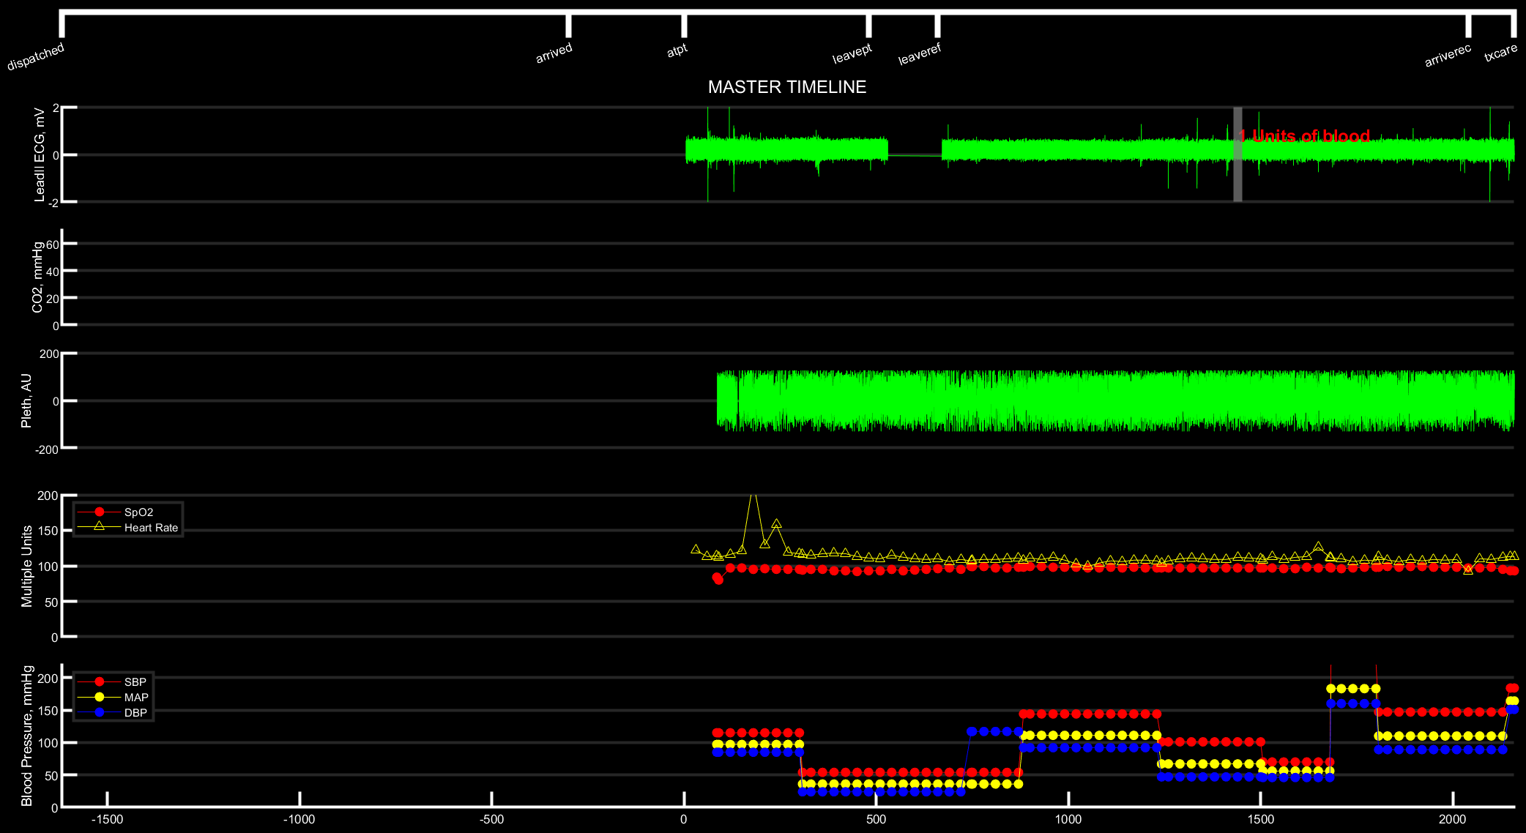
LOS: 38 Days
Dispo: Alive / Home

Slide 15
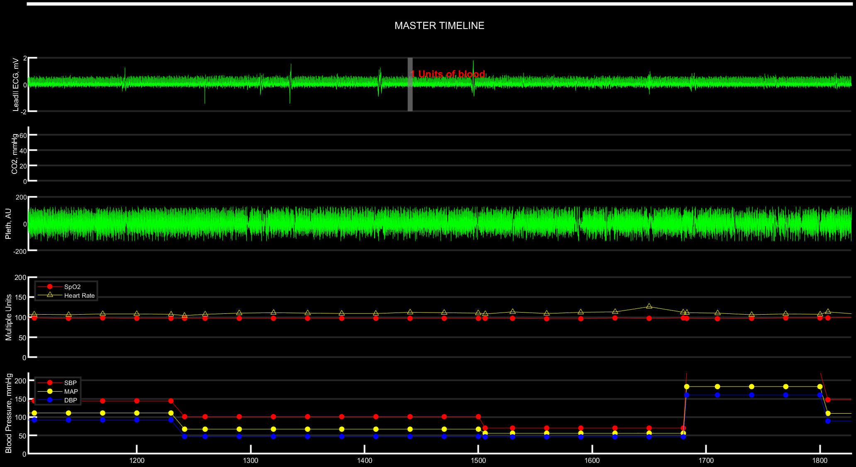

Slide 16
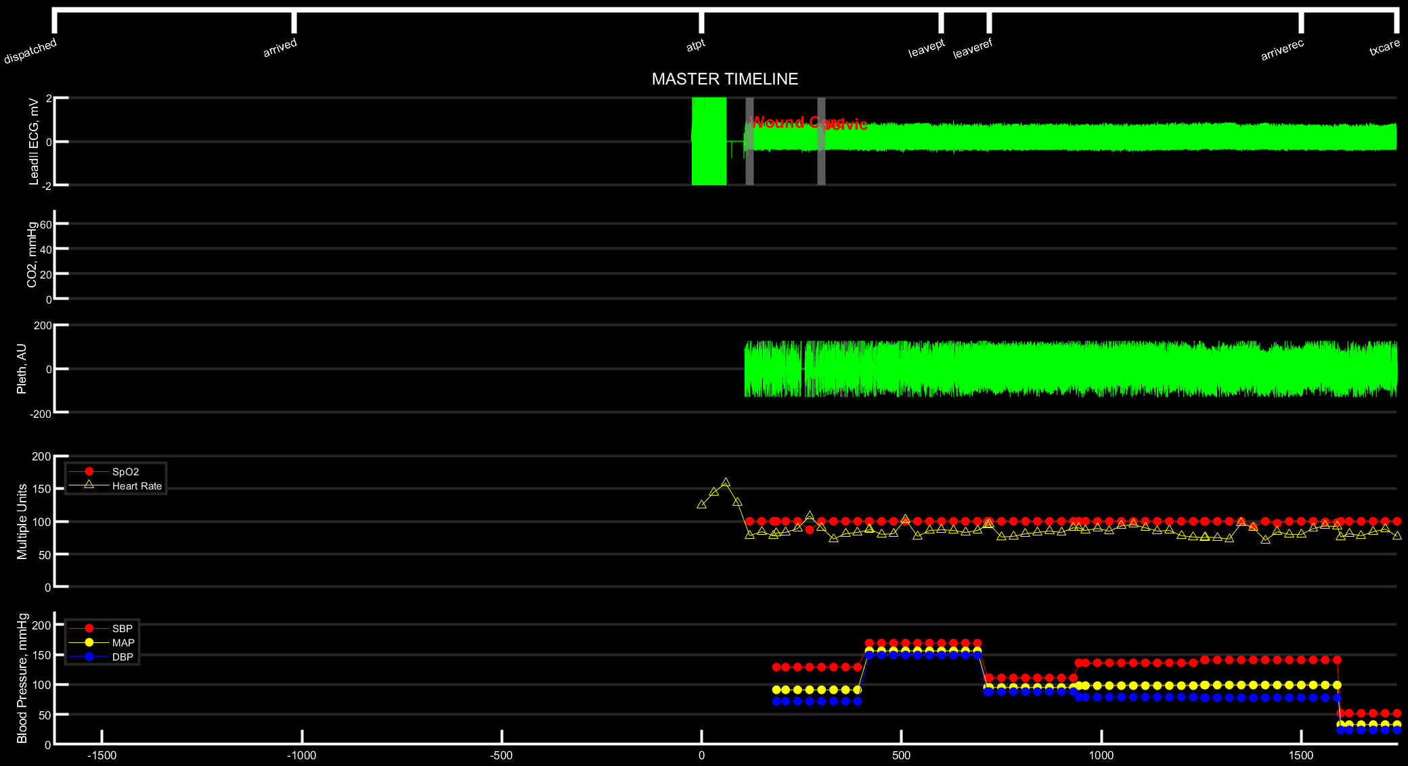
LOS: 14 Days
Dispo: Alive / Home

Slide 17
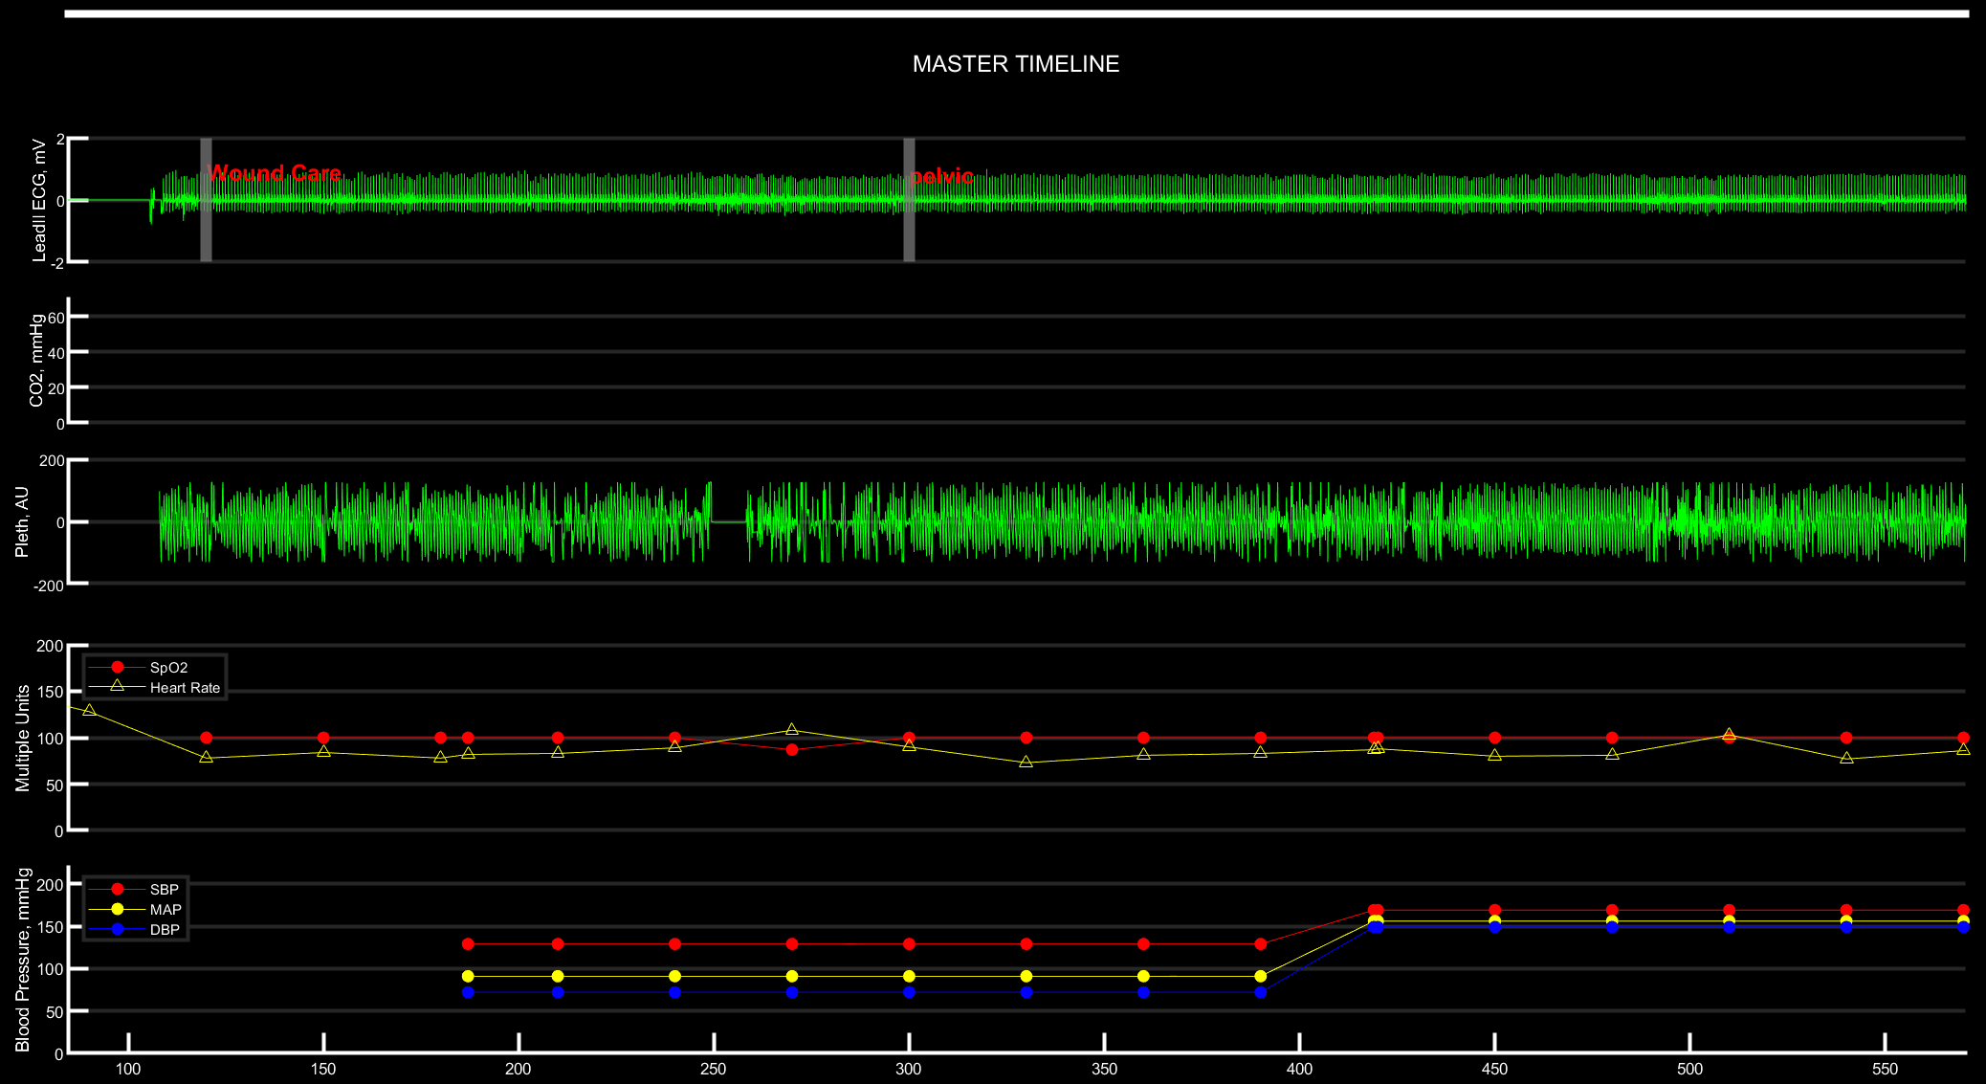

Slide 18
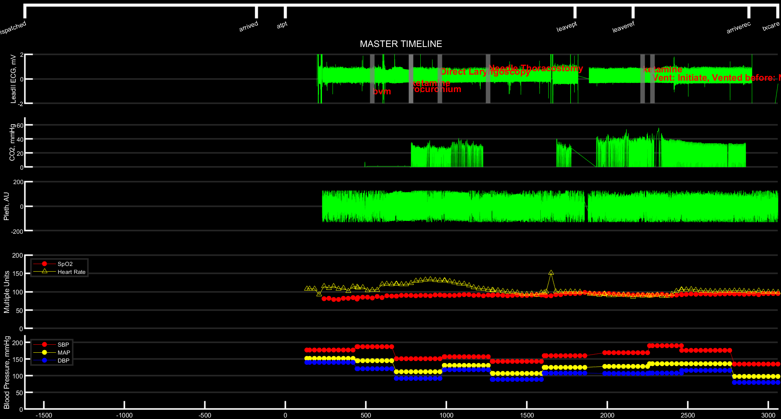
LOS: 75 Days
Dispo: Alive / SNF

Slide 19
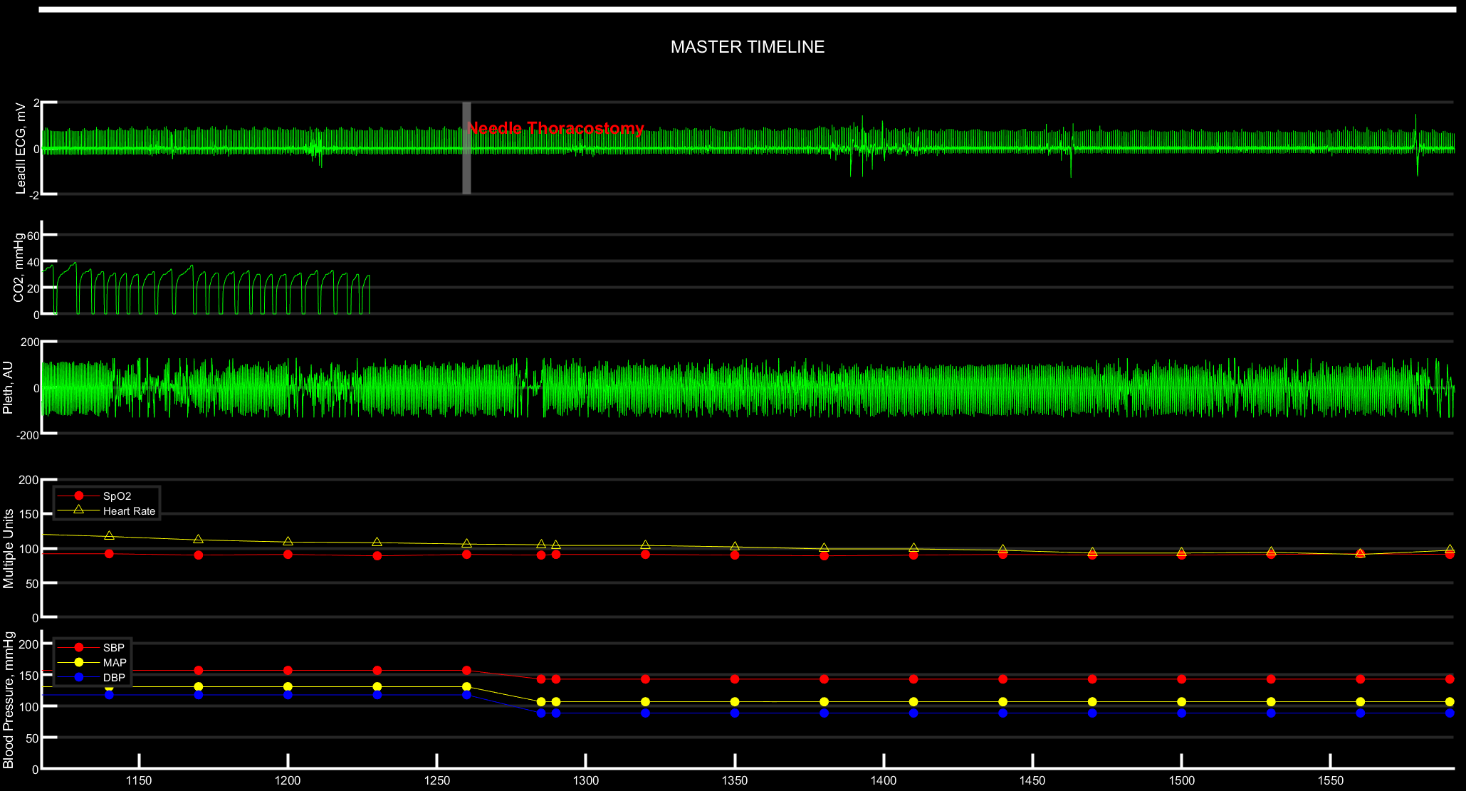

Slide 20
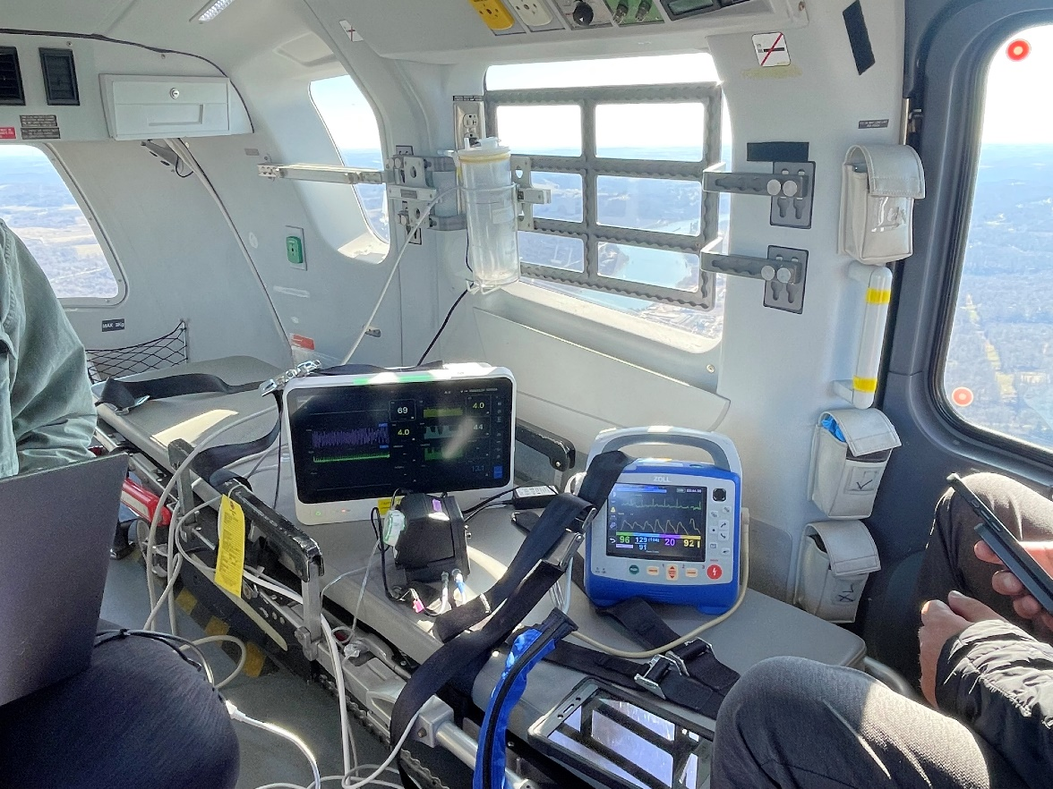
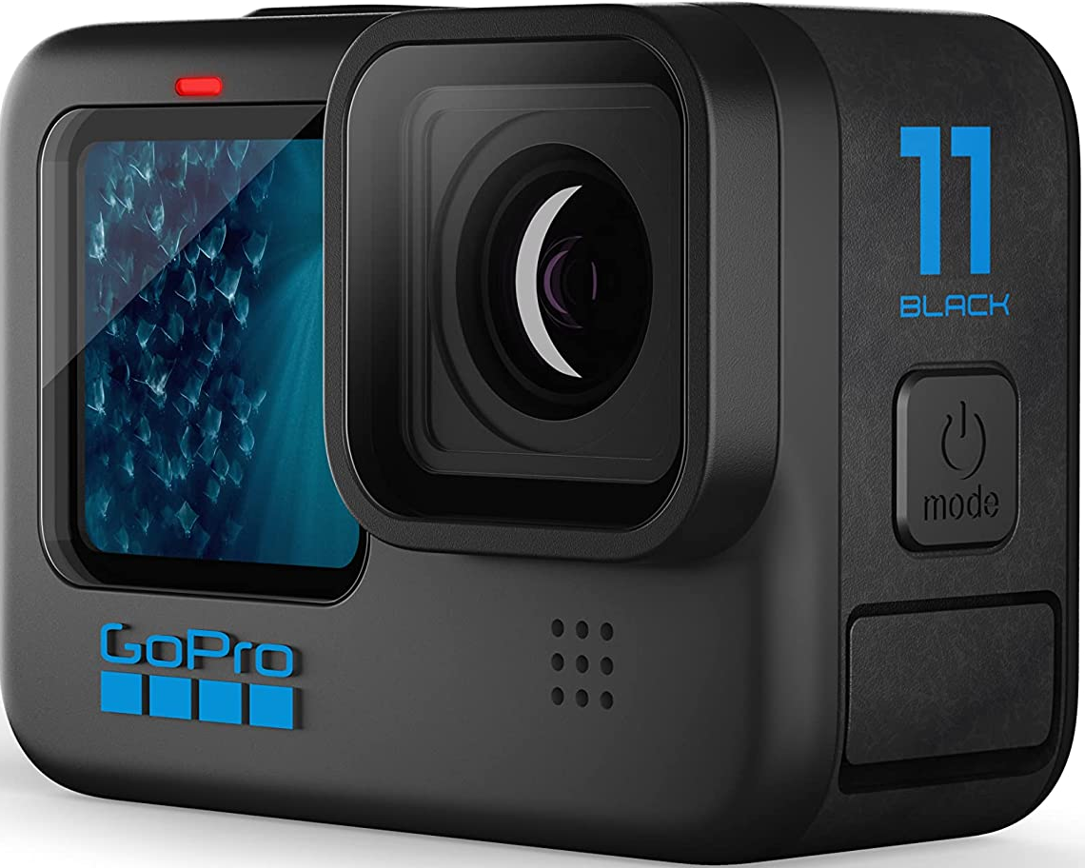
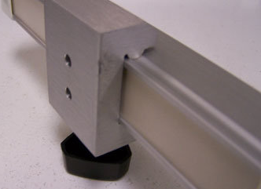
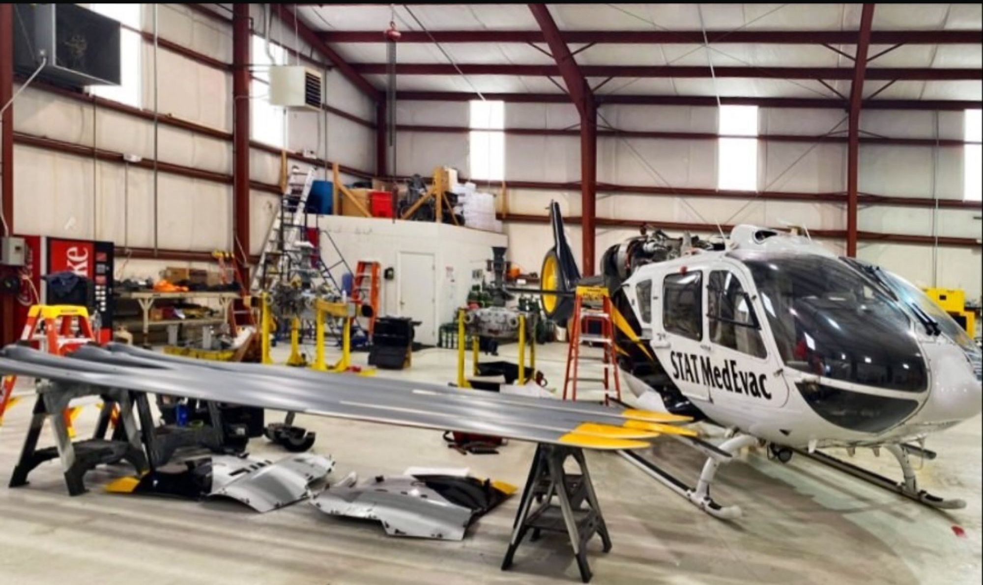
Additional Sensors: Mounted Cameras in Aircraft
Notes:
Rail mounts available from multiple perspectives in aircraft = fixed angle to be determined and refined
Camera to be mounted with Fairfield Clamp on Rail
Camera brand agnostic – look for versatility and reliability in power supply, storage, motion-detection start/stop, data transmission
We have home grown aviation maintenance, engineering & upfitting, testing, and certification

Slide 21
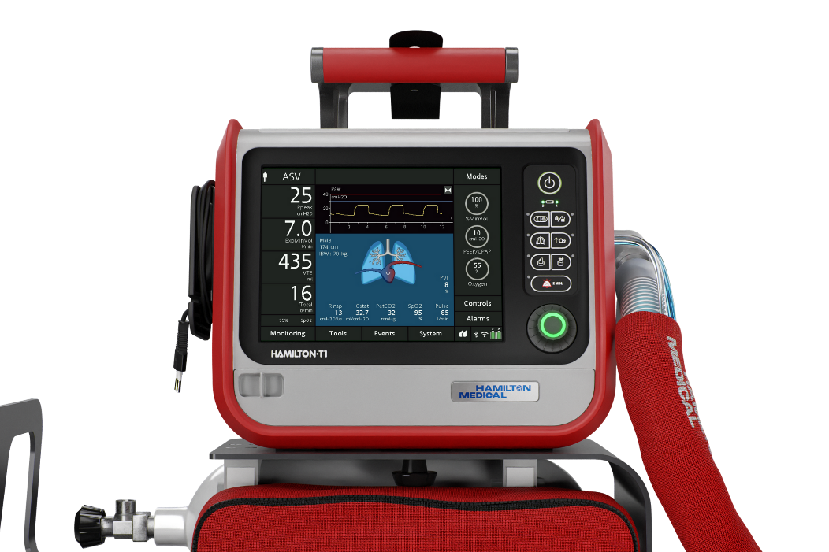
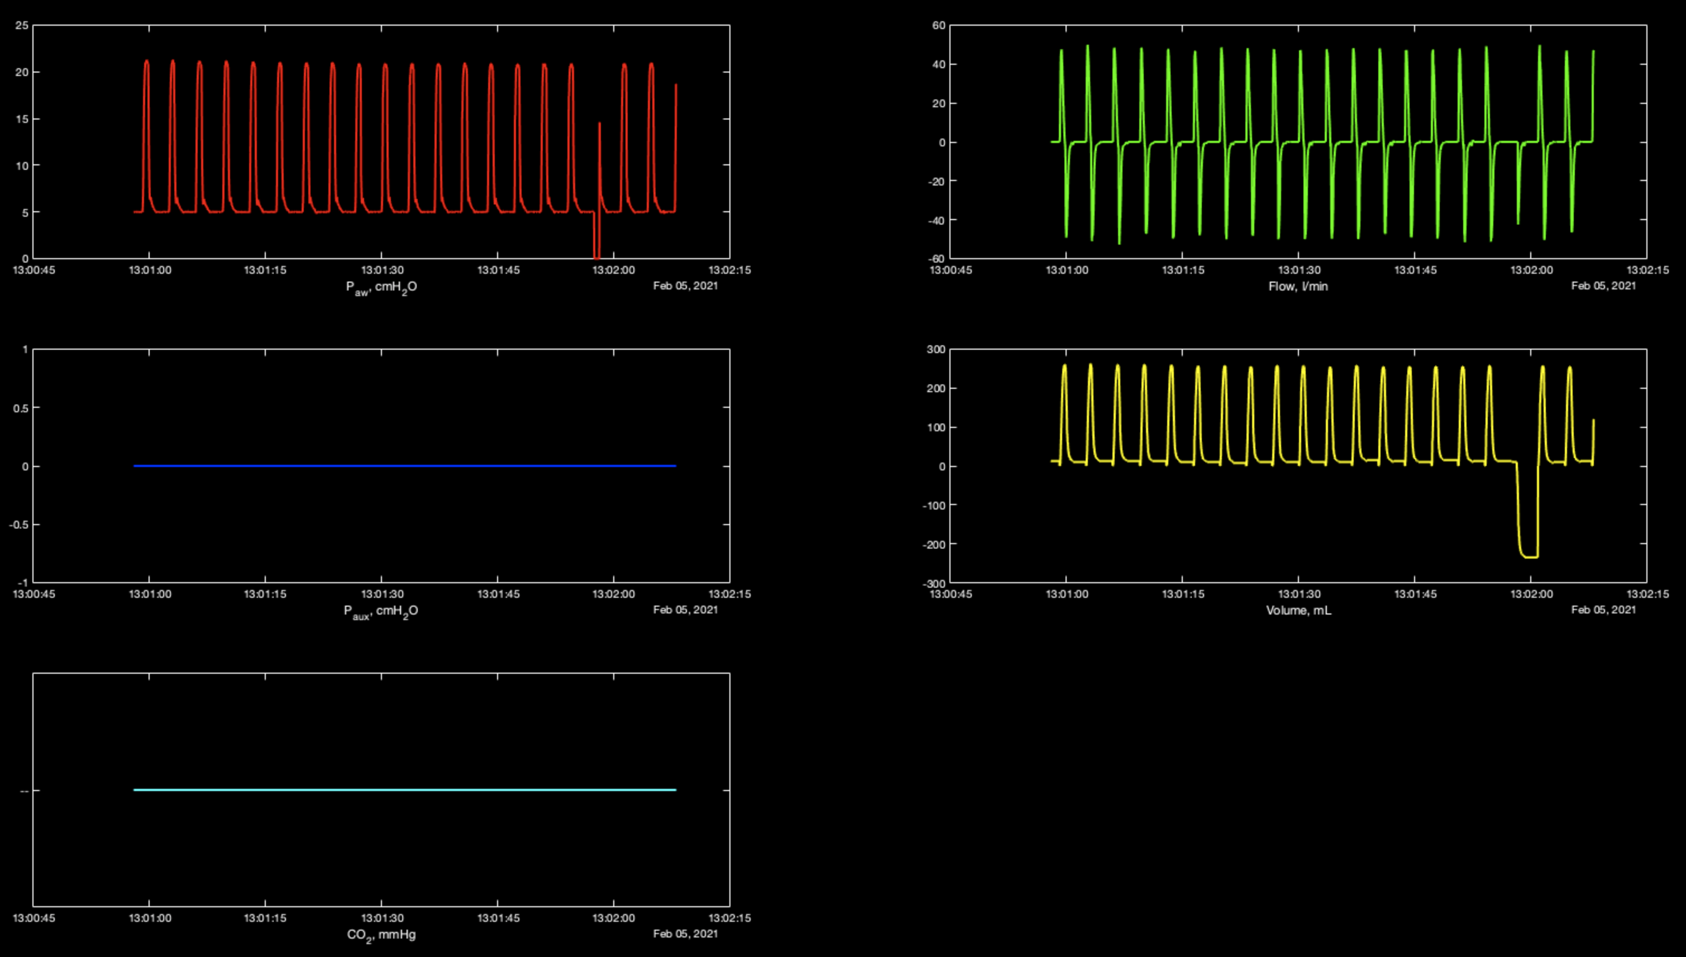
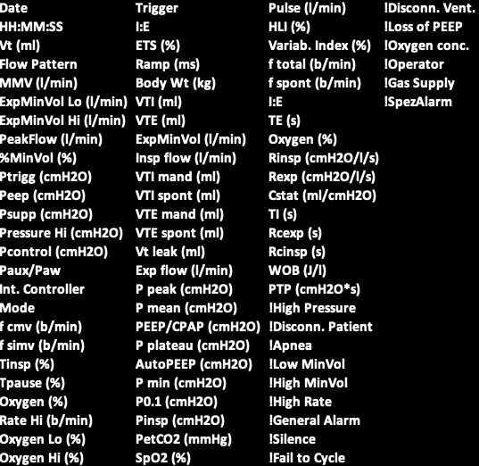
Ventilator Waveform and Beat x Beat Data
Waveforms
Beat x Beat
Notes:
Rail mounts available from multiple perspectives in aircraft = fixed angle to be determined and refined
Camera to be mounted with Fairfield Clamp on Rail
Camera brand agnostic – look for versatility and reliability in power supply, storage, motion-detection start/stop, data transmission
We have home grown aviation maintenance, engineering & upfitting, testing, and certification

Slide 22
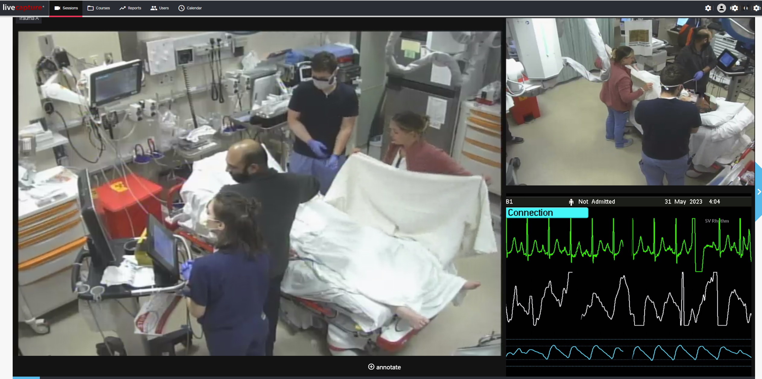








Additional Sensors: Trauma Bay

Slide 23
Appendix

Slide 24
STAT Medevac Database Scope and Structure
MySQL & STATA
Encounter
Demographics
Transport DateTimes
Initial Exam / Impression
History of Present Illness
Circumstantial Detail
Origin/Destination
(>598 Variables)
Patient Characteristics
Timestamped
Vital Signs
Exams / Scores
Status Changes
(>70 Variables)
Events
Timestamped
Labs
Instrumentation
Medication
Interventions
Equipment Adjustments
(>250 Variables)
Procedures
EMSCharts
EMR (XML)
ZOLL X-Series
Signal Record (JSON)
PRID
PRID
PRID
PRID
MATLAB & Influx TimeSeries Db
Derived / Sampled
HR
RR
SpO2 (and related)
ETCO2
BP – NIBP/IBP
(>23 Trends)
ECG Leads
SpO2 Pleth
Impedance
ETCO2
IABP
Temperature
CPR
(>15 Waveforms)
Trends
Alarms
Calibration Events
Sensor On/Off
Intervention (auto/man.)
Post-hoc
(>50 Types)
Waveforms
Annotations
PRID
PRID
PRID
Notes:
How the data is collected

Slide 25
STAT Medevac Database Scope and Structure
Demographics
Transport DateTimes
Initial Exam / Impression
History of Present Illness
Circumstantial Detail
Origin/Destination
(>598 Variables)
Patient Characteristics
Timestamped
Vital Signs
Exams / Scores
Status Changes
(>70 Variables)
Events
Timestamped
Labs
Instrumentation
Medication
Interventions
Equipment Adjustments
(>250 Variables)
Procedures
Encounter
EMSCharts
EMR (XML)
TRACIRDB
ZOLL X-Series
Signal Record (JSON)
PRID
PRID
PRID
PRID
Derived / Sampled
HR
RR
SpO2 (and related)
ETCO2
BP – NIBP/IBP
(>23 Trends)
ECG Leads
SpO2 Pleth
Impedance
ETCO2
IABP
Temperature
CPR
(>15 Waveforms)
Trends
Alarms
Calibration Events
Sensor On/Off
Intervention (auto/man.)
Post-hoc
(>50 Types)
Waveforms
Annotations
PRID
PRID
PRID

Slide 26
In-hospital LSI
Missing Data key variables | Proportion (%)
Age | 0%
Sex | 0.1%
Mechanism of injury | 0.1%
SBP (admission) | 1.5%
GCS (admission) | 2.7%
HR (admission) | 2.6%
RR (admission) | 14.2%
SpO2 (admission) | 7.7%
Temp (admission) | 48.5%
Survival | 0%
LOS | 0%
ISS | 0.9%
Ethnicity | 5.2%
ED disposition | 0%
Functional status on discharge | 78.9%

Slide 27
Deidentification protocol
The subject unit of analysis is prehospital patient encounter
  i.e., not necessarily a unique individual, but highly likely
  Repeated encounter information is available, but not currently planned as a deliverable
All downstream data are linked on the UPMC/Pitt side with a single ID# for the originating encounter
  Prehospital record ID (PRID)
  Encoded before data transmission outside of Pitt
  Linkage and deidentification handled by Emergency Medicine Data Lab
Deductive Identifiers
Direct Identifiers
Deductive Identifiers
PRID
Linkage Process
Direct Identifiers
Prehospital Health Record
Hospital
Health Record
Prehospital Encounter
Monitors*
PRID
Fully Linked Database
Video

Slide 28
Deidentification protocol
Prehospital Health Record
    Dedicated PHI fields (MRN/SSN/Name/DoB/etc) are prescreened and excluded from the database
    Free text “comment” fields with reasonable likelihood of PHI will be excluded out of an abundance of caution
      Those without a reasonable likelihood, e.g., Chief Complaint, will be included
    Datetimes can be:
      Converted to elapsed time and paired with an episode order number for temporal anonymity
    Geospatial data will be excluded
    Crew data will be categorically encoded across the entire database and anonymized
      Medic #205 is always “David Salcido” regardless of which case it appears in
      Demography of crew will not be included

Slide 29
Deidentification protocol
Monitors
  Defining a monitor here as a device that collects and stores acquired directly from the patient
    Therefore, not helicopter avionics / sensing or radio transmissions
    ZOLL X-series patient monitor/defibrillator
      By protocol, patient details are not entered into the ZOLL monitor
      The export function used by STAT MedEvac also strips patient identifiers as an extra security layer
      Clock time is present as a deductive identifier, but concealed for this study
    Hamilton T-1 ventilator
      Capabilities for adding directly identifiable data are not utilized on this device
      Clock time is present as a deductive identifier, but concealed for this project
    I-Stat POC blood analyzer
      Natively requires identifiable information about the crew and flight for tracking, but stripped before data entry
      Clock time is present as a deductive identifier, but concealed for this project

Slide 30
Deidentification protocol
Video Annotation Review
Synchronize EHR with Video
Place Key Frame & ROI Markers for Identifiers
Downsample*
Passive ROI Redaction
Apply fixed ROIs
Quality Review 1
Active ROI Redaction
Apply context ROIs
Quality Review 2
Final Review

Slide 31
Deidentification protocol
Hospital Health Record
    Mirrors Prehospital Health Record….
    Dedicated PHI fields (MRN/SSN/Name/DoB/etc) are prescreened and excluded from the database
    Free text “comment” fields with reasonable likelihood of PHI will be excluded out of an abundance of caution
      Very sparse in the hospital dataset
    Datetimes can be:
      Converted to elapsed time and paired with an episode order number for temporal anonymity
      Or, shifted by a random interval within cases

Slide 32
Overall Approach
Develop a de-identified, large-volume, multimodal field through trauma bay dataset to identify physiological features of injury that predict medical needs and resources.
Retrospective data include: Multidimensional output from the Zoll X series monitor, annotated with Life Saving Interventions (LSIs) and linked to inpatient outcomes including mortality, need for operative intervention and LOS.
Prospective data include: All data from the retrospective phase plus mechanical ventilator data and point of care laboratory data.
Will add inpatient monitor data and video from both the prehospital transport and trauma bay

Slide 33
Anticipated Technical Challenges
Issue | Technical Issues | Operational Issues | Mitigation
Phase 0 (Monitor)
Data Loss | Monitor downloads | Crew data entry | TQM / Auto Downloader
Data Linkage | Manual registration | Key stroke errors | HL7 and Probabilistic Link
Phase 1 (Vent/iSTAT)
Regulation | QC / Downloader | CLIA / State Regs | TQM / Oversight
Device Failure | Temp/ Vibration | User error | Training for storage and ops
Phase 2 (Cameras)
Environment | Temp/Light | SWaP / Data storage | Ruggedized / Motion Sensor
Privacy Protection | Obscuring faces / ID | Secure Storage | ROI removal / Encryption
Phase 3 (TB Video)
Registration | Video is continuous | Monitor needs to be associated | QR Code /RFID
Privacy Protection | Obscuring faces / ID | Secure Storage | ROI removal / Encryption

Slide 34
Team contacts
Affiliation | Name | Email | Role
Univ. Pittsburgh | Francis Guyette | guyefx@UPMC.EDU | PI
Univ. Pittsburgh | David Salcido | dds6@pitt.edu | Co-PI
Univ. Pittsburgh | Joshua Brown | brownjb@upmc.edu | Co-I
Univ. Pittsburgh | Raquel Forsythe | forsytherm@upmc.edu | Co-I
Univ. Pittsburgh Univ. Pittsburgh Univ. Pittsburgh Univ. Pittsburgh Univ. Pittsburgh Univ. Pittsburgh Univ. Pittsburgh Univ. Pittsburgh NOMA-AI | Christian Martin-Gill Michael R Pinsky Ron Poropatich Lenny Weiss Howard Stein Chase Zikmund Ravi Patel Rosie Christ Salim Malakouti | martingillc2@upmc.edu pinsky@pitt.edu RKP19@pitt.edu weissls2@upmc.edu hos12@pitt.edu chz106@pitt.edu rap279@pitt.edu christr2@upmc.edu salim@noma.ai | Co-I Co-I Co-I Co-I Program Manager Data Manager Data Analysts Grant Administrator CEO NOMA-AI

Slide 35
Draft Data Dictionary
Top Level Table Mapping
Table Variable Details
Section | Code | Notes
Header | 1 | Record creation details
General | 2 | Event characteristics
Referring | 3 | Location of patient origin
Receiving | 4 | Transport Destination
Crew | 5 | Flight Crew / Treament Team
Times | 6 | Encounter and transport datetimes
Odometer | 7 | Transport parameters and distances
Patient | 8 | Patient characteristics and demography
Neonatal | 10 | Pertaining to neonatal care
Scene | 12 | EMS characterization of scene and response
Exposure | 13 | Crew biologic exposure
Medication | 14 | Patient medications
Neuro | 16 | Neurologic assessments and scores
Airway | 17 | Airway management process
Respiratory | 18 | Characterization of respiratory status
Ventilator | 19 | Ventilator settings and adjustments
Cardiovascular | 20 | Cardiovascular assessments and scores
Pacemaker | 21 | Pacemaker details, mode, status
IABP | 22 | IABP management details
CardiacArrest | 23 | Cardiac arrest workflow and outcomes
MVI | 24 | Motor vehical incident details
InjuryDetails | 25 | Injury characterization, mechanisms
InitialPhysicalFindings | 26 | Findings compartmentalized to anatomic regions
Pregnancy | 27 | Characteristics and management of pregnancy
Burns | 28 | Regional burn assessment
DrainsTubes | 29 | Drain placement and parameters
BurnsExam | 30 | Burn exam results
Lab | 31 | Lab test results by analyte
Imaging | 32 | Summary of imagine process and results
Fluids | 33 | Fluids given, rates, volumes and timing
CustomFluids | 34 | Non-precoded fluid record
PriorIV | 35 | IV lines established before patient custody
PriorMed | 36 | Drugs administered before patient custody
Event | 37 | Vital sign monitoring and non-procedure event details and times
Procedure | 38 | Procedure details and times
Immobilization | 39 | Immobilization details and times
Factor | 40 | Case contributing factors
HospitalNotes | 41 | Information derived from hospital sources
Assessment | 42 | Systematic assessments by organ system / function
Injuries | 43 | Characterization of injury by anatomic region / system
Sedation | 44 | Details of sedation scale events and timing
Miscellaneous | 46 | Wide range of orphan categories
AbdomenAppearance | No | String | InitialPhysicalFindings | 26
AbdomenComments | No | String | InitialPhysicalFindings | 26
AbdomenPalpation | No | String | InitialPhysicalFindings | 26
BackBoardPTA | No | String | InitialPhysicalFindings | 26
BackComments | No | String | InitialPhysicalFindings | 26
BowelSounds | No | String | InitialPhysicalFindings | 26
CCollarPTA | No | String | InitialPhysicalFindings | 26
CIDPTA | No | String | InitialPhysicalFindings | 26
ChestComments | No | String | InitialPhysicalFindings | 26
DateAssessment | No | Date | InitialPhysicalFindings | 26
DateAssessmentAtPt | Yes | Date | InitialPhysicalFindings | 26
DatePatientAssessment | No | Date | InitialPhysicalFindings | 26
ExtremityComments | No | String | InitialPhysicalFindings | 26
HeadComments | No | String | InitialPhysicalFindings | 26
ImmobilizationPTAOutcome | No | Number | InitialPhysicalFindings | 26
ImmobilizationPTAPerformedBy | No | Number | InitialPhysicalFindings | 26
KEDPTA | No | String | InitialPhysicalFindings | 26
MASTPTA | No | String | InitialPhysicalFindings | 26
NeckComments | No | String | InitialPhysicalFindings | 26
PelvisComments | No | String | InitialPhysicalFindings | 26
PrimaryDiagnosis | No | Number | InitialPhysicalFindings | 26
Restraints | No | String | InitialPhysicalFindings | 26
SkinComments | No | String | InitialPhysicalFindings | 26
Trachea | No | String | InitialPhysicalFindings | 26

Slide 36
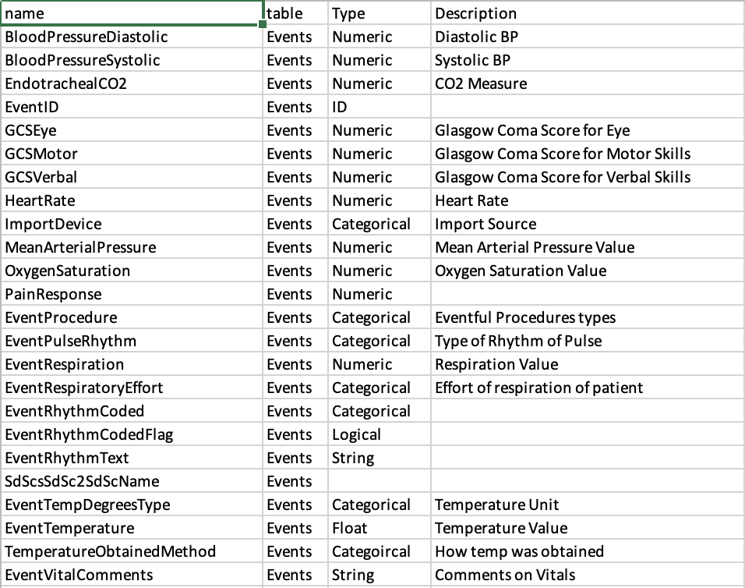
Draft Data Dictionary

Slide 37
Signal / Trend Data Time Formatting Update
Native
Type: datetime
ddMMyyyyTHH:mm:ss.SSS
Center on Arrival at Patient
t_{centered} = seconds(t_{i} – t_{AtPatient})
Interpret via posix standard
All times relative to 1/1/1970

Slide 38
Additional Sensors: Trauma Bay
Trauma bay video
  720p resolution (upgrading to 4K in 2024)
  3 different angles of stretch
  Allow true time stamped interventions
  Computer vision processing to de-identify patient and clinicians
  Exploratory potential – gross anatomic injury patterns
Trauma bay monitor
  Continuous waveform ECG & PPG
  NIBP
  Challenges – linking patient to data
    Visual ID: QR code, Wrist band
    RFID

Slide 39
Human Subject Research Plan
Human Subjects research is limited to observational data collection using minimal risk devices
Breech of confidentiality is the greatest risk
Regulatory Approval Timeline
Phase 0
PITT HRPO (M2)
Phase 1
PITT HRPO (M4)
Phase 2
PITT HRPO (M9)
Phase 3
PITT HRPO (M15)
Phase 0
DoD HRPO (M4)
Retrospective
Phase 2
DoD HRPO (M12)
Helicopter Video
Phase 1
DoD HRPO (M6)
Prospective Vent /iSTAT
Phase 3
DoD HRPO (M18)
Trauma Video and Waveform

Slide 40
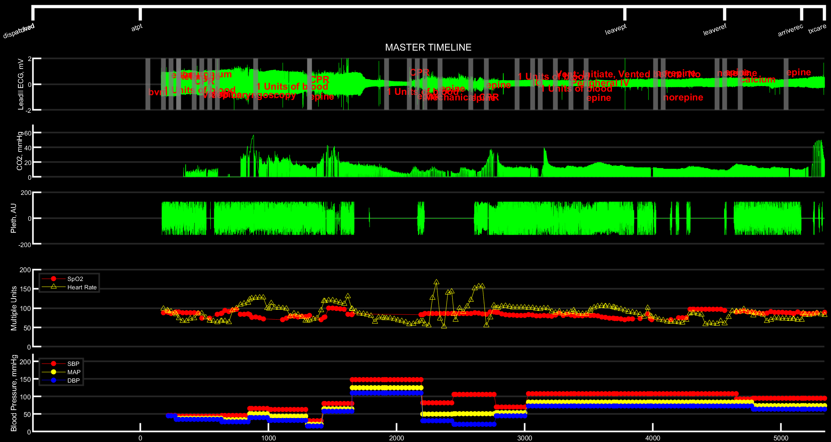
LOS: 1
Dispo: Dead / Morgue

Slide 41
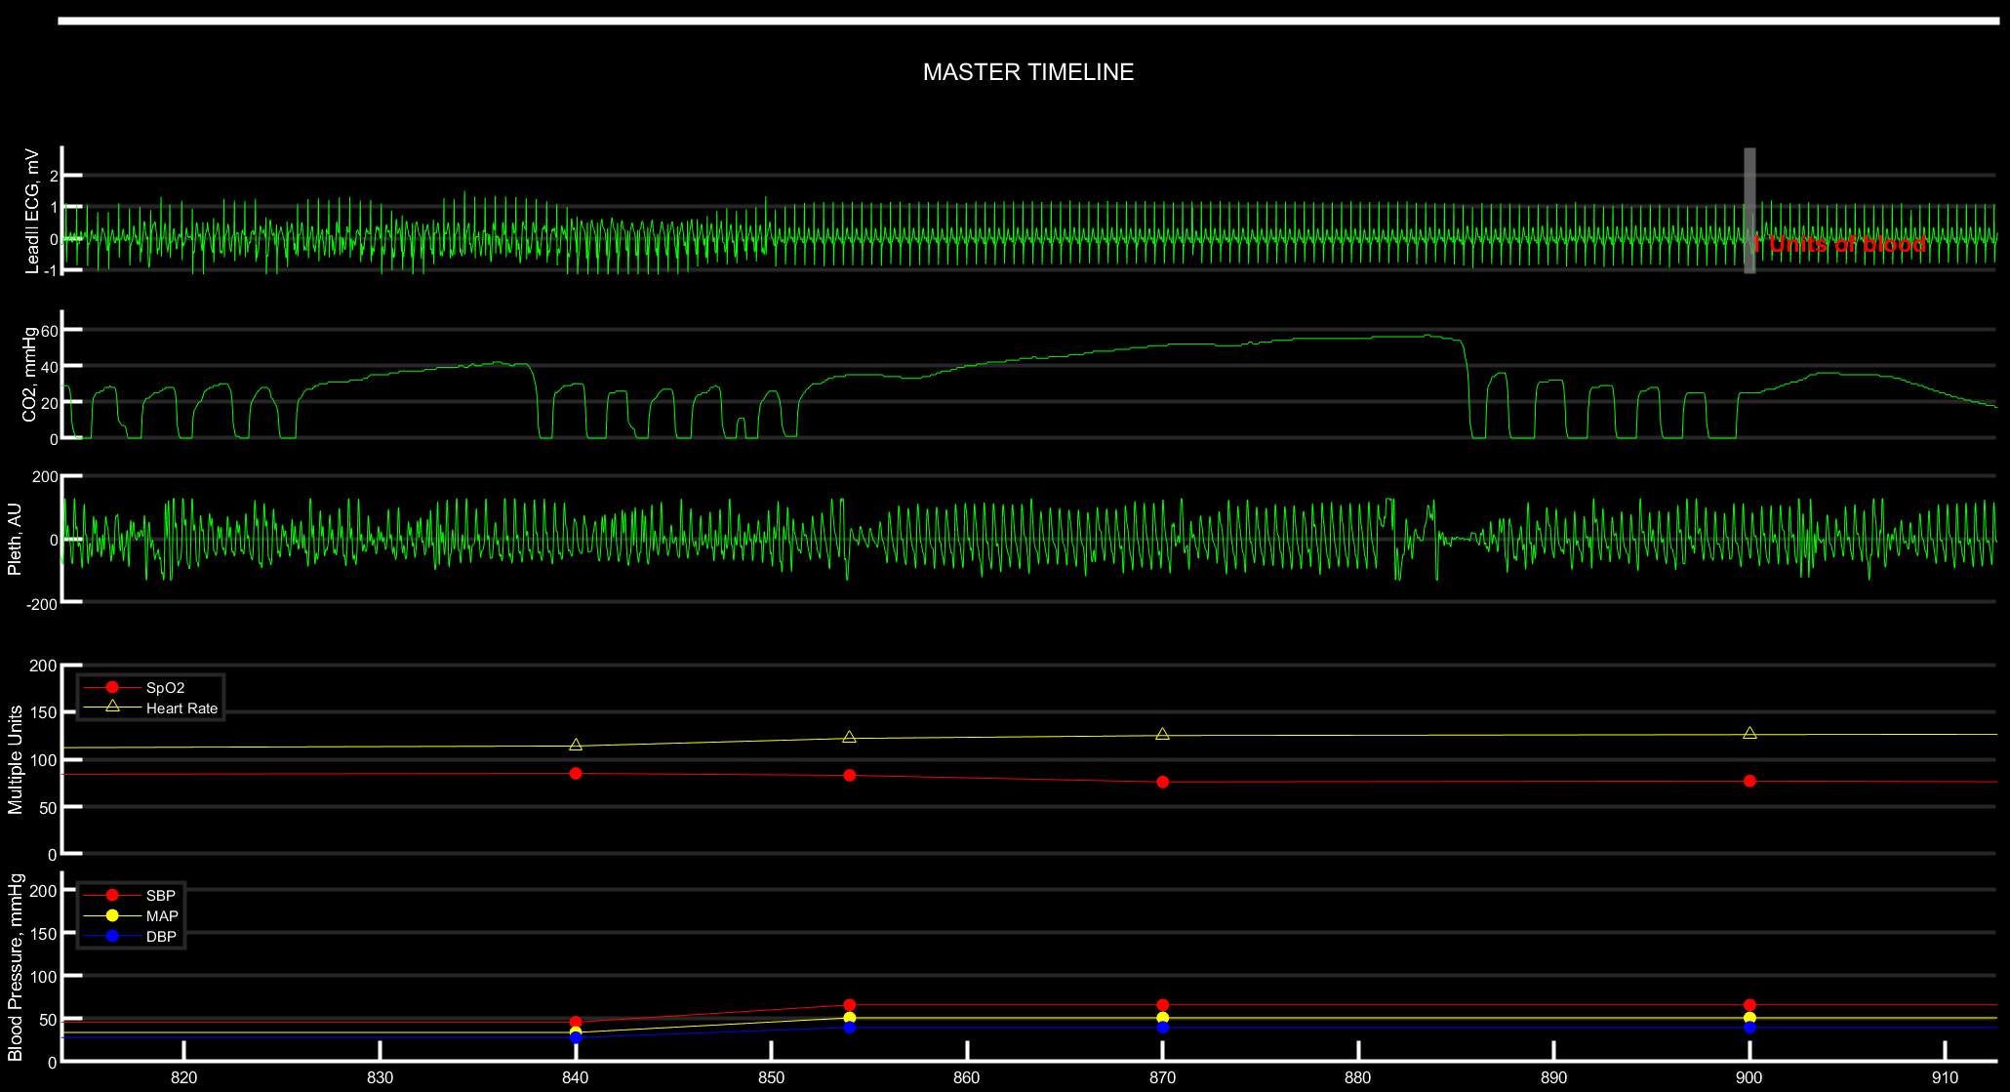

Slide 42
LSI | Freq (%)
Cardiac | 179 (0.8)
Airway | 3,926 (18.2)
Thoracic | 506 (2.3)
Invasive | 3,499 (16.2)
Blood | 1,320 (6.11)
Bleed | 1,742 (8.06)
Medication | 3,968 (18.37)
Cardiac includes, CPR (mechanical included), Defibrillation, Pacing, Patient Cooling – Post Resuscitation, ECMO IABP, VAD, and Impella
Airway: Bag Valve Mask, Nasal and Oral Pharyngeal, King Airway, i-gel Supreglottic, Cricothyroidotomy, Nasotracheal, Orotrachcheal, video laryngoscopy, NIPPV
Thoracic: Chest tube, needle thoracostomy, pericardiocentesis, escharotomy
Invasive: ICP, peripheral IV, IO, External Jugular, arterial IV, internal jugular, central IV
Blood: Patients who receive packed red blood cells, fresh frozen plasma, whole blood, platelets
Bleed: Wound care (pressure, gauze, etc), tourniquet, pelvic binder, TXA
Medication: vasoactive meds (epinephrine, norepinephrine, vasopressin, etc.) and RSI meds (ketamine, propofol, rocuronium)

