Slide 1
Dr. William Teeter, UMB

Slide 2
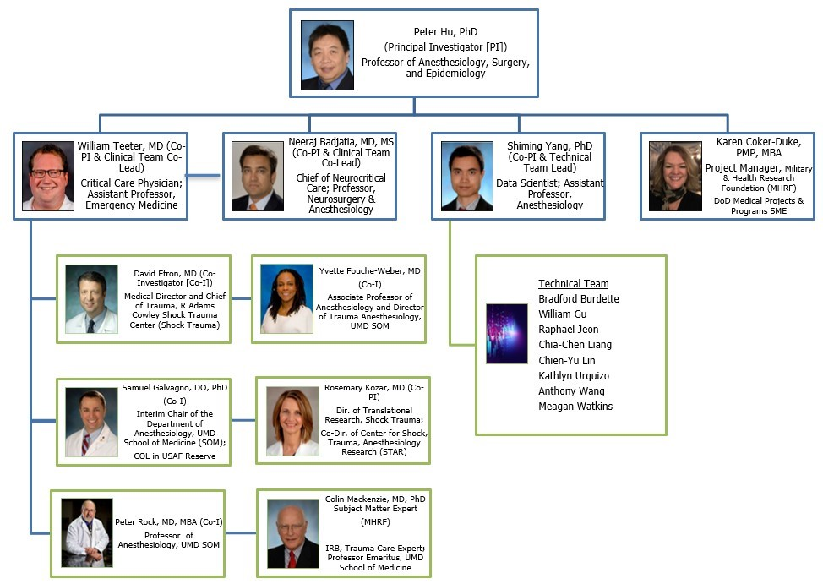
University of Maryland Shock Trauma Center-RITMO Team
Notes:
G

Slide 3
Project Overview
Goal: Collect signals from routine and new sensor non-invasive continuous vital signs (VS) linked to time-stamped, life-saving interventions (LSIs) and trauma patient outcomes during field care, helicopter transport, trauma center reception, resuscitation, and stabilization.
Approach: Collected VS data from patient monitors during field and Shock Trauma Resuscitation and stabilization linked with Electronic Health Record and Trauma Registry diagnoses and outcomes. Also collect VS data from new, continuous non-invasive sensors of brain oxygenation, tissue oxygenation and pupillometry.
Impacts: The accumulation of continuous non-invasive vital signs signals collected from the trauma patient at the point of injury and through helicopter transport, reception, and resuscitation in the Shock Trauma Center, will provide a testbed for extraction of signal features providing decision support to all echelons of military and civilian casualty care. This decision support will reliably predict the early need for life-saving interventions (LSIs) and outcomes and assist trauma team readiness.

Slide 4
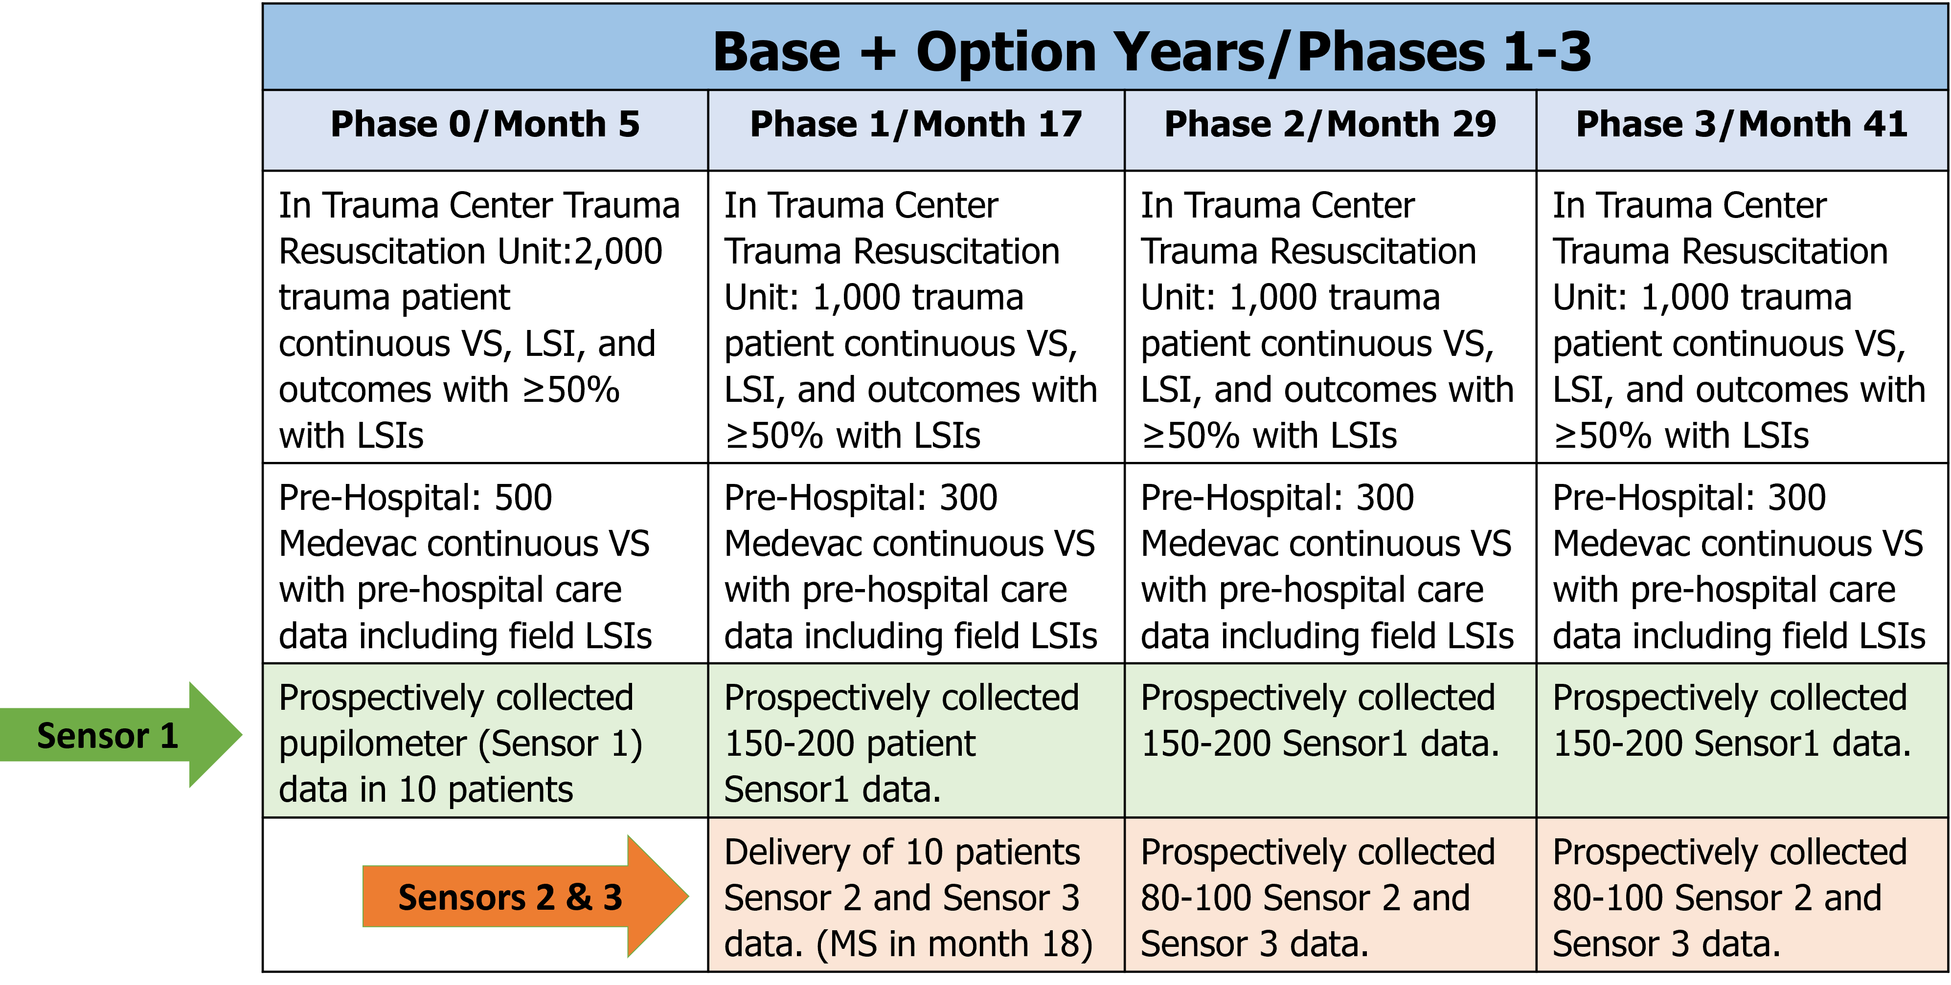
Overall Approach
Retrospective and prospective data summary and sensor planning timeline
Additional non-invasive Sensors: 1) Pupilometer; 2) NIRS: Brain Tissue Oxygenation; 3) NIRS: Tissue Oxygenation

Slide 5
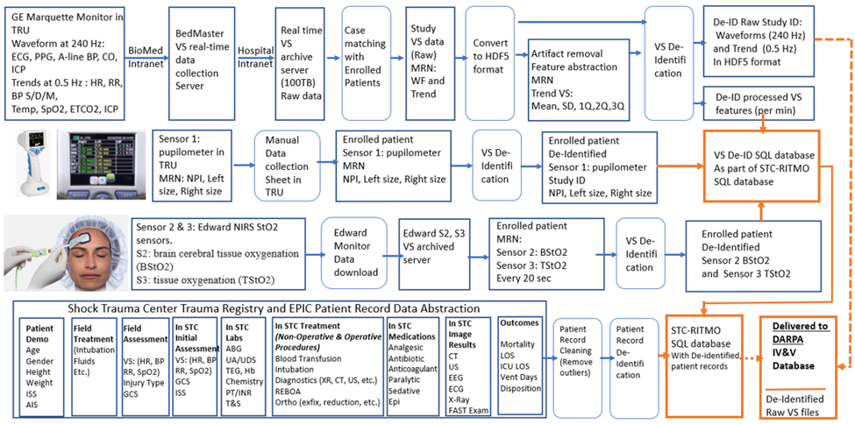
Retrospective and Prospective Data Collection
Retrospective and Prospective Data Collection Schema
Provide detailed description of prospective data collection plans
Need content here
Include data types, data format, number of patients, size of data corpus
Need content here
Include predictions on data quality, data cleaning procedures and typical data drop out rates
Need content here
Use tabular format where appropriate

Slide 6
Patient Demo, Injury, and LSI stats
Cohort | All (3000) | Medevac (1025)
Female % | 27.1% | 29.8%
Blunt % | 81.7% | 91.3%
Penetrating % | 17.1% | 7.0%
Mortality % | 3.0% | 3.9%
Intubation (First 4hr) % | 12.5% | 14.4%
Ventilation (First 4hr) % | 12.5% | 17.6%
Uncrossmatched Blood (First hour) % | 5.4% | 9.2%
Critical Administration Threshold (Blood > = 3 unit in 4hr) % | 5.2% | 6.8%
Massive Transfusion (Blood > = 10 unit in 4hr)% | 1.7% | 0.1%
ICU % | 15.2% | 21.5%
Admission GCS (3-8) % | 7.8% | 11.0%
ISS >= 16 % | 21.6% | 30.4%

Slide 7
LSI Focus: Blood Transfusion
Bleeding is the leading cause of preventable battlefield death in OIF/OEF
Exsanguination is the loss of blood which will irreversibly result in the patient’s death
EARLY hemorrhage control is the key to survival
Replacement of circulating blood volume prior to exsanguination will temporize the patient
Whole blood is preferred with improved outcomes
Can be obtained on battlefield through donation
Used sparingly in civilian setting
Component blood resuscitation is most common
Can be stored longer than whole blood
Sometimes large amounts of blood products are necessary
Escalating costs to the patient with the amount of blood transfused

Slide 8
LSI Focus: Blood Transfusion
Multiple criteria schema exist, e.g. ABC, Shock Index, etc.
Joint Trauma System / U.S. Army Ranger Regiment uses the following criteria for transfusion:
Signs and symptoms of hemorrhagic shock
---OR---
1+ amputation, blunt/penetrating trauma (junctional/abdominal/thoracic), or pelvic fracture
---OR---
SBP <90-100mmHg (*differs in some schema)
---OR---
lactate >5 and pulse >100
Transfusion can be given in ‘units’ of blood/blood products
Critical Administration Threshold (CAT: ≥ 3 units in first hour)
Massive Transfusion (MT ≥ 10 units in 24 hours)

Slide 9
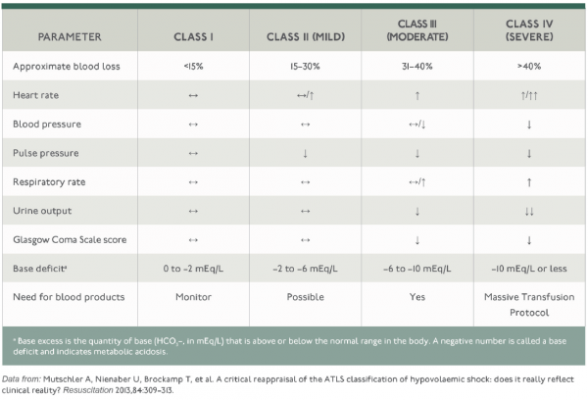
LSI Focus: Blood Transfusion

Slide 10
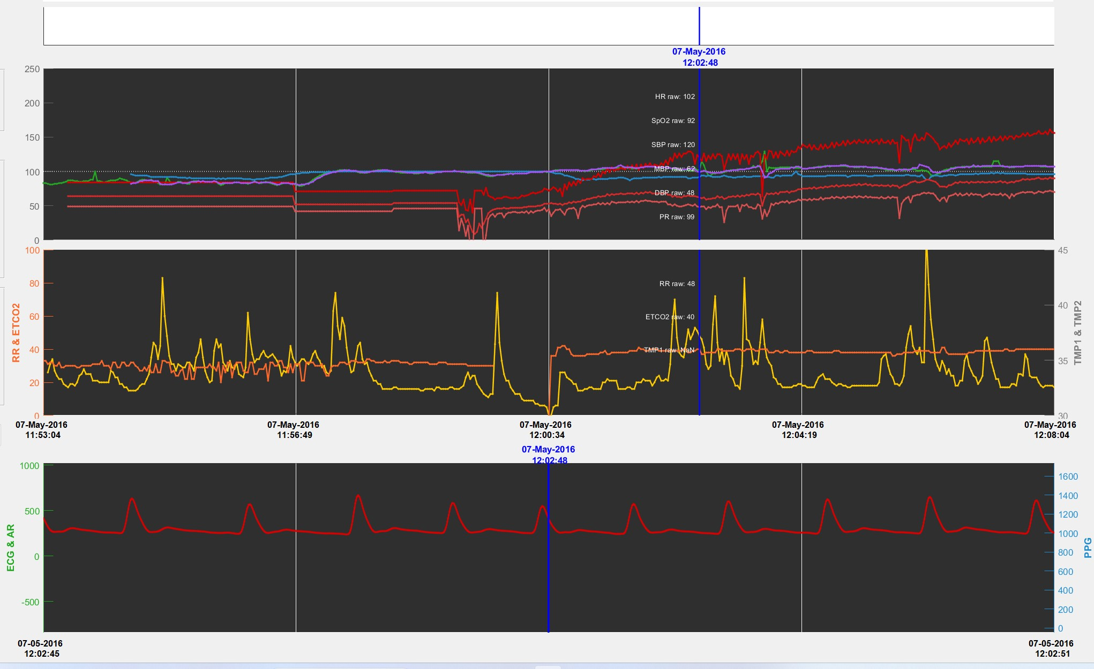
Arterial Line
Add more for your presentation

Slide 11
42 year old female after fall of 20+ feet with altered mental status and low blood pressure
Blood Pressure Cuff - Intermittent
Arterial Line
Add more for your presentation

Slide 12
Presentation with HR 83 and BP of 84/58
Blood Pressure Cuff - Intermittent
Arterial Line
Add more for your presentation

Slide 13
Heart Rate Begins to Increase
Blood Pressure Cuff - Intermittent
Arterial Line
Add more for your presentation

Slide 14
Blood Pressure drops to 68/42
during intubation
Blood Pressure Cuff - Intermittent
Arterial Line
Add more for your presentation

Slide 15
Arterial line is placed
Blood Pressure Cuff - Intermittent
Arterial Line
Add more for your presentation

Slide 16
Blood Product Administration
Blood Pressure Cuff - Intermittent
Arterial Line
Add more for your presentation

Slide 17
Blood Product Administration
Blood Product Administration
Blood Product Administration
Blood Pressure Response
Blood Pressure Response
Blood Pressure Cuff - Intermittent
Arterial Line
Add more for your presentation

Slide 18
Arterial Line
Add more for your presentation
Patient required intubation, central line placement, CAT, and eventually required a thoracotomy for perforation of blunt cardiac injury
Discharged home after LOS of 44 days

Slide 19
LSI Focus: Blood Transfusion

Slide 20
LSI Focus: Blood Transfusion

Slide 21
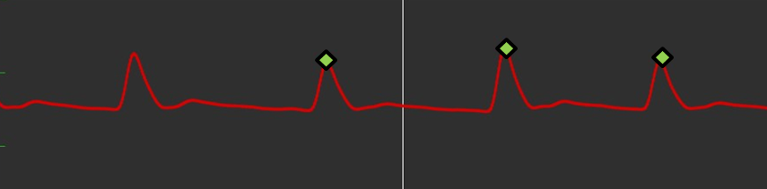
LSI Focus: Blood Transfusion

Slide 22
LSI Focus: Blood Transfusion
Internal bleeding is often difficult to detect and appreciable signs of bleeding are usually late
EARLY hemorrhage control is the key to survival
Focus should be on the identification of physiologic signatures as early as possible

Slide 23
Team Contacts
Affiliation | Name | Email | Role
UMB | Peter Hu | phu@som.umaryland.edu | PI
UMB | William Teeter | William.Teeter@som.umaryland.edu | Co-PI
UMB | Neeraj Badjatia | NBadjatia@som.umaryland.edu | Co-PI
UMB | Shiming Yang | syang@som.umaryland.edu | Co-PI
MHRF | Karen Coker-Duke | kcokerduke@som.umaryland.edu | PM

Slide 24

Database Scope, Structure, and Considerations for Algorithm Development
Dr. David Salcido, UPitt
Dr. Peter Hu, UMB

Slide 25
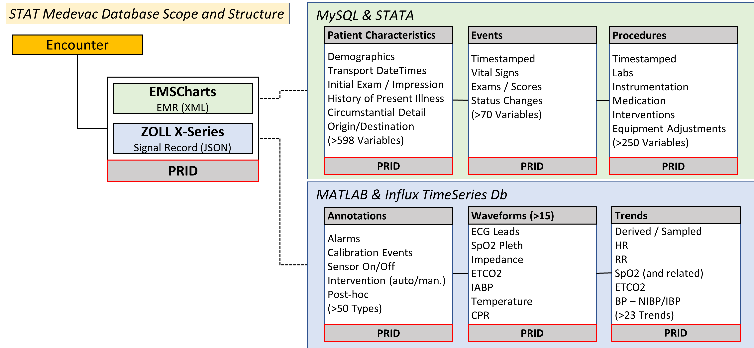
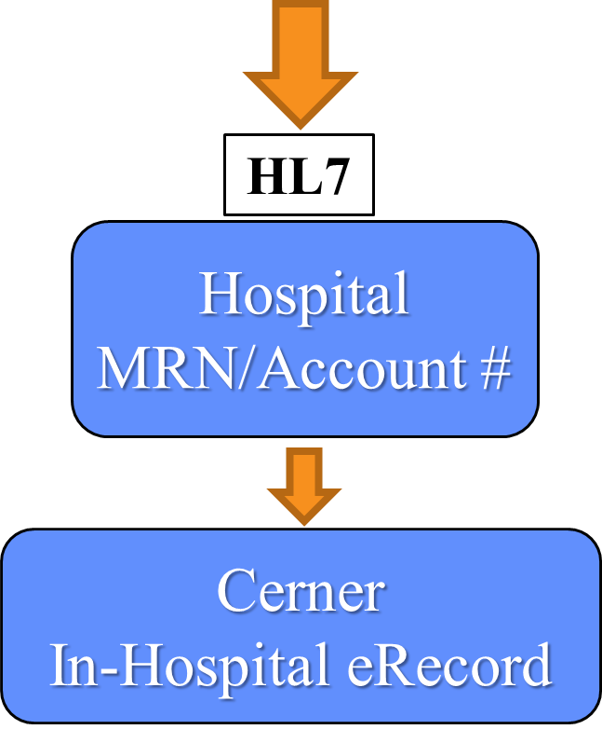

Slide 26
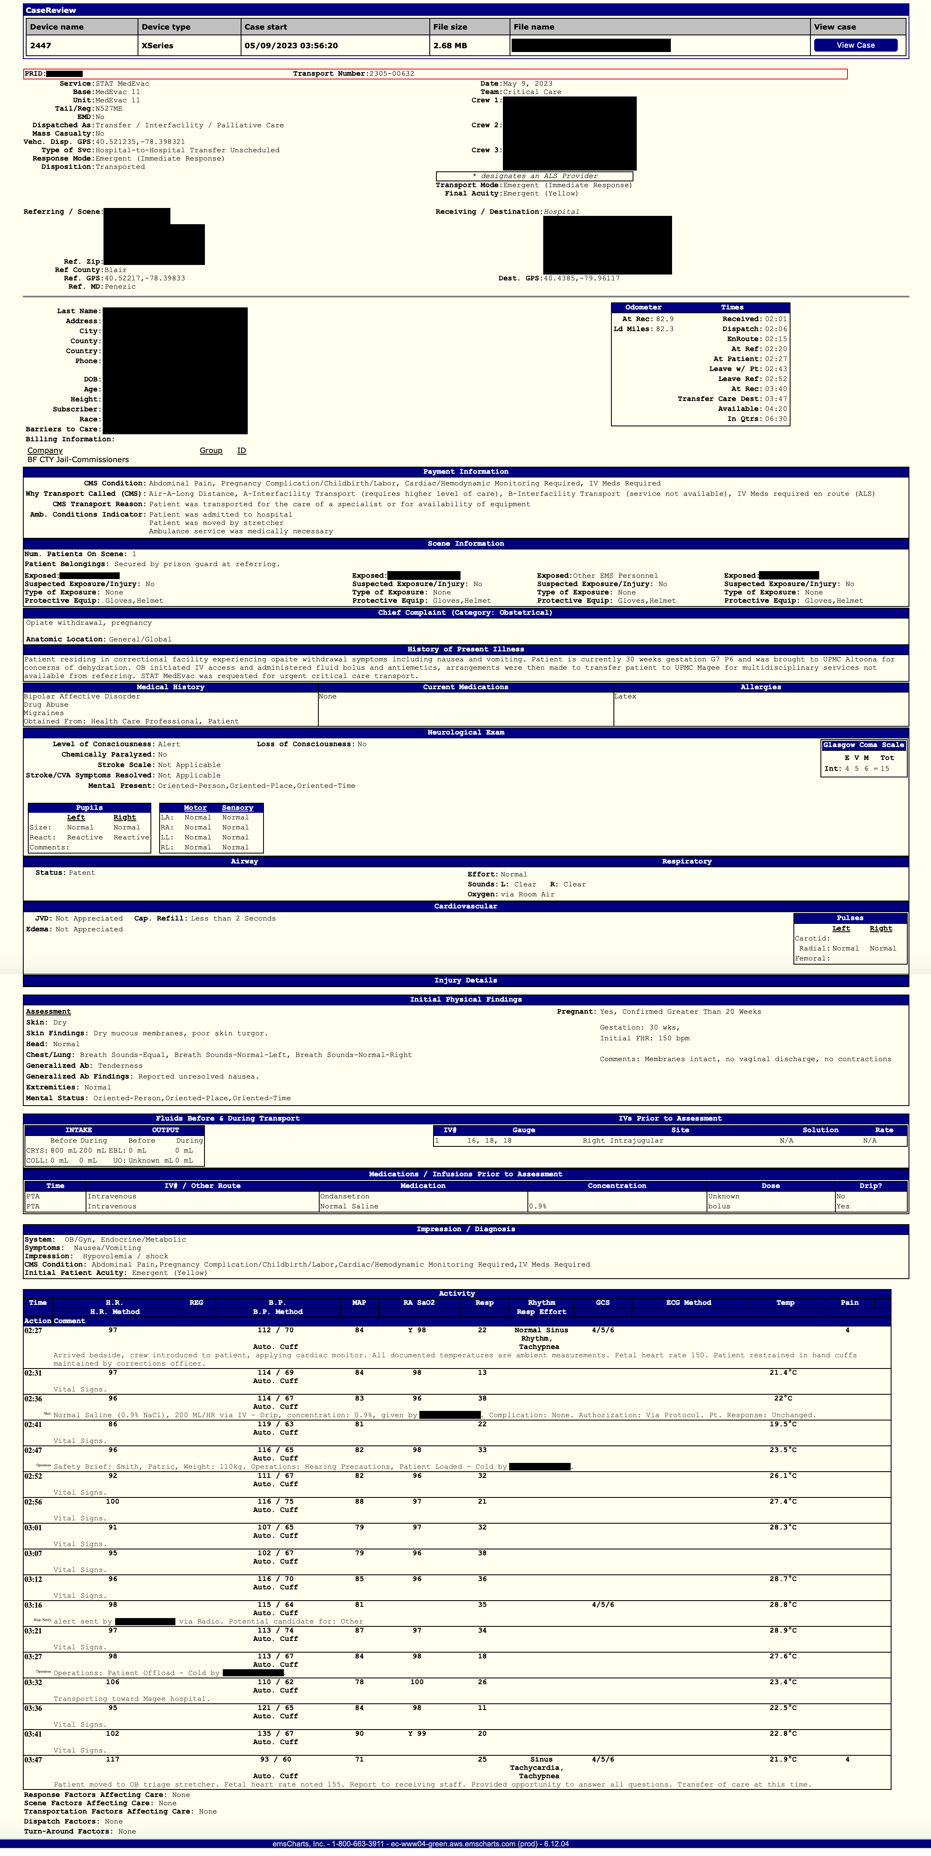
Wide Data
Long Data
PHI of Addendums
PHI of Main Demographic
PHI of Events
PHI of Receiving Status
PHI of Procedures
PHI of Prior IVs
Data Schema
PHI of Billing
PHI of Patient Followups
IPFDrainTubes
IPFAssessmentsGen
IPFAssessmentsSpc
Main Demographic Table
IPFBurns
IPFPregancy
IPFComments
IPFMisc
ID key: PRID
Addendums
Prior Meds
Past Medical History
Events
Imaging
Allergies
Prior IVs
Patient Follow ups
Labs
Procedures
CMSConditionCodes
Fluids
Receiving Status
Factors
P Meds
Crew
IABP
Chart Summary
Billing

Slide 27
STC Trauma Registry and Medical Record Data Cleaning Process
Patient Demo
Age
Field Treatment
Intubation
Field Assessment
VS: (HR, BP, RR, SpO2)
Gender
Height
Weight
ISS
AIS
Fluids
Etc.
Injury Type
GCS
In STC Labs
ABG
UA/UDS
TEG
Hb
Chemistry
PT/INR
T&S
In STC Treatment (Non-Operative & Operative Procedures)
Blood transfusion
Intubation
REBOA
Ortho (exfix, reduction, etc.)
Outcomes
Mortality
LOS
ICU LOS
Vent Days
Disposition
Patient Record Cleaning
Remove outliers
Patient Record De-identification
Deliver to IV&V
In-Hospital Medications
Analgesic
Antibiotic
Anticoagulant
Paralytic
Sedative
Epi
Receive, review, and clean data from each stage of care
Note: In-hospital labs, medications, and treatment data will be limited to the first four hours post-admission.
This process ensures the delivered database will have high-quality, valid, complete, and accurate data.

Slide 28
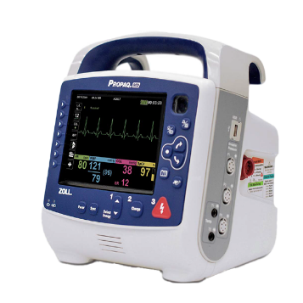
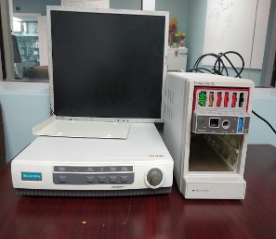
Five Stages of Predictive Algorithm Development
Data Acquisition
Artifact Removal
Feature Abstraction
Algorithm
Development
Evaluation & Visualization
In Flight (Pre Hospital Field Patient Transfer)
Patient monitor: Propaq Monitor
Waveforms include:
Photoplethysmographic (PPG), ECG, Arterial BP, waveform (at 250Hz)
Trends include:
HR, SpO2, NBPS/D/M, TEMP, ETCO2 etc. (at 1 Hz)
STC Trauma Resuscitation Unit (TRU)/”Trauma ED”
Patient monitor: GE-Marquette-Solar-7000/8000®
Waveforms include:
Photoplethysmographic (PPG), ECG, Arterial BP, waveform (at 240Hz)
Trends include:
HR, SpO2, NBPS/D/M, TEMP, ETCO2 etc. (at 0.5 Hz)
Identify the out of bound values
and remove artifact.
Signal Quality Index

Slide 29
Five Stages of Predictive Algorithm Development
Data Acquisition
Artifact Removal
Feature Abstraction
Algorithm
Development
Evaluation & Visualization
Feature Abstraction
Clinically Relevant Features
Trend based features
Waveform based features
Multi Trend based features
Trend+Waveform based features
Model Generated features
Features with signal quality index
How do you evaluate these features?
Big Data Machine Learning Models
Can your model work with a single sensor such as only PPG, or ECG, or BP
and the same time work with
multiple sensors?
How does your model deal with the gaps and noise in the data ?
What are the selected variables in
your model and were the variables
correlated with clinical knowledge?
Can your model adjust for time?
Can your model address uncertainty?
Criteria Defined by JHU APL IV&V Team

