Slide 1

Questions & Answers
DARPA Triage Challenge Kick-Off Meeting
CDR Jean-Paul Chretien, M.D., Ph.D., MC, USN
Program Manager Biological Technologies Office (BTO)
November 7, 2023
Distribution Statement ‘A’ (Approved for Public Release, Distribution Unlimited)

Slide 2

Human Subject Research at DARPA
Definition of Human Subjects Research in Federal and DoD Policies
The term “human subject” can be applied to research efforts that meet EITHER of the following criteria:
A living individual about whom an investigator (whether professional or student) conducting research:
Obtains information or biospecimens through intervention or interaction with the individual, and uses, studies, or analyzes the information or biospecimens; or
Obtains, uses, studies, analyzes, or generates identifiable private information, personally identifiable information, or identifiable biospecimens.
Human Subjects Research involves:
Activities that include both a systematic investigation designed to develop or contribute to generalizable knowledge and involve a living individual about whom an investigator conducting research obtains information or biospecimens through intervention or interaction with the individual, or identifiable private information, or biospecimens.
Any DARPA-funded research which involves humans as defined on this page MUST be
considered HSR.
Distribution Statement ‘A’ (Approved for Public Release, Distribution Unlimited)

Slide 3
HSR Approval Process
Principal Investigator submits protocol to local IRB for review and approval
HSR package is then submitted for DoD headquarter review and approval
Includes local IRB approval letter
Federal Wide Assurance (of institution performing research)
Informed Consent Document ***Make sure informed consent document includes statement that the research is being funded by DoD and thus the DoD has access to the data***
Recruiting Materials
Biosketches/CVs
Training Certifications
DoD review authority, reviews the entire package
May go back to PI with comments/recommendations/changes
Once DoD HRPO approval is obtained, HSR research can begin
Note that protected populations (i.e. military, pregnant women, etc.) have special regulations that need to be followed. This includes such things as command level approval for recruitment of subjects (active duty military)
Note – DoD HRPO review and approval can take anywhere from 3-6 months. Do not delay in starting this
process!
Distribution Statement ‘A’ (Approved for Public Release, Distribution Unlimited)

Slide 4
Helpful Hints/FAQ
If possible, submit an IRB approval letter and/or a Draft HSR Protocol with proposal.
Especially, in cases where humans are involved and you don’t know that the work is really HSR. Having
an IRB already look at it will help you and DARPA in moving forward faster.
If you do not have an internal IRB, you have one of three options
Hire a commercial IRB
Work with the Contracting Agent to determine if they have an internal IRB that could assist
If work involves collaboration with other performers, considering using their IRB
If you have a contract involving subcontractors who are conducting HSR; they will also need to obtain HSR approval. Any performer including subcontractors must receive HSR approval through the local IRB and the DoD HRPO office, before start of their research.
If you make changes to the statement of work, they also need to be approved. If the changes are to the HSR portion of the work, the revisions will have to go through the local IRB for review, as well as DoD HRPO office for approval and concurrence.
Distribution Statement ‘A’ (Approved for Public Release, Distribution Unlimited)

Slide 5
Questions?
For questions pertaining to HSR in this program, please contact the DARPA PM/SETA team and they will route your questions to the DARPA COHRP
Distribution Statement ‘A’ (Approved for Public Release, Distribution Unlimited)

Slide 6
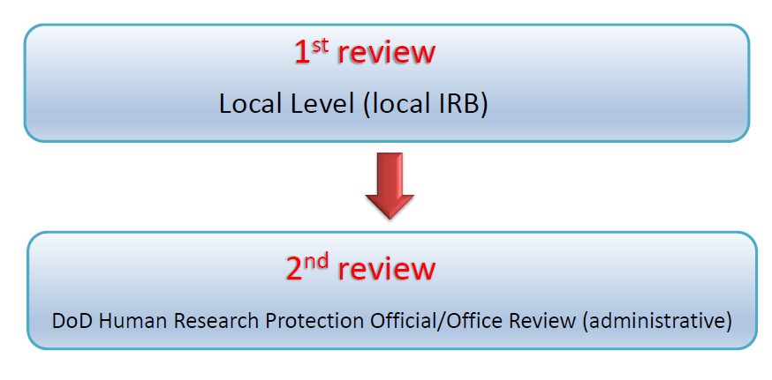
Review of the protocol
All DARPA human subjects research protocols must go through two reviews
Distribution Statement ‘A’ (Approved for Public Release, Distribution Unlimited)

Slide 7
HSR Implications for DTC Data Access
DoD Definition of Human Subjects Research (HSR)
“Human use” protocols apply to all research that meets either of the following criteria:
Any research involving an intervention or an interaction with a living person that would not be occurring but for this research.
Any research involving data/information/specimens collected originally from a person(s) for whom his/her identity is known or can be ascertained from the collected data/information/specimens. (Applies to deidentified data)
 | Systems | Virtual | Data
All teams | Training data provided by TATRC, interactions with actors during competition events covered by TATRC IRB Requirements: Team qualification data use check list. Complete forms and agreements (IAIR, CITI training, COI, CV, DoA) | No HSR collection or use allowed, simulations only | Datasets allowed for training: 1) RITMO Dataset 2) MIMIC III/IV datasets Requirements: Team qualification data use check list. Complete CITI training and register on the physionet site to access MIMIC datasets
Govt-Funded | Collection or use of other patient datasets constitutes HSR and must go through local IRB and DoD HRPO approval | N/A | Collection or use of other patient datasets constitutes HSR and must go through local IRB and DoD HRPO approval
Self-Funded | No HSR collection or use allowed, simulations only | No HSR collection or use allowed, simulations only | No HSR collection or use allowed, simulations only
Please see qualification guide and FAQ page for details
Distribution Statement ‘A’ (Approved for Public Release, Distribution Unlimited)

Slide 8
Questions emailed to us
Distribution Statement ‘A’ (Approved for Public Release, Distribution Unlimited)

