Slide 1
Evaluation Metrics Overview
DARPA Triage Challenge: Phase 1 Kick-off
Ben Skerritt-Davis
Johns Hopkins University Applied Physics Lab
DTC IV&V Team
Distribution Statement ‘A’ (Approved for Public Release, Distribution Unlimited)

Slide 2
Design Considerations
We want evaluation metrics that…
incentivize accurate and early clinical decision-making
mirror operational setting
minimally constrain solution space
are easy to explain
have clear tie-breaking mechanisms
flexibly calibrate to task difficulty
scale with added complexity in future phases
Distribution Statement ‘A’ (Approved for Public Release, Distribution Unlimited)

Slide 3
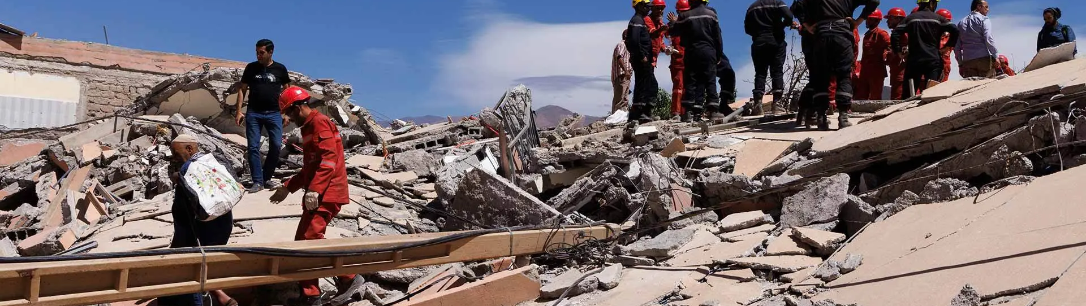
Primary Triage
Systems and Virtual Challenge
Distribution Statement ‘A’ (Approved for Public Release, Distribution Unlimited)

Slide 4



Scope of Envisioned System
Search and find casualties in a complex scene
Remotely assess casualty condition using stand-off sensors on one or more autonomous systems
Quickly identify critically ill
Provide sufficient clinical information in order to prioritize:
who needs treatment
whom to treat first
what equipment to bring
Casualty Report
Teams will be evaluated on the accuracy and timeliness of Casualty Reports.
Distribution Statement ‘A’ (Approved for Public Release, Distribution Unlimited)

Slide 5
Casualty Reports
A casualty report is a timestamped list of clinical facts about a detected person.
Reports are separated into two sections based on urgency:
Section 1 Time-critical indicators of need for care.
Section 2 Additional details on injury and severity.
Severe Hemorrhage | [present, absent]
Respiratory Distress | [present, absent]
Vitals | HR: integer RR: integer
Trauma | Head: [wound, normal] Torso: [wound, normal] Upper Ext.: [wound, amputation, normal] Lower Ext.: [wound, amputation, normal]
Alertness | Eyelids: [open, closed] Verbal: [normal, abnormal, absent] Motor: [normal, abnormal, absent]
Distribution Statement ‘A’ (Approved for Public Release, Distribution Unlimited)

Slide 6
Reporting & Scoring
Competitors will be given a finite number of reports at the beginning of each scored run
During a scored run, Casualty Reports are submitted to the DARPA command post to be scored against ground truth
Competitors receive up to 10 points per casualty for correct responses in the report
Points accumulate over a scored run and the final Event Score is based on multiple runs
Tie-breaking of same-scoring teams favors earliest final positive-scored report
Competitors will be given a finite number of reports at the beginning of each scored run
During a scored run, Casualty Reports are submitted to the DARPA command post to be scored against ground truth
Competitors receive up to 10 points per casualty for correct responses in the report
Points accumulate over a scored run and the final Event Score is based on multiple runs
Tie-breaking of same-scoring teams favors earliest final positive-scored report
Casualty Report |  | Max Points
Severe Hemorrhage |  | 2
Respiratory Distress |  | 2
Vitals | HR RR | 2
Trauma | Head Torso Upper Ext. Lower Ext. | 2
Alertness | Eyelids Verbal Motor | 2
 | TOTAL | 10
Section 1
Section 2
Distribution Statement ‘A’ (Approved for Public Release, Distribution Unlimited)

Slide 7
“Golden Window”: Timeliness Incentive
Bonus points are awarded for early and correct assessment of time-critical information (Section 1 of the Casualty Report) within an initial “golden window”
Each section of the report can be submitted separately to facilitate early reporting of bonus-applicable responses (total number of reports applies independently to each section)
Teams are encouraged to quickly determine indicators of urgent need first, followed by detailed casualty assessment
Bonus is awarded for any correct response, whether casualty is injured or not
Bonus points are awarded for early and correct assessment of time-critical information (Section 1 of the Casualty Report) within an initial “golden window”
Each section of the report can be submitted separately to facilitate early reporting of bonus-applicable responses (total number of reports applies independently to each section)
Teams are encouraged to quickly determine indicators of urgent need first, followed by detailed casualty assessment
Bonus is awarded for any correct response, whether casualty is injured or not
Casualty Report |  | Bonus Points
Severe Hemorrhage |  | +2
Respiratory Distress |  | +2
Vitals | HR RR | +1
TOTAL |  | +5
Section 1
Reports receive from 0 (all incorrect) up to 15 points (all correct within bonus window) per casualty.
Distribution Statement ‘A’ (Approved for Public Release, Distribution Unlimited)

Slide 8

Example: Casualty Report and Scored Run
Scored run
Casualty Report |  | Points
Severe Hemorrhage: Present |  | 2
Respiratory Distress: Present |  | 0
Vitals | HR: 65 RR: 26 | 2
Trauma | Head: Normal Torso: Normal Upper Ext.: Normal Lower Ext.: Amputation | 1
Alertness | Eyelids: Closed Verbal: Abnormal Motor: Abnormal | 2
 | TOTAL | 7
Bonus
Casualty Report |  | Points
Severe Hemorrhage: Present |  | 2
Respiratory Distress: Present |  | 0
Vitals | HR: 65 RR: 26 | 2
Trauma | Head: Normal Torso: Normal Upper Ext.: Normal Lower Ext.: Amputation | 1
Alertness | Eyelids: Closed Verbal: Abnormal Motor: Abnormal | 2
 | TOTAL | 7
Golden Window
Team Y
+2
Team W
Team Z
+1
Score
Team X
Time
+3 = 10 Points
Distribution Statement ‘A’ (Approved for Public Release, Distribution Unlimited)

Slide 9
Future Phases
New or modified clinical information in the Casualty Report to keep pace with additional sensors and simulated conditions
Example: Temperature
Example: Cyanosis
Accurate localization of casualties as a prerequisite to any reward
In Phase 1, casualty identification will be provided for reporting without localization
Penalties for over-triage: incorrectly reporting injury when there is none present
Incorporate explainability into evaluation
Distribution Statement ‘A’ (Approved for Public Release, Distribution Unlimited)

Slide 10

Secondary Triage Evaluation Design
Data Challenge
Distribution Statement ‘A’ (Approved for Public Release, Distribution Unlimited)

Slide 11
Scope of Envisioned System
Using continuous vital signs and contextual health data, predict need for Life-Saving Interventions (LSIs) within first few hours of care
Predict type of treatment needed with enough lead time and accuracy to aid medical resource management at scale
Replicate decisions made by expert clinicians
!
Teams will be evaluated on the accuracy, completeness, and timeliness of LSI predictions.
Distribution Statement ‘A’ (Approved for Public Release, Distribution Unlimited)

Slide 12
Life-Saving Interventions (LSIs)
Definition: a medical care resource, activity, or procedure used to sustain life.
LSIs have been grouped by type of injury and/or mechanism of treatment
Solutions predict the group, rather than the specific treatment or procedure
Definition: a medical care resource, activity, or procedure used to sustain life.
LSIs have been grouped by type of injury and/or mechanism of treatment
Solutions predict the group, rather than the specific treatment or procedure
LSI Group | Examples (not comprehensive)
Airway & respiration | Intubation, Cricothyroidotomy, Laryngoscopy, Mechanic Ventilation
Vascular access & monitoring | Peripheral IV, Central Line Maintenance, Arterial Line Maintenance,
Bleeding control | Tourniquet, Pelvic Binder, IR embolization
Vaso/Cardioactive medications | Epinephrine, Dopamine, Phenylephrine, Vasopressin, Hydrocortisone
Crystalloid products | Normal Saline (>500cc), Lactated Ringers (>500cc)
Blood products | Packed red blood cells, Plasma, Whole blood transfusion
Cardiovascular procedures | CPR, Defibrillation/Cardioversion, Pericardiocentesis
Thoracic and other procedures | Thoracotomy, Laparotomy, Amputation, Fasciotomy
Chest decompression | Needle Decompression, Chest Tube Management
Neurologic products & procedures | Craniotomy/craniectomy, Hypertonic saline, Antiepileptic medications
RSI Sedation medications | Ketamine, Versed, Etomidate, Ativan, Propofol
Distribution Statement ‘A’ (Approved for Public Release, Distribution Unlimited)

Slide 13
Simulated Online Prediction
Task: Predict the set of LSIs in the near future and up to four hours after hospital admission using past data.
Simulate online prediction by sliding the evaluation timepoint along the same case, with additional data available for prediction at subsequent timepoints but shrinking utility of predictions as LSIs occur:
Ground-Truth LSIs
A
B
C
D
C
Prediction Target:
t=0
“Past”
gap
“Future”
[A, B, C, D]
Start of care
Evaluation timepoint, a.k.a. “now”
Up to 4 hours post-admission
Same case
t=1
[B, C, D]
t=2
[C, D]
t=3
[C, D]
Sequence of LSI predictions are evaluated against ground truth LSIs over the entire case.
Distribution Statement ‘A’ (Approved for Public Release, Distribution Unlimited)

Slide 14

Evaluation Approach
Team solutions will be evaluated on a held-out set of test cases
Evaluation is similar to a game of “Pictionary”:
To get points, teams must correctly predict more LSIs earlier than the other teams.
Each case treated as a separate scoring round:
For each case,
Calculate performance metrics for each team
Rank teams according to performance metrics from a)
Reward top-k teams with +1 point
Team with the most points across test cases wins!
Event Score has meaningful units:
Number of cases where each team out-performed the other teams.
Team solutions will be evaluated on a held-out set of test cases
Evaluation is similar to a game of “Pictionary”:
To get points, teams must correctly predict more LSIs earlier than the other teams.
Each case treated as a separate scoring round:
For each case,
Calculate performance metrics for each team
Rank teams according to performance metrics from a)
Reward top-k teams with +1 point
Team with the most points across test cases wins!
Event Score has meaningful units:
Number of cases where each team out-performed the other teams.
Distribution Statement ‘A’ (Approved for Public Release, Distribution Unlimited)

Slide 15



Performance Metrics
Measure similarity between two event sequences: ground-truth (GT) LSIs and predicted LSIs
Reward earlier correct predictions, ignoring order and frequency
Penalize misses and false alarms
Combination of two statistics: Intersection-over-Union and Prediction Lead-Time
Intersection-over-Union (IoU)
Prediction Lead-Time (PLT)
Predicted LSIs
GT LSIs
Prediction time
GT LSI timestamp
$$\hat{Y}$$
$$Y$$
time
False alarms
Misses
PLT_{i}
Correct
∑
$$\frac{\left|\hat{Y}∩\text{Y}\right|}{\left|\hat{Y}∪\text{Y}\right|}$$
PLT =
IoU
=
=
LSI timestamp – Prediction time
Correct Predictions
Distribution Statement ‘A’ (Approved for Public Release, Distribution Unlimited)

Slide 16

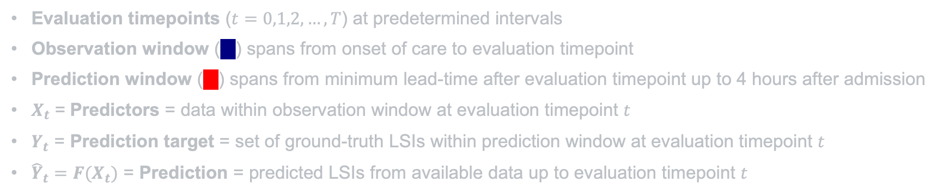

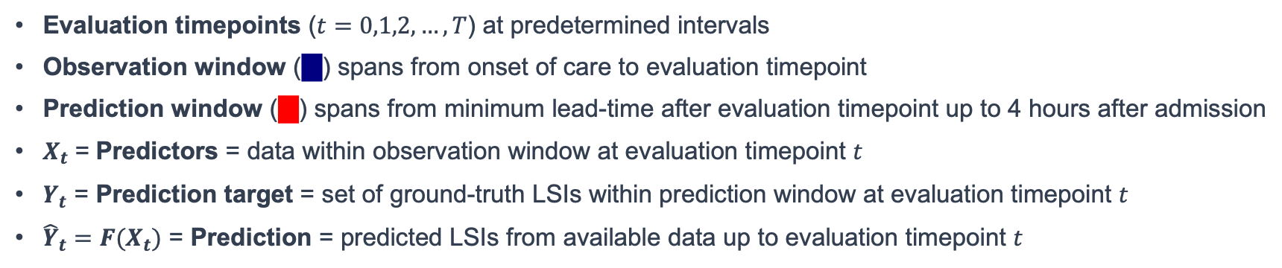
Definitions
Evaluation timepoints ($t=0,1,2,…,T$) at predetermined intervals
Observation window ( ) spans from onset of care to evaluation timepoint
Prediction window ( ) spans from minimum lead-time after evaluation timepoint up to 4 hours after admission
$X_{t}$ = Predictors = data within observation window at evaluation timepoint $t$
$Y_{t}$ = Prediction target = set of ground-truth LSIs within prediction window at evaluation timepoint $t$
${\hat{Y}}_{t}=F(X_{t})$ = Prediction = predicted LSIs from available data up to evaluation timepoint $t$
Evaluation timepoints ($t=0,1,2,…,T$) at predetermined intervals
Observation window ( ) spans from onset of care to evaluation timepoint
Prediction window ( ) spans from minimum lead-time after evaluation timepoint up to 4 hours after admission
$X_{t}$ = Predictors = data within observation window at evaluation timepoint $t$
$Y_{t}$ = Prediction target = set of ground-truth LSIs within prediction window at evaluation timepoint $t$
${\hat{Y}}_{t}=F(X_{t})$ = Prediction = predicted LSIs from available data up to evaluation timepoint $t$
Ground truth LSIs:
A
B
A
C
D
$$Y_{t}$$
$${\hat{Y}}_{t}$$
t=0
[A,B,C,D]
[A]
t=1
[A,C,D]
[A,B]
t=2
[A,C,D]
[ ]
t=3
[C,D]
[C,E]
Team Z
Predicted LSIs:
[A]
[A,B]
[ ]
[C,E]
Distribution Statement ‘A’ (Approved for Public Release, Distribution Unlimited)

Slide 17
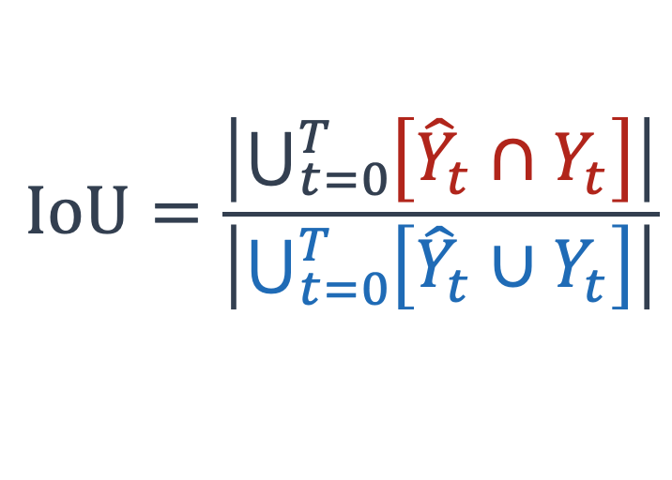
Performance Metrics, refined.
Specific definitions for time-sensitive Intersection-over-Union (IoU) and Prediction Lead-Time (PLT):
$$\text{IoU}=\frac{\left|\bigcup_{t=0}^{T}{\left[{\hat{Y}}_{t}∩Y_{t}\right]}\right|}{\left|\bigcup_{t=0}^{T}{\left[{\hat{Y}}_{t}∪Y_{t}\right]}\right|}$$
LSIs within prediction window correctly predicted at time t
All predicted and ground truth LSIs over entire case
∑
PLT =
LSI timestamp – (Evaluation timepoint + processing delay)
Earliest correct predictions for each LSI type
Distribution Statement ‘A’ (Approved for Public Release, Distribution Unlimited)

Slide 18


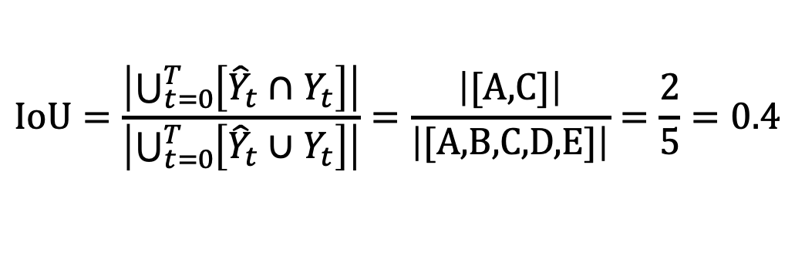

Example: Single competitor
$$\text{IoU}=\frac{\left|\bigcup_{t=0}^{T}{\left[{\hat{Y}}_{t}∩Y_{t}\right]}\right|}{\left|\bigcup_{t=0}^{T}{\left[{\hat{Y}}_{t}∪Y_{t}\right]}\right|}=\frac{\left|\text{[}\text{A}\text{,}\text{C}\text{]}\right|}{\left|\text{[}\text{A}\text{,}\text{B}\text{,}\text{C}\text{,}\text{D}\text{,}\text{E}\text{]}\right|}=\frac{2}{5}=0.4$$
Ground truth LSIs:
A
B
A
C
D
$$Y_{t}$$
$${\hat{Y}}_{t}$$
$${\hat{Y}}_{t}∩Y_{t}$$
t=0
[A,B,C,D]
[A]
[A]
t=1
[A,C,D]
[A,B]
[A]
t=2
[A,C,D]
[ ]
[ ]
t=3
[C,D]
[C,E]
[C]
Team Z
Predicted LSIs:
[A]
[A,B]
[ ]
[C,E]
①
③
②
PLT = ① + ② + ③ = Δ_{Z}
Distribution Statement ‘A’ (Approved for Public Release, Distribution Unlimited)

Slide 19
Example: Multiple competitors
Compute performance metrics for each team over the same case
Rank by IoU then by PLT
Reward points to top-k teams! (k=2, for example)
Ground truth LSIs:
A
B
A
C
D
IoU
PLT
Rank
Team Z
0.4
Δ_{Z}
#3
[A]
[A,B]
[ ]
[C,E]
Team Y
0.6
Δ_{Y}
#1
⭐️
[A,B]
[A]
[ ]
[C,E]
Team X
0.5
Δ_{X}
#2
⭐️
[ ]
[A,B]
[ ]
[C]
Team W
0.4
Δ_{W}
#4
[ ]
[A,B]
[ ]
[C,E]
t₀
t₁
t₂
t₃
(Δ_{W}< Δ_{Z})
Distribution Statement ‘A’ (Approved for Public Release, Distribution Unlimited)

Slide 20
Example: Multiple competitors, Negative case
Negative cases have no LSIs present in ground truth
Any teams that falsely predict need for an LSI receive no points
Any teams that correctly return empty responses over the entire case receive +1 point
Ground truth LSIs: (NONE)
Team Z
⭐️
[ ]
[ ]
[ ]
[ ]
Team Y
[A]
[B]
[ ]
[ ]
Team X
[ ]
[ ]
[ ]
[C]
Team W
⭐️
[ ]
[ ]
[ ]
[ ]
t₀
t₁
t₂
t₃
Distribution Statement ‘A’ (Approved for Public Release, Distribution Unlimited)

Slide 21
Performance Metrics: Fine print
Minimum lead-time (“gap”) enforces actionable predictions
Processing time must be less than minimum lead time, otherwise empty response is assumed.
Empty response indicates either:
there is insufficient evidence to make a prediction, or
no LSI is needed
Teams must have a non-zero IoU in order to receive a point
In other words: teams must make at least one correct prediction to receive a point
Tie-breaking of same-scoring teams favors maximum sum of prediction lead-time for correct predictions across all cases
Minimum lead-time (“gap”) enforces actionable predictions
Processing time must be less than minimum lead time, otherwise empty response is assumed.
Empty response indicates either:
there is insufficient evidence to make a prediction, or
no LSI is needed
Teams must have a non-zero IoU in order to receive a point
In other words: teams must make at least one correct prediction to receive a point
Tie-breaking of same-scoring teams favors maximum sum of prediction lead-time for correct predictions across all cases
Distribution Statement ‘A’ (Approved for Public Release, Distribution Unlimited)

Slide 22
Future Phases
Evaluate with fewer data sources available at test time to mimic low-resource setting
Incorporate resource usage in LSI grouping as surrogate for predicting resources needed
Modify task and metrics to predict frequency of LSIs relying on limited resources (example: blood products)
Modify performance metrics to penalize more for over-triage: predicting LSIs that were not needed
Distribution Statement ‘A’ (Approved for Public Release, Distribution Unlimited)

Slide 23
Questions?
Distribution Statement ‘A’ (Approved for Public Release, Distribution Unlimited)

Slide 24
Distribution Statement ‘A’ (Approved for Public Release, Distribution Unlimited)

Slide 25
Appendix
Distribution Statement ‘A’ (Approved for Public Release, Distribution Unlimited)

Slide 26
Casualty Report: Scoring Criteria
Feature | Values | Max score | Scoring Criteria
Severe Hemorrhage | [present, absent] | 2* | 2 if correct 0 if incorrect/missing
Respiratory Distress | [present, absent] | 2* | 2 if correct 0 if incorrect/missing
Vitals | HR: integer RR: integer | 2^ | 2 if both vitals within ± n 1 if one of vitals within ± n 0 if both outside ± n
Trauma | Head: [wound, normal] Torso: [wound, normal] Upper Ext.: [wound, amputation, normal] Lower Ext.: [wound, amputation, normal] | 2 | 2 if all responses are correct 1 if at least two responses are correct 0 otherwise
Alertness | Eyelids: [open, closed, NT] Verbal: [normal, abnormal, absent, NT] Motor: [normal, abnormal, absent, NT] | 2 | 2 if all responses are correct 1 if at least two responses are correct 0 otherwise
TOTAL |  | 10 | + up to 5 bonus points
Section 1
Section 2
*2x if within “golden window”
^1.5x if within “golden window”
NT = Not testable
Distribution Statement ‘A’ (Approved for Public Release, Distribution Unlimited)

Slide 27
Casualty Report: Indicators
Feature |  | Indicators in simulation
Heart Rate |  | (Actors only) Visual indicators of heart rate, rPPG
Respiratory Rate |  | Chest rise/fall
Severe Hemorrhage |  | Oozing/squirting/pooling blood external to the body, >50% body with blood present on clothes or exposed skin
Respiratory Distress |  | Body position (tripod or head/neck position), unequal chest-wall movement, arhythmic chest movement (agonal), gasping sounds from open mouth; false if RR=0
Trauma types | Amputation | (Manikins only) Traumatic removal of body part with severe hemorrhage at/around wound site
Trauma Details: Burn | Wound | Non-amputation visible wound (burn, hemorrhage, abrasion) using makeup/moulage, blood-soaked clothing, hands pressed on body region
Alertness Details | Eyelids | Open: eyelids open or blinking Closed: eyelids closed and not moving
Alertness Details: Verbal | Verbal | Normal: Responsive to speech with coherent speech Abnormal: Non-speech or incoherent vocalization Absent: No vocalization
Alertness Details: Motor | Motor | (Actors only) Normal: Purposeful movement of limbs, obeys commands, walking Abnormal: Minimal movement or twitching of limbs Absent: No movement
Distribution Statement ‘A’ (Approved for Public Release, Distribution Unlimited)

