Slide 1

Autonomy Standards and Ideals with Military Operational Values
(ASIMOV)
Dr. Timothy (TJ) Klausutis
Program Manager
Strategic Technology Office (STO)
ASIMOV Proposers Day
January 29, 2024

Slide 2

The Ethics of Autonomy
Isaac Asimov’s Three Laws of Robotics (Runaround, 1942)
A robot may not injure a human being or, through inaction, allow a human being to come to harm.
A robot must obey the orders given it by human beings except where such orders would conflict with the First Law.
A robot must protect its own existence as long as such protection does not conflict with the First or Second Law.
Zeroth Law of Robotics (Robots and Empire, 1986)
A robot may not harm humanity or, by inaction, allow humanity to suffer harm.
“©[“I, Robot”, Isaac Asimov - First Edition Book Cover, Gnome Press, December 1952]
Asimov’s four laws are important but insufficient to address all the complexities

Slide 3
Several Schools of Ethical Thought Apply to Autonomy
 | Consequentialism | Deontology | Virtue Ethics
Description | An action is right if it promotes the best consequences | An action is right if it is in accordance with a moral rule or principle | An action is right if it is what a virtuous agent would do in the circumstances
Central Issue | The result matters, not the actions themselves | Persons must be ends in and of themselves and may never be used as means | Emphasizes the character of the agent making the actions
Guiding Issues | Good (maximum happiness) | Right (doing one’s moral duty) | Virtue (dispositions leading to the attainment of happiness)
Practical Issues | The best for most (means-ends reasoning) | Follow the rules (rational reasoning) | Practice human qualities (social practice)
Deliberation Focus | Consequences (What is outcome of action?) | Action (Is action compatible with imperative?) | Motives (Is action motivated by virtue?)
Proposers are encouraged to explore the many ethical theories to frame their ASIMOV approach

Slide 4
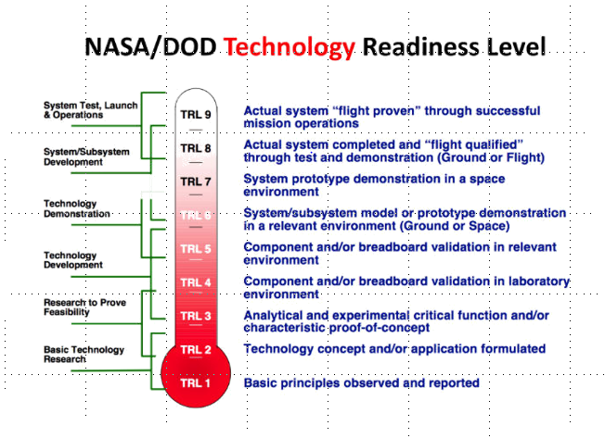
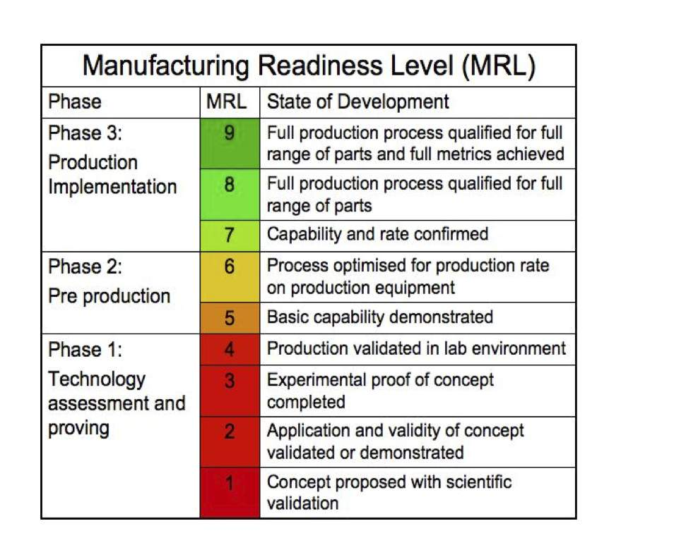
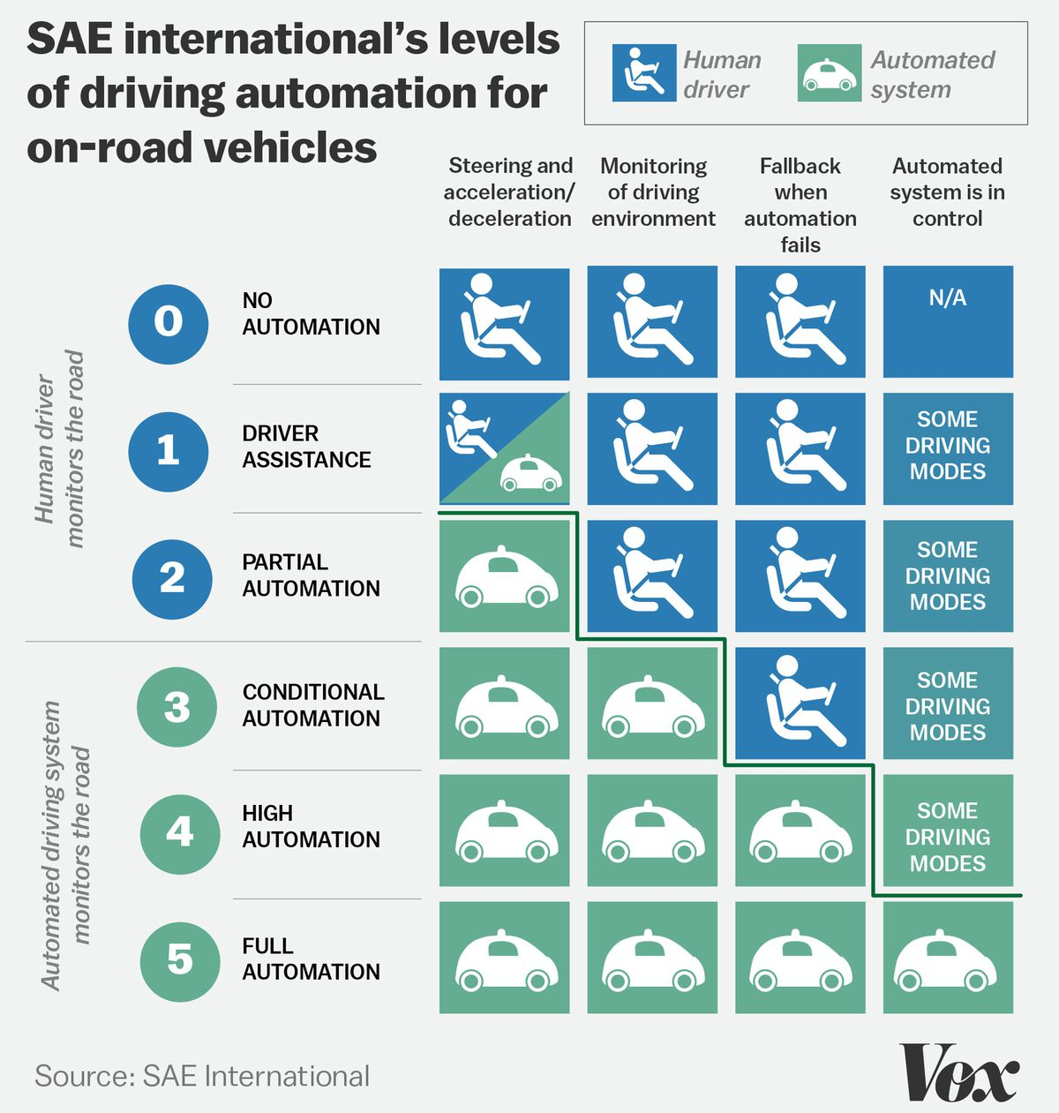
Prior Benchmark Developments – Self Driving Cars, TRLs, MRLs
Standardized Performance Evaluation
Objective: Define initial set of standardized tests to explore as technology matures
Methods: Develop standardized tests against common technology solutions
Results: Subjective over variation of unit under test and environment
Conclusions: standardized testing can assist in determining current state and indicate paths of development for unit under test and more standardized tests
  NASA: National Aeronautics and Space Administration
  TRL: Technology Readiness Level
  SAE: Society of Automotive Engineers
  DOD: Department of Defense
  MRL: Manufacturing Readiness Level
“©[2020 The Authors. Published by Atlantis Press SARL]”
Source: Jeanne C. Yu. et al. “Total Technology Readiness Level: Accelerating Technology Readiness for Aircraft Design”, Aerospace Research Center, AIAA Aviation 2021 Forum, 28 Jul 2021
“©[Copyright © 2021 by Copyright 2021 United States Government as represented by the Administrator of the National Aeronautics and Space Administration, Boeing, and Integr8 Engineering Consulting. All Rights Reserved.]”
Source: Serban A et al. “A Standard Driven Software Architecture for Fully Autonomous Vehicles”, January 2020, Journal of Automotive Software Engineering
Critical gaps: Semi-quantitative benchmarks are subjective and not independently verifiable, and standardized test ports for autonomy don’t currently exist

Slide 5
What Is ASIMOV Going To Do?
Develop Autonomous Weapon System (AWS) benchmarks
  Quantitative ethical benchmark, not qualitative
  Responsible Autonomy framework
  Define reference and instance architecture
  DOT&E ethical autonomy exploration tools
DoD Ethical AI principles^{1,2} are aspirational adjectives:
  Responsible, Equitable, Traceability, Reliability, Governable
Develop meaningful developmental and operational testable metrics representative of military operational values
DoD 3000.09 Lethal AWS present most stressing use case for ethical autonomy benchmark development
Develop and demonstrate AWS benchmarks in accordance with DoD AI Ethical Principles and IHL³
  DoD: Department of Defense
  AI: Artificial Intelligence
  IHL: International Humanitarian Law
  AWS: Autonomous Weapon System
Artificial Intelligence Ethical Principles for the Department of Defense, February 2020
Responsible AI Strategy and Implementation Pathway, DepSecDef 2022
Crowe, Weston-Scheuber, “Principles of International Humanitarian Law”, Edward Elgar Publishing, 2013

Slide 6

What ASIMOV Is NOT About
Evolutionary improvements to the existing state of practice
  e.g., Qualitative benchmarks or binning of behaviors
Development of autonomous weapon systems
  e.g., Any robots
Development of autonomous weapon system algorithms
  e.g., Autonomous target recognition algorithms, collaborative swarming algorithms, etc.
Development of standards and ideals for all autonomous systems
  e.g., Self-driving cars, large language models, machine learning, etc.
Benchmarking techniques, computational development, new ways of testing, etc. that are not focused on, and do not result in, a testable and implementable quantitative autonomy benchmark specifically developed for AWSs
  AWS: Autonomous Weapon System

Slide 7

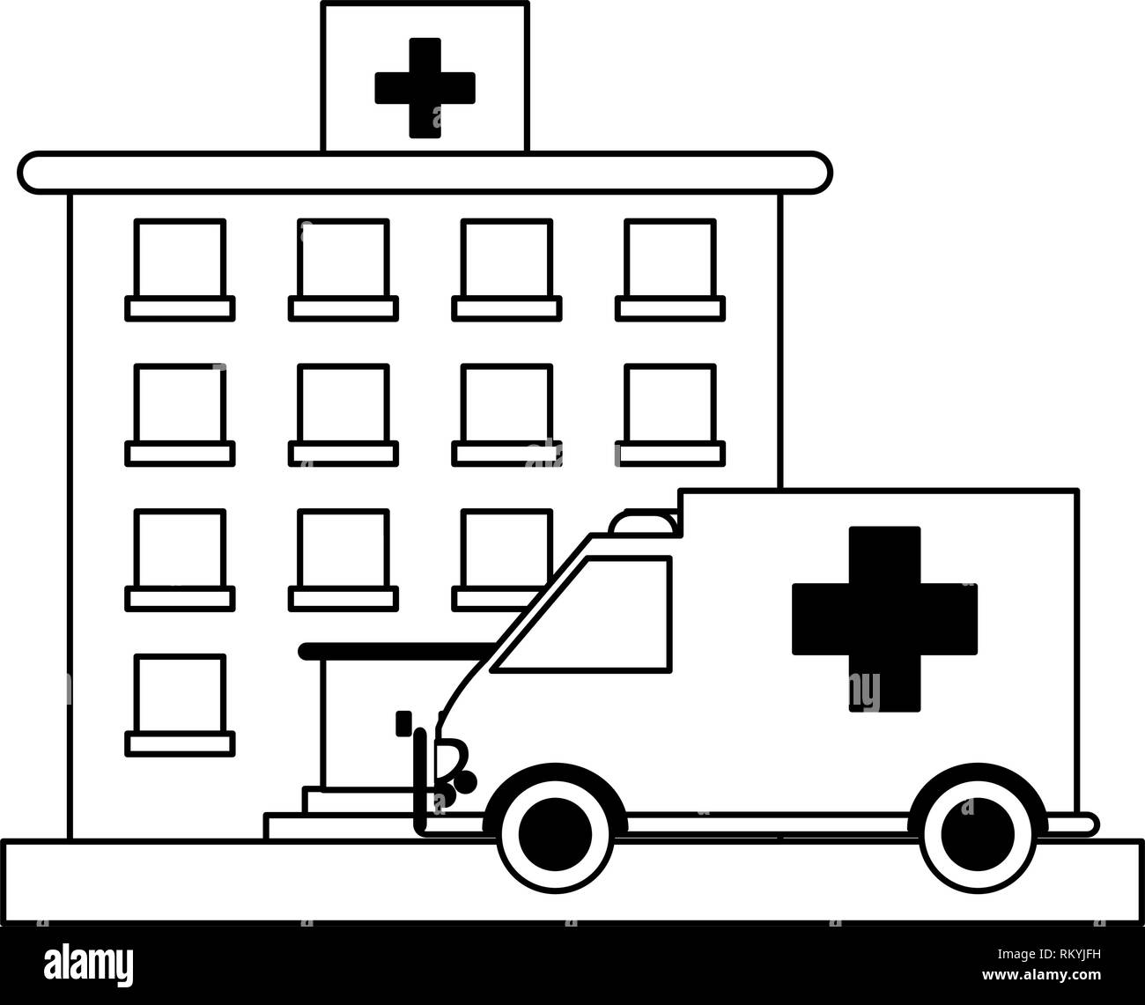






ASIMOV Autonomy Readiness Levels Transformation
R&D Community
Framework, tools, and metrics
Guides research to achievable autonomy and military values
What have you solved?
What more needs to be achieved?
Can it be solved?
DT/OT Community
Autonomy Readiness Levels (ARL)
  Responsible ARL
  Equitable ARL
  Reliable ARL
  Traceable ARL
  Governable ARL
Processes and tools to test and certify Autonomous Weapons Systems
Test definitions and data requirements
Operational Community
Informs commanders where and when autonomous systems can be used
  Rules of Engagement
  Pre-mission prediction
Manage life-long adaptation and verify system fit for function
Governability
Quantitative development and operational evaluation over the entire autonomous weapon system lifecycle
  ARL: Autonomy Readiness Level
  DT/OT: Developmental/Operational Test
  R&D: Research and Development

Slide 8

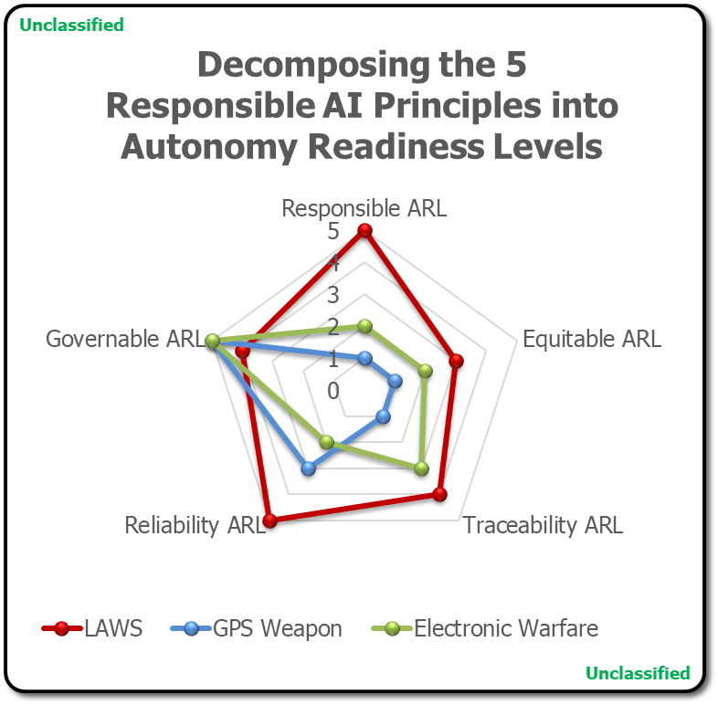

Explicitly Encoding Military Operational Values With Quantifiable Metrics
Military Operational Value Decomposition:
Operational task definitions
Decompose “values” for 5 RAI principles and IHL
Define “levels” for each RAI Principles → ARL
Define test criteria
Define test data
Ground truth
Define observables
Model algorithm architecture with test points
Ethical autonomy exploration tools
ASIMOV Benchmark:
Task specific definition
Task specific data sets
Ground truth
  Multi-valued for ethical decisions
Task specific observables
ARL level definitions
* Instance Architecture
* Reference Architecture
Responsible AI Developmental Framework:
AI Principles
  Accountability
  Transparency
  Fairness
  Interpretability
Responsible/Explainable development processes
Best practices
Model Under Test
* Multiple frameworks already exist
Transforms Ethical AI Principles into Measurable Outcomes → Autonomy Readiness Levels
  IHL: International Humanitarian Law
  AI: Artificial Intelligence
  RAI: Responsible Artificial Intelligence
  ARL: Autonomy Readiness Level
Notes:
Definitions for Architecture and Design
General Terms
An Architecture is a strategic description of “what” the system needs to do
A Design is a tactical description of “how” the architecture will be realized.
Specific Terms
A Reference Architecture is a template solution for building similar systems given differing needs and constraints.
It is based on the generalization of a set of solutions and provides guidance on how to compose a specific solution.
An Instance Architecture is a specific set of desired system behaviors and data needs based on a specific real world need.
It is the result of selecting relevant sections from the reference architecture based on specific sets of constraints that define the concrete needs.
An Instance Design is a derived from the instance architecture as designers start selecting concrete components.

Slide 9
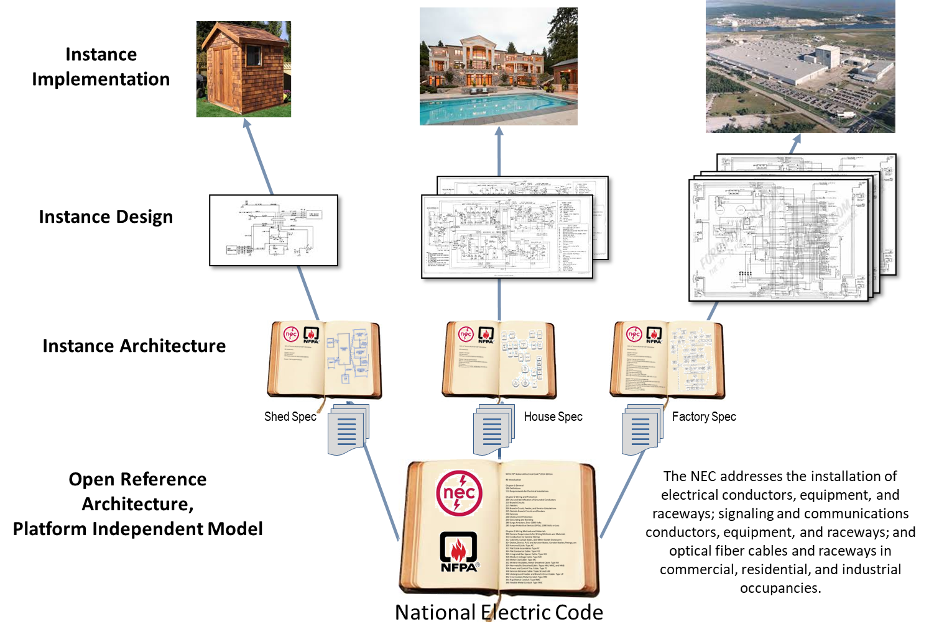
Illustration of Open Standard Approach
“©[General Dynamics/DARPA]”
  NEC: National Electric Code
Notes:
Definitions for Architecture and Design
General Terms
An Architecture is a strategic description of “what” the system needs to do
A Design is a tactical description of “how” the architecture will be realized.
Specific Terms
A Reference Architecture is a template solution for building similar systems given differing needs and constraints.
It is based on the generalization of a set of solutions and provides guidance on how to compose a specific solution.
An Instance Architecture is a specific set of desired system behaviors and data needs based on a specific real world need.
It is the result of selecting relevant sections from the reference architecture based on specific sets of constraints that define the concrete needs.
An Instance Design is a derived from the instance architecture as designers start selecting concrete components.

Slide 10
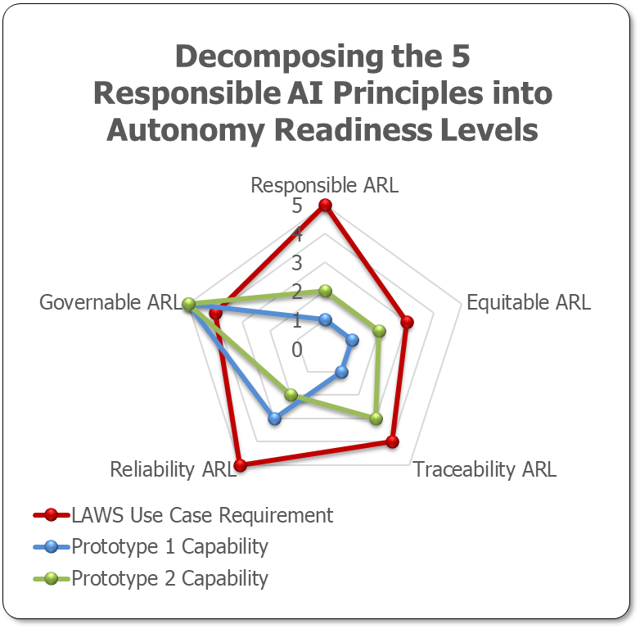
Benchmark Development and Testing – ARLs
Program Spirals Equates to Autonomy Readiness Level (1-5)
Spiral 1
Spiral 2
Spiral 3
Spiral 4
Spiral 5
Responsible Autonomy Readiness Level (Res-ARL)
Spiral Test Until Failure
For Each ARL
Equitable Autonomy Readiness Level (Equ-ARL)
Traceability Autonomy Readiness Level (Tra-ARL)
Reliability Autonomy Readiness Level (Rel-ARL)
Model Under Test
Res-ARL (5)
Equ-ARL (3)
Tra-ARL (4)
Rel-ARL (5)
Gov-ARL (4)
*Illustrative Example
Governable Autonomy Readiness Level (Gov-ARL)
Scale of benchmarks and Data Required
x80
Illustrative
Example →
$$benchmarks=5 ARLs∗4 observables per ARL∗4 measures per observable=80$$
$$datasets=5 levels of Autonomy ∗5 ARL values=25 unique datasets$$
x25
  ARL: Autonomy Readiness Level

Slide 11
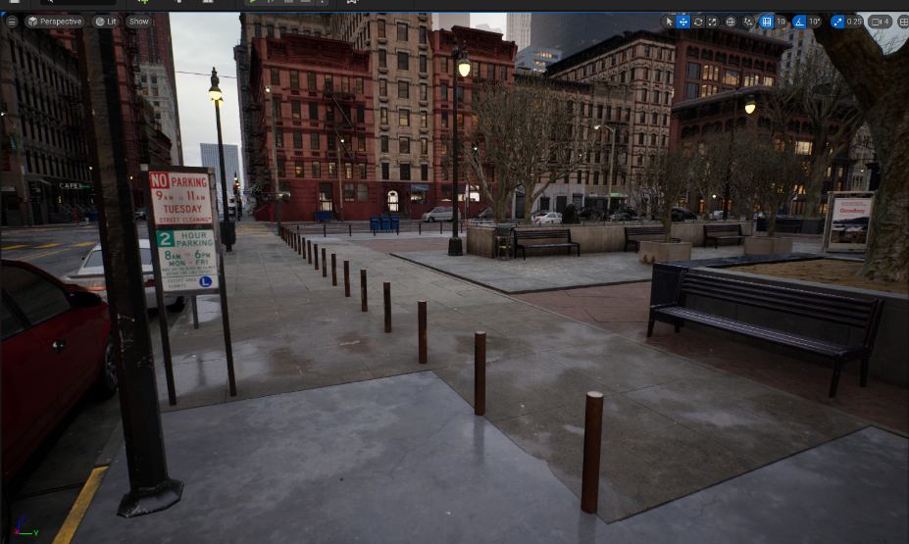
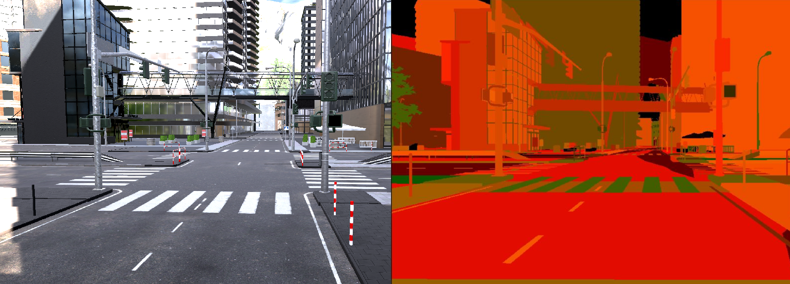

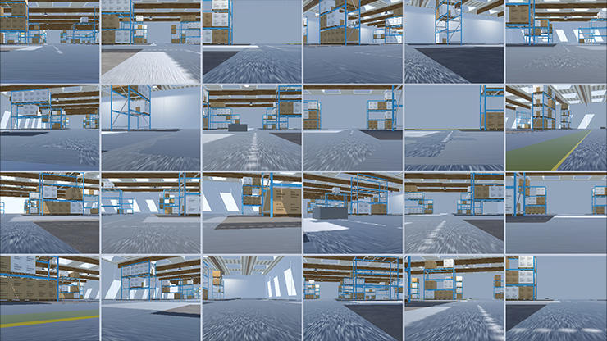
ASIMOV Generative Environment
Source: Unity
Examples
Source: https://docs.unrealengine.com/5.0/en-US/city-sample-project-unreal-engine-demonstration/
“©[Unreal Engine 5]”
Source: https://docs.unity3d.com/Packages/com.unity.perception@0.6/manual/index.html
https://unity.com/products/unity-simulation-pro
“©[Unity]”
ASIMOV to leverage commercial off-the-shelf 3D physics engines to accelerate development of quick-turn generative environment capable of rending EO/IR, LADAR, SAR, and radar scenes
Generative environment to be anchored by data collections
  EO/IR: Electro-Optic/Infrared
  LADAR: Laser Detection and Ranging
  SAR: Synthetic Aperture Radar
  RADAR: Radio Detection and Ranging

Slide 12
ASIMOV Program Ecosystem
Provide input to and inform Instances, military realism, guidance on rules of engagement
Potentially furnish whitebox algorithms
Coordinate and conduct data collections
Assess efficacy and performance of the Reference-Instance-Approach test chain
GOV IV&V
Decompose Responsible AI ethical principles into measurable levels
Develop generative test environment based on commercial engines
Refine benchmarks iteratively using self-selected Instances
Define requirements for algorithm “test ports”
Bring whitebox or use open source algorithms for early test case exploration
ASIMOV Performers
(Benchmark Development)
Define benchmark conditions and independently assess ethicality from inherently human point of view
Advise performers from ethical POV during development of benchmarks
Independently review ethical performance from a human POV
ELSI Group
Tech Community Panel
Unfunded community of technical developers to inform benchmark development
Diversity of thought in Instance simulation and Approach algorithm development
A generative environment and ethical decomposition creates tractable DT/OT pipelines
  DT/OT: Development Test / Operational Test
  ELSI: Ethical, Legal, and Societal Implications
  POV: Point Of View
  GOV: Government
  IV&V: Independent Verification & Validation
  AI: Artificial Intelligence

Slide 13
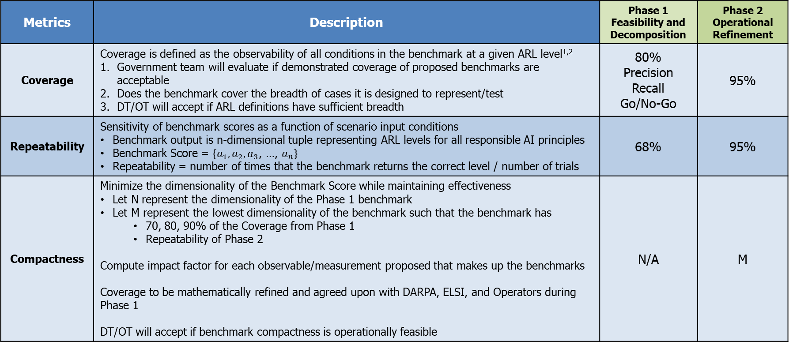
ASIMOV Metrics
Metrics | Description | Phase 1 Feasibility and Decomposition | Phase 2 Operational Refinement
Coverage | Coverage is defined as the observability of all conditions in the benchmark at a given ARL level^{1,2} Government team will evaluate if demonstrated coverage of proposed benchmarks are acceptable Does the benchmark cover the breadth of cases it is designed to represent/test DT/OT will accept if ARL definitions have sufficient breadth | 80% Precision Recall Go/No-Go | 95%
Repeatability | Sensitivity of benchmark scores as a function of scenario input conditions Benchmark output is n-dimensional tuple representing ARL levels for all responsible AI principles Benchmark Score = $\left\{a_{1},a_{2},a_{3}\text{, …,} a_{n}\right\}$ Repeatability = number of times that the benchmark returns the correct level / number of trials | 68% | 95%
Compactness | Minimize the dimensionality of the Benchmark Score while maintaining effectiveness Let N represent the dimensionality of the Phase 1 benchmark Let M represent the lowest dimensionality of the benchmark such that the benchmark has 70, 80, 90% of the Coverage from Phase 1 Repeatability of Phase 2 Compute impact factor for each observable/measurement proposed that makes up the benchmarks Coverage to be mathematically refined and agreed upon with DARPA, ELSI, and Operators during Phase 1 DT/OT will accept if benchmark compactness is operationally feasible | N/A | M
Number of conditions covered by the benchmarks is established by the user community: ELSI, Operators, DOT&E, R&D, …
Expect well over 100 conditions to be identified
  DT/OT: Developmental Test / Operational Test
  AI: Artificial Intelligence
  ARL: Autonomy Readiness Level
  ELSI: Ethical, Legal, Societal, and Implications
  DOT&E: Director Operational Test and Evaluation
  R&D: Research and Development

Slide 14

Ethical Exploration of AWS
Phase 1: Feasibility & Decomposition
Virtual World Builder
Simulation Framework
Generative Environment
Metric 1: Coverage
ASIMOV Benchmark Decomposition
Correlation/Validation
Metric 2: Repeatability
Phase 2: Operational Refinement
Design of Experiments
Real World Data Collection
(Reduced Order)
Metric 3: Compactness
  AWS: Autonomous Weapon System
Notes:
TA1
Define/nominate Responsible AI Framework
This is seen as a set of tools and methods to be utilized for AI development. The TA2 teams will necessarily need to nominate their own or accept the TA1 nomination
Benchmark definition
“a standard or point of reference against which things may be compared or assessed”
ASIMOV Benchmark will be composed of a
Reference architecture
Definition of each ARL with at least 5 levels of autonomy (1-5 where one is the lowest grade and five is the highest grade)
Utilize SAE self driving cars as an analog
Instance Architecture (ASIMOV will study the LAWS use case)
Components to include
Task definition (a task the system is supposed to accomplish)
Scenario definitions for each ARL and each level of autonomy
Develop reference architecture for the Autonomy Reliability Level benchmark
Decompose Military Operational Values across all 5 of the DoD Responsible AI Principles
This should include constraints given International Humanitarian Laws
This should include prohibitions based on Rules of Engagement
This should include adaptation given Commander’s Intent
Decomposition should include the observations/behaviors or decision states the system can make
Define what it means to be Level “x” for one of the ARL axes
Include data set and scenario development, test methodology
Include proposed “measures” that become the pool of benchmarks to be evaluated
Include impact factor or plan to evaluate the impact factor for each benchmark (“measure”)
Develop instance architecture
Define specifics for the TA2 use case
Define Level 1-5 for each of the 5 ARL
Develop test data sets
Develop task definitions
Propose and develop task observables or measures
Program metrics on the benchmarks developed by TA1
Coverage
Correctness
Performance
Ethical Performance Reliability
Rare event
Develop fast synthetic scene generation capability to quickly evaluate ethical scenarios

Slide 15
ASIMOV Schedule
P1: Feasibility & Decomposition
P2: Operational Refinement
FY24 |  |  |  | FY25 |  |  |  | FY26 |  |  |  | FY27
Q1 | Q2 | Q3 | Q4 | Q1 | Q2 | Q3 | Q4 | Q1 | Q2 | Q3 | Q4 | Q1 | Q2 | Q3 | Q4
Programmatic
Gov KO
KO
Go/No-Go
Performer Teams
AWS Reference decomposition
Generative environment development (quick turn Instance emulations)
CVG
REP
CPQ
EO/IR & LADAR
SAR/RADAR
Instances of increasing ethical difficulty
Government Team
Instance definition guidance
Experimentation & assessment
Live data collection
P1/2/3: Phase 1/2/3 CVG: Coverage metric assessment REP: Repeatability metric assessment CPQ: Compactness metric assessment
ARL: Autonomy Readiness Level EO/IR: Electro-optic / infrared SAR: Synthetic aperture radar KO: kickoff
LADAR: Laser Detection and Ranging

Slide 16
ASIMOV Deliverables
Milestone | Required Deliverable | Time After Phase 1 Start | Time After Phase 2 Start
Kickoff (KO) Meeting | Presentation materials | Within 1 month | Within 1 month
Monthly Updates | Technical and financial monthly status report | Monthly | Monthly
Quarterly Progress Reviews (QPRs) | Presentation materials | Approximately every 3 months | Approximately every 3 months
TCP and ELSI Group Meetings | Presentation materials, as appropriate | As needed | As needed
AWS Reference Initial Conceptual Design Review | Benchmark decomposition, training requirements, baseline Instances, generative test environment capable of producing scenes in EO/IR and LADAR | No later than (NLT) 6 months | -
AWS Reference Implementation Review | Updated benchmark decomposition, training requirements, expanded Instances, updated generative test environment capable of producing scenes in EO/IR, LADAR, and RADAR domains | - | NLT 6 months
AWS Reference System Requirements Review (SRR) | AWS Reference requirements document (system requirements document, SRD) | NLT 11 months | -
AWS Reference Final Conceptual Design Review | Coverage and Repeatability results, Test Port requirements. | NLT 11 months | -
 | Phase I final report
AWS Reference Design Review | Compactness results, updated Test Port requirements | - | NLT 11 months
 | Phase II final report | - | NLT 11 months
  EO/IR: Electro-Optic/Infrared
  LADAR: Laser Detection and Ranging
  RADAR: Radio Detection and Ranging
  NLT: No Later Than
  AWS: Autonomous Weapon System
  TCP: Technical Community Panel
  ELSI: Ethical, Legal, Societal, and Implications

Slide 17
ASIMOV Security
Element of Information | Index | Category | Reason | LDC or Distribution Statement | Remarks
Data from live collection of targets | Defense | CTI | DoDI 5230.24 and DFARS 252.204.7012 | DISTRO C | FOIA Exemption 3 may be applicable
Modeling and Simulation approaches and results that provide realistic military scenarios for EO/IR, LADAR, and RADAR domains | Defense | CTI | DoDI 5230.24 | DISTRO C | FOIA Exemption 3 may be applicable
Ethical performance of Approach algorithms when applied to specific Instance(s) | Defense | CTI | DoDI 5230.24 and DFARS 252.204.7012 | DISTRO C | FOIA Exemption 3 may be applicable
Technical performance of Approach algorithms when applied to specific Instance(s) | Defense | CTI | DoDI 5230.24 and DFARS 252.204.7012 | DISTRO C | FOIA Exemption 3 may be applicable
Experimental results from modeling and simulation, virtual M&S and field experiments | Defense | CTI | DoDI 5230.24 and DFARS 252.204.7012 | DISTRO C | FOIA Exemption 3 may be applicable
Highlighting CTI from ASIMOV CUI Guide (**for full CUI information on the ASIMOV program, review the ASIMOV CUI guide**)
  LDC: Limited Dissemination Control
  CTI: Controlled Technical Information
  DoDI: Department of Defense Instruction
  DFARS: Defense Federal Acquisition Regulation Supplement
  FOIA: Freedom of Information Act
  EO/IR: Electro-Optical/Infrared
  LADAR: Laser Detection and Ranging
  RADAR: Radio Detection and Ranging

Slide 18
Important ASIMOV Dates
ASIMOV BAA Posting Date: approximately ~ January 25, 2024
Proposers Day: January 29, 2024
Abstract Due Date: 10 business days after Proposers Day – February 12, 2024 at 4:00 p.m.
Abstract Response: approximately ~ 30 calendar days after receival
FAQ Submission Due Date: March 1, 2024 at 4:00 p.m.
Full Proposal Due Date: 45 business days after BAA is published – March 28, 2024 at 4:00 p.m.
*All times are Eastern Time Zone (ET)
**Review and reference the published BAA for important ASIMOV dates
*** BAA is definitive source of information
  BAA: Broad Agency Announcement

Slide 19
Questions
Please submit questions via notecards
  If questions arise after Proposers Day, please submit questions to hr001124s0011@darpa.mil
Answers to most questions will be provided after the poster session
All relevant questions and answers will be published sam.gov and potentially as part of the official ASIMOV FAQs located at www.darpa.mil/work-with-us/opportunities under ASIMOV

