Slide 1
Pipelined Reasoning Of Verifiers Enabling Robust Systems (PROVERS)
Brad Martin
Program Manager
Information Innovation Office (I2O)
Proposers Day
April 6th, 2023

Slide 2
PROVERS program objective
Develop automated, scalable formal methods tools that are integrated into traditional software development pipelines.
Enable traditional software developers to incrementally produce and maintain high-assurance national security systems.

Slide 3
DoD Challenges
  Nimble, sophisticated adversary
  Challenge creates demand for the rapid flow of capability to achieve higher levels of assurance through direct evaluation of evidence
    Deployment cycles scale as software scales
    Certification practices disproportionately delay Authority To Operate (ATO), with uncertain value add
    Current practice does not give sufficient evidence for Test and Evaluation (T&E) judgements
    Formal Methods (FM) usability, scalability, and cost uncertainties impede FM adoption in support of T&E judgements

Slide 4
Our weapon systems are vulnerable
2021 DOT&E Annual Report
Although all exercises that Director Operational Test and Evaluation (DOT&E) participates in include a DOT&E-sponsored Red Team, exercise authorities seldom permit warfighters to experience representative adversarial cyber effects because of the risk of degrading other training objectives. The net result of this limitation is a false sense of confidence by warfighters and leadership alike: failure to train in realistic cyber environments leaves warfighter skills and playbooks immature.
General Accounting Office (GAO) Report to Congressional Committees GAO-21-179
In operational testing, DOD routinely found mission-critical cybersecurity vulnerabilities in systems under development. Using relatively simple tools and techniques, testers were able to take control of systems and largely operate undetected, due in part to basic issues such as poor password management and unencrypted communications. In addition, due to limitations in the extent and sophistication of testing, DOD was likely aware of only a fraction of the total vulnerabilities in its weapon systems.

Slide 5
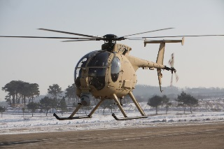



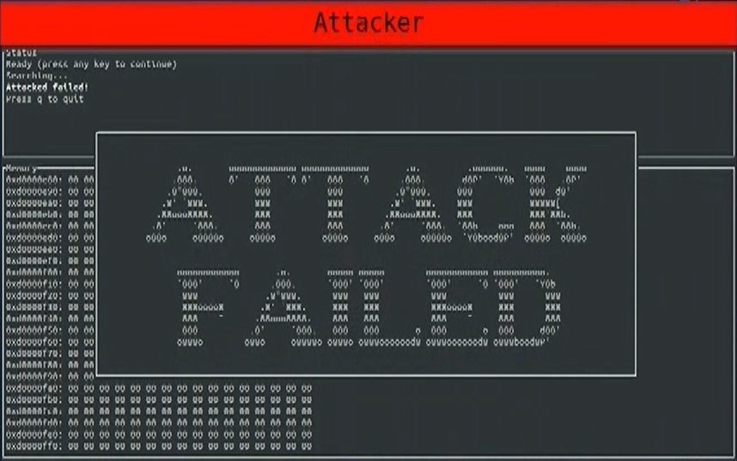
Today: Formal methods can harden DoD systems
High Assurance Cyber Military Systems (HACMS)
Skilled red teams were unable to compromise HACMS hardened platform
Encrypted control and telemetry
Auth
Virtual Machine (VM) Linux
Vehicle bus
Flight control comms
Remote data link attack
Flight
control
Key
Camera
Wi-Fi Video
eChronos Real-time Operating System (RTOS)
seL4 secure kernel
Flight computer
Mission computer
HACMS Successes
Demonstrated a way to dramatically improve the security of an existing system by leveraging high-assurance artifacts
Reimplemented security-critical code using formal methods
“cyber-retrofit”: existing components can be reconfigured to operate within a system context that protects them and prevents cascading cyber-security failures
Inserted mathematically-analyzed secure software kernel underneath mission computer software
Added secure components to replace security-critical elements of the existing Unmanned Little Bird software
Source: Secure Mathematically-Assured Composition of Control Models, Rockwell Collins,
Final Technical Report, September 2017, apps.dtic.mil/sti/pdfs/AD1039782.pdf

Slide 6
Today: Workforce, resource, and tool challenges hamper Defense Industrial Base (DIB) adoption of formal methods
DoD contractors:
High need to adopt for mission, but risky
Workforce is hard to recruit
Limited resources
Tools are often fragile, and hard to use
Tools don’t fit within existing processes/pipelines
Desire to Adopt (ROI, cost/benefit)
Ideal Scenario
Big-name tech companies:
Adoption is typically profit driven
Highly skilled workforce
Vast resources
Have control over existing processes/pipelines
Ability to Adopt (Workforce, resources)
Adoptability (Usability, scalability)
Source: I2O ISAT presentation, Addressing the Untrustworthiness of
Software Supply Chains, November 7th, 2022

Slide 7
Market Adoption for Formal Methods
Tools are deployed in production environments:
Properties delivered to domain-expert teams building and maintaining systems
Assured systems range up to millions of lines of code / hundreds of millions of users
Systems requirements rapidly change as use cases, security threat models, and developer intentions change
Code rapidly changes, e.g. at FB / Google, hundreds of commits per day
Recent formal methods successes at Amazon Web Services (AWS), Facebook, Google, others:
S2n (signal-to-noise) TLS (transport layer security) - cryptographic properties of code checked within seconds of developer commit
Identity Access Manager (AWS) - cloud access controls validated in seconds for millions of Amazon network policies
Infer (Facebook-FB) - memory safety checked on developer commit for 100k+ loc apps
ErrorProne (Google) - correctness checked in the IDE for millions of lines of code
Key enablers of success:
Integration into developer workflows
Flexibility to deliver different assurance requirements
Scalability in users, developers, lines of code
Vision: Scalable Formal Methods for DoD systems
Serviceable markets within DoD emerging
Distribution A. Approved for public release: distribution unlimited.

Slide 8
PROVERS builds on community technical advances
  Assured Components
    Promoting modular adoption and composition
  Body of Evidence
    Open Source, w/open interfaces and frameworks for evidence/engineering data
    Support for rapid re-assessment
      Automated Rapid Certification Of Software (ARCOS), providing open frameworks for engineering data and evidence
  Hybrid, formal and informal methods
    Formal/informal methods to address DoD system complexity/scale
    Support for integrating components with lower transparency – no “purity proposition” required
  Architecture
    Segregation of high assurance from untrusted/low assurance components, enabling composition (HACMS, Cyber Assured System Engineering (CASE), seL4, etc.)
  Formal Methods Infrastructure
    Development catalyzes community use (ACL2, Coq, etc.)
  FM Tool Base
    Leveraging of rich ecosystem of FM tools and capabilities that exist
Distribution A. Approved for public release: distribution unlimited.

Slide 9
Relevant DARPA programs
DARPA program | Relevance to PROVERS program
HACMS | Utilization of formal methods to build systems that are resilient against cyber-attack through “cyber-retrofit”, reconfiguration of existing components to operate within a system context that protects them and prevents cascading cyber-security failures
CASE | Formal verification of functional and cyber-resiliency properties in support of model-based systems engineering workflows by experts
ARCOS | Expert generated formal evidence to support evidence-backed arguments that software is fit for use
Assured Micropatching (AMP) | Capability to reason about generated patches and isolation of the patch change’s effects
Verified Secrity and Performance Enhancement of Large Legacy Software (V-SPELLS) | Providing for decomposition of legacy software into separate modules to reduce verification burden
Computers and Humans Exploring Software Security (CHESS) | Exploration of the workflow of expert and novice hackers
Hardening Development Toolchains Against Emergent Execution Engines (HARDEN) | Developing efficient means of communicating about complex technical areas, emergent execution in the case of HARDEN, with traditional developers
PEARLS AIE – Proof Engineering, Adaptation, Repair, and Learning for Software | Serving as a PROVERS “seedling” to explore the use of AI and machine learning to automate the generation and maintenance of proof engineering
Distribution A. Approved for public release: distribution unlimited.

Slide 10


Infrastructure
Multiple ecosystems around several formal tool chains
Critical Systems
Increasing opportunities
Scope
Opportunity to broaden scope
Experience
Successful major industrial use cases
Distribution A. Approved for public release: distribution unlimited.

Slide 11
Tomorrow: PROVERS tools dramatically increase DIB adoption
PROVERS tools:
Provide scalable automation targeted at traditional software developers (DIB workforce)
Integrate into standard software workflows
Enable incremental maintenance processes
Refined via a continuous feedback process
Create demonstrably more secure software based on red-team analysis
Desire to Adopt (ROI, cost/benefit)
Automated, scalable PROVERs tools
Ideal Scenario
Ability to Adopt (Workforce, resources)
Adoptability (Usability, scalability)
Source: I2O ISAT presentation, Addressing the Untrustworthiness of
Software Supply Chains, November 7th, 2022 (modified)
Distribution A. Approved for public release: distribution unlimited.

Slide 12
Formal methods: current state & PROVERS
Current tool capabilities | Problems resulting from limitations | PROVERS tool capabilities
Tools are limited in range of properties | High cost to deploying multiple tools. No synergies when introducing more FM tools into pipeline | Provide broad coverage of assurance properties of systems, through interoperability of tool types
There is limited incorporation of tools with modern pipelined software processes | Unclear assurance outcomes. Gaps in certification, or expensive additional certification work | Operate in modern pipelined software processes, integrated with developer tools
A high cost is required to maintain assurance during update and maintenance | High time cost in maintaining assurance. Assurance may fall out of sync with real system | Require low cost to maintain assurance during update and maintenance
Formal methods tools require expertise and extensive expert knowledge | Tools cannot be deployed due to lack of expertise. Tools provide no value due to difficulty interpreting results | Suitable for traditional software developers without formal methods expertise
Formal verification
Incremental
Workforce
Distribution A. Approved for public release: distribution unlimited.

Slide 13
PROVERS program structure
Proof Engineering (Technical Area (TA) 1)
Scalable Automation
(TA1.1)
Workflow Integration
(TA1.2)
Platform Development (TA2)
“Verified” Platform
Find me a part of the system
that has…
Find me a part of the system
that has…
Continuous Feedback (TA1.3)
Voice of the Offense
(TA3)
Baseline
Platform Assessment
Voice of the Offense
(TA3)
“Verified”
Platform Assessment
Quantitative Evaluation &
Evidence Curation (FFRDC)
Distribution A. Approved for public release: distribution unlimited.

Slide 14
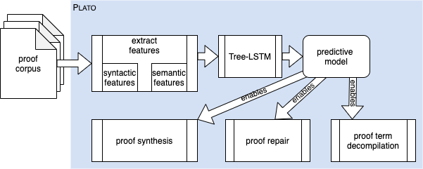
TA1.1: Proof Engineering - Scalable Automation
Challenges
Tools cannot be used due to system scale and tool usability
Tool capabilities require high cost to maintain assurance during update and maintenance
Tools limited in range of properties supported, resulting in high cost to deploying multiple tools and no synergy when introducing more FM tools into pipeline
Approaches
Develop proof engineering tools to guide engineers through the process of designing proof-friendly software systems, increasing the scale and reducing the burden of proof repair through increased automation and integration^{1, 2, 3}
Develop and advance techniques such as proof maintenance & repair^{4, 5, 6, 7, 8}
Develop pipelined versions of new and existing techniques in support of a broad range of properties⁹
Basis for Confidence¹⁰
PLATO: Enriched Tactic Prediction Models for Proof Synthesis & Repair
Developed three enhancement methods for improving tactic-prediction models by encoding identifier information
  Enhancements prove 29% more theorems than the best-performing comparable tool
  Combining all enhancements proves 38%
  Combined with prior tools, enhancements prove 45% more theorems
1 G. Klein, “Proof engineering considered essential,” in Proc. 2014 - Formal Methods 19th Int’l Symp. May 2014, Springer LNCS 8442.
2 R. Gu, et. al “CertiKOS: An Extensible Architecture for Building Certified Concurrent OS Kernels,” in Proc. 12th USENIX OSDI, Nov. 2016. https://www.usenix.org/system/files/conference/osdi16/osdi16-gu.pdf
3 B. Aydemir, et. al., “Engineering Formal Metatheory,” POPL '08: Proceedings of the 35th annual ACM SIGPLAN-SIGACT symposium on Principles of programming languages. https://www.usenix.org/system/files/conference/osdi16/osdi16-gu.pdf
4 T. Ringer, Proof Repair, Seattle: University of Washington, 2021. https://homes.cs.washington.edu/~djg/theses/ringer_dissertation.pdf
5 D. Hutter, "Management of change in structured verification," Proceedings ASE 2000. Fifteenth IEEE International Conference on Automated Software Engineering, Grenoble, France, 2000, pp. 23-31, doi: 10.1109/ASE.2000.873647.. https://ieeexplore.ieee.org/stamp/stamp.jsp?tp=&arnumber=873647
6 I. Whiteside. Refactoring Proofs. Ph.D. Dissertation, School of Informatic, University of Edinburgh, 2013. https://era.ed.ac.uk/bitstream/handle/1842/7970/Whiteside2013.pdf
7 R. Mitchell and L. de Moura. “Automation and Computation in the Lean Theorem Prover,” 2016. http://aitp-conference.org/2016/slides/RLslides.pdf
8 R. Selsam and L. de Moura. Congruence Closure in Intensional Type Theory. International Joint Conference on Automated Reasoning (IJCAR) 2016. https://arxiv.org/pdf/1701.04391.pdf
9 MuseDev, "MuseDev Readme," 5 Dec 2019. [Online]. Available: https://github.com/Muse-Dev/MuseDev#readme.
10 UIUC Milestone 3, DARPA PEARLS AIE Report
Distribution A. Approved for public release: distribution unlimited.

Slide 15
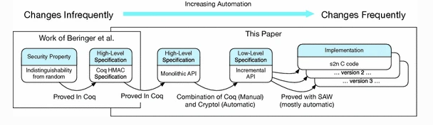
TA1.2: Proof Engineering - Workflow Integration
Challenges
Tools should integrate with DoD software and system workflows. Tools routinely cannot run in CI/CD processes
Tools are difficult to deploy due to lack of expertise. Tools provide limited value due to difficulty interpreting results
Approaches
Integrate TA1.1 (Scalable Automation) pipelined versions of new and existing techniques with widely-used tool chains, consistent with common DoD workflows^{1, 2, 3, 4}
Design and develop user interfaces and tools that match the intuitions and expectations of software developers/engineers rather than proof engineers^{5, 6}
Basis for Confidence⁷
Continuous Formal Verification of Amazon s2n
AWS demonstrated that code changes resulted in automatic corrections to the corresponding proof scripts 953/956 times
  Only 3 times were proof engineers called
  Workflow integration of this repair technology enabled performance enhancements with little involvement of proof engineers
Proof applied as part of the continuous integration system for s2n and runs every time a code change pushes or a pull request is issued
1 MuseDev, URL: https://github.com/Muse-Dev/MuseDev
2 Travis CI, Travis-CI, Leverkusen, Germany. https://docs.travis-ci.com/user/tutorial/
3 B. Ekici, et. al., “SMTCoq: A plug-in for integrating SMT solvers into Coq,” Int’l Conf. on Computer Aided Verification (ICAV) 2017, LNCS 10427. https://homepage.divms.uiowa.edu/~tinelli/papers/EkiEtAl-CAV-17.pdf
4 D. Matichuk, T. Murray, M. Wenzel. “Eisbach: A Proof Method Language for Isabelle.” Journal of Automated Reasoning Vol. 56, Issue 3, March 2016 pp 261–282. https://trustworthy.systems/publications/nicta_full_text/8465.pdf
5 A. Chudnov, et. al., "Continuous Formal Verification of Amazon s2n," in International Conference on Computer Aided Verification, 2018. https://link.springer.com/chapter/10.1007/978-3-319-96142-2_26
6 D. Distefano, et. al. “Scaling Static Analysis at Facebook,”
Communications of the ACM, August 2019, Vol. 62 No. 8, Pages 62-70 https://cacm.acm.org/magazines/2019/8/238344-scaling-static-analyses-at-facebook/fulltext
7 A. Chudnov, et. al., "Continuous Formal Verification of Amazon s2n," in International Conference on Computer Aided Verification, 2018. https://link.springer.com/chapter/10.1007/978-3-319-96142-2_26
Distribution A. Approved for public release: distribution unlimited.

Slide 16

TA1.3: Proof Engineering - Continuous Feedback
Challenges
Formal methods are not oriented to traditional developers’ concerns
Uncertain cost/benefit of formal methods deployment make it difficult for industry program managers to justify their use
Approaches
Instrumenting of proof engineering capabilities developed within TA1.1 (Scalable Automation)/1.2 (Workflow Integration) to collect usage data, with reporting and feedback provided to TA1.1/1.2 performers to improve capability development^{1, 2}
Development of models to predict cost/benefit of using formal methods³
Realize developer/engineer-oriented approach where formal reasoning methods adapt to help developers and engineers⁴
Basis for Confidence⁵
RacerD – Static program analysis for detecting data races
Experience developing and deploying concurrency analysis at Facebook, highlighting:
  Feedback benefits between science and engineering
  Tension encountered between principle and compromise
  Value of being flexible and adaptable in the presence of a changing engineering context
RacerD | Infer
1 L. Dennis, R. Monroy and P. Nogueira, "Proof-Directed Debugging and Repair," in Seventh Symposium on Trends in Functional Programming (TFP06), Nottingham, 2006. https://personalpages.manchester.ac.uk/staff/louise.dennis/pubs/proofddebugging.pdf
2 Proof, but at what cost? Robin Salkeld (AWS) HCSS 2022.
https://cps-vo.org/hcss2022/Salkeld
3 T. Ringer, et. al., "REPLica: REPL instrumentation for Coq analysis," in CPP 2020: Proc. 9th ACM SIGPLAN International Conference on Certified Programs and Proofs, New Orleans, 2020. https://dependenttyp.es/pdf/analytics.pdf
4 D. Distefano, et. al. “Scaling Static Analysis at Facebook,”
Communications of the ACM, August 2019, Vol. 62 No. 8, Pages 62-70 https://cacm.acm.org/magazines/2019/8/238344-scaling-static-analyses-at-facebook/fulltext
5 P. O'Hearn, "Experience developing and deploying concurrency analysis at Facebook," 9 July 2018. [Online]. Available: https://research.facebook.com/publications/experience-developing-and-deploying-concurrency-analysis-at-facebook/
Distribution A. Approved for public release: distribution unlimited.

Slide 17
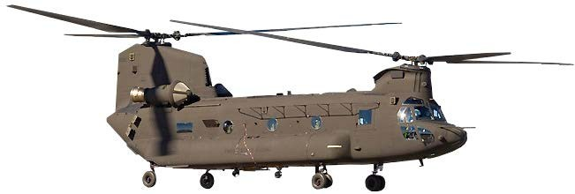
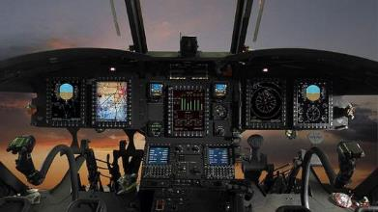
TA2: Platform Development
Challenges
Availability of publicly available platforms providing DoD relevance that can be accessed by all performers
Availability of relevant DoD platforms to demonstrate program capabilities
Approaches
Provide publicly available platforms (Phase 1) and relevant National Security System platforms (Phases 2 and 3) to program performers
  Provide subject matter platform expertise
  Provide traditional developer/engineer personnel to participate in concert with TA1 performers
Basis for Confidence¹
DARPA CASE demonstration platform
Demonstration to DARPA, Army, and other DoD customers of CASE program capabilities to extend helicopter avionics network, providing for a secure wireless gateway, the Collins CH-47 CAAS (Common Avionics Architecture System) wireless gateway
Final CASE program demonstration held at Collins Aerospace Army Customer Experience Center, Huntsville, AL
Source: https://api.army.mil/e2/c/images/2020/09/24/834124fe/max1200.jpg
Source: https://www.collinsaerospace.com/what-we-do/industries/helicopters/rotary-wing/common-avionics-architecture-system
¹ Cyberassured Systems Engineering at Scale, Cofer, et al., IEEE Security & Privacy,
May/June 2022 Vol. 20. No. 3
Distribution A. Approved for public release: distribution unlimited.

Slide 18
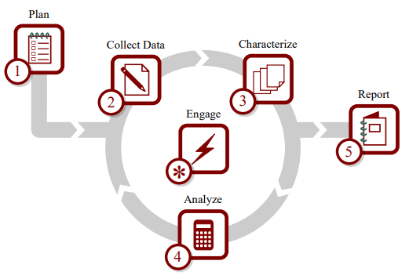
TA3: Red Team
Challenges
The number and types of attacks used for evaluating system security may not be representative of real-world threat vectors
Red team may be seen as threat, limiting information sharing
Approaches
Develop evaluation in conjunction with other performers, incorporation of assessment feedback within overall FFRDC led eval
  Assess baseline and verified use-cases at the beginning and end of each phase, respectively
Basis for Confidence¹
Information Design Assurance Red Team (IDART)
Developed at Sandia, the IDART framework is designed for repeatability and measurable results
  Analyzing the system for security strengths/weaknesses
  Measurement of risks posed by system weaknesses through an adversarial lens
¹ https://casa.sandia.gov/idart
Distribution A. Approved for public release: distribution unlimited.

Slide 19
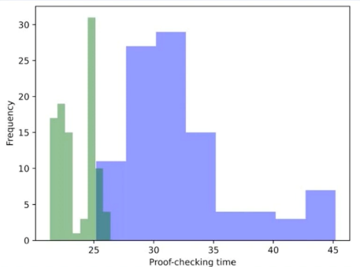
FFRDC: Quantitative Evaluation & Evidence Curation
Challenges
Measurement of effectiveness of toolsets at scale
Measurement of individual tools for proof repair
Curation of various types of technical artifacts
Approaches
Perform periodic quantitative technology assessment of TA1 (Proof Engineering) technologies, leveraging TA2 traditional developer/engineer personnel in support of usability assessment
Program-level
  Number of classes of system properties proven
  Percentage of lines of proof requiring manual change following a software update and maintenance
  Level of effort required to build and maintain high-assurance artifacts
TA-level
  Scale in terms of false positive rate, fix rate, diff time deployment, alarm signal effectiveness
  Tool scalability in terms of suitability in terms of complex projects
  Cost related to adding FM related assurances/integration with software developer workflow (e.g. inertial friction, drag)
  Efficiency and quality of outputs within existing and modified workflows (user performance)
Curation of PROVERS platforms and artifacts
Basis for Confidence^{1,2, 3}
Program Level
  Recent efforts at quantifying proof instability as code changes in Dafny at AWS
TA-Level
  Facebook assessments of Infer
… a striking situation where the diff time deployment saw a 70% fix rate, where a more traditional “offline” or “batch” deployment (where bug lists are presented to engineers, outside their workflow) saw a 0% fix rate.
¹ Proof, but at what cost? Robin Salkeld (AWS) HCSS 2022.
https://cps-vo.org/hcss2022/Salkeld
² Scaling Static Analyses at Facebook. Distefano et al, CACM August 2019.
https://cacm.acm.org/magazines/2019/8/238344-scaling-static-analyses-at-facebook/fulltext
³ RACK: A Semantic Model and Triplestore for Curation of Assurance Case Evidence
Distribution A. Approved for public release: distribution unlimited.

Slide 20
Program metrics
 |  | Phase 1: Preparation | Phase 2: Hardening | Phase 3: Maturation
 |  | Low complexity Unlimited FM Expertise | Moderate complexity Modest FM Expertise | High complexity Traditional developer
Capability | Metrics
Hardened artifact assessment | % of serious findings by Red Team remaining | Less Than 25% | Less Than 10% | Less Than 5%
Provide for broad range of property verification | Number of classes of system properties proven | 5 | 10 | Greater than 10
Provide increments of assurance during system update and maintenance | Percentage of lines of proof requiring manual change following software update and maintenance | 20% | 10% | 1%
Example properties
Functional Correctness, Information Flow Analysis, Isolation, Null Pointer Access, Integrity,
Safety, Liveness, Confidentiality, Availability, Temporal, Hyper Properties, …
Distribution A. Approved for public release: distribution unlimited.

Slide 21
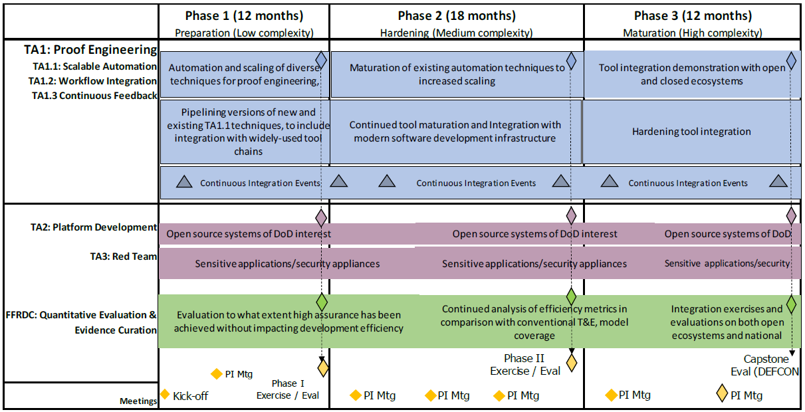
Program schedule
Distribution A. Approved for public release: distribution unlimited.

Slide 22
PROVERS builds on mission pull and willing partners
Partner pull now exists
  Elements of acquisition community in a state of readiness
    GAO report on $2T program of record review – highlights overarching problems noted as software and cybersecurity – mission partner/weapons systems relatable concerns
  Systems architects/designers are eager to exploit the continuous flow of emerging technology capabilities
  Alignment with partners in T&E, Research and Engineering (R&E), etc.
  Early tools are showing value to partners
PROVERS seeks to exploit mission pull and acquisition readiness to address adversarial threat and overcome barriers to state of the practice through receipt of rapid flow of capability to achieve higher levels of assurance and confidence through direct evaluation of evidence
Distribution A. Approved for public release: distribution unlimited.

Slide 23
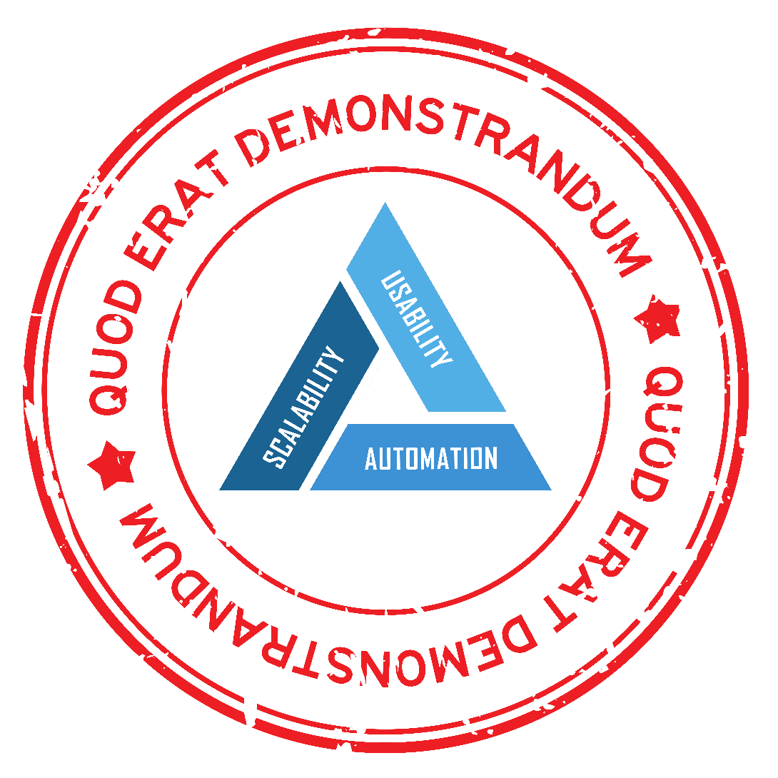


Slide 25
Proposal Submission and Awards
Proposal Submission
    Proposal submissions may cover TA1, TA2, TAs 1 and 2, or TA3
      Proposers selected for TA3 red team cannot be selected for any portion of the other two TAs
    If an organization is proposed at any level under both a TA3 and another TA proposal, the decision to de-conflict this matter is at the discretion of the Government
    If a proposal is submitted for a TA1 and 2 combination, the decision as to which TA(s), if any, to consider for award is at the discretion of the Government
Awards
    Multiple awards are anticipated for TA1 and TA2
    A single award is anticipated for TA3
Collaborative proposals are encouraged

Slide 26
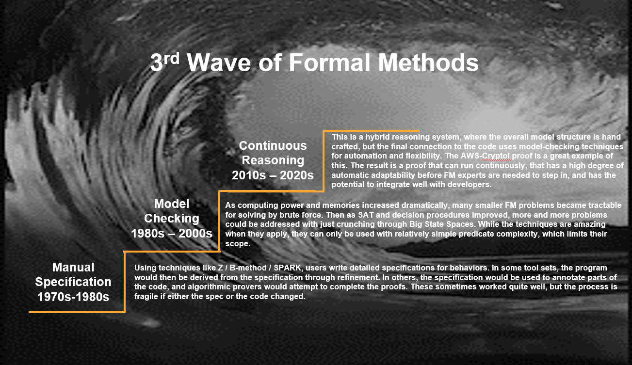
Distribution A. Approved for public release: distribution unlimited.

