Slide 1

MUSE: Mining and Understanding
Software Enclaves
Reasoning with Big Code
Suresh Jagannathan, I2O
March 7, 2014
Distribution Statement A - Approved for Public Release, Distribution Unlimited

Slide 2
MUSE Proposers’ Day Agenda
0900 – 1000 Check-In/Registration
1000 – 1050 Welcome and Overview Dr. Suresh Jagannathan, DARPA
of MUSE Program
1050 – 1105 Contracts Mr. Mark Jones, DARPA
1105 – 1115 Security Mr. Wayne Warner, DARPA
1115 – 1245 LUNCH BREAK
1245 – 1345 Individual Company Presentations
1345 – 1445 Government Response to Questions Dr. Suresh Jagannathan, DARPA
Distribution Statement A - Approved for Public Release, Distribution Unlimited

Slide 3
Logistics
DARPA-BAA 14-22
  Posted on FedBizOpps website (http://www.fedbizopps.gov) and Grants.gov website (http://www.grants.gov)
  Posting Date: February 25, 2014
  Proposal Due Date: April 15, 2014 at Noon ET
Procedure for Questions/Answer
  Questions can be submitted until 1145 this morning to MUSE@darpa.mil
  Questions will be answered during Q&A session in the afternoon
Program website http://www.darpa.mil/Our_Work/I2O/Programs/Mining_and_Understanding_Software_Enclaves_%28MUSE%29.aspx
  Copy of presentations
  Video recording
  Frequently Asked Questions (FAQs)
Distribution Statement A - Approved for Public Release, Distribution Unlimited

Slide 4
A myriad set of techniques for software validation
Testing
Static Program Analysis
Dynamic Program Analysis
PLT Redex: DSL for specifying, debugging, and testing operational semantics
Quickcheck: Specification-driven formulation of properties that can be checked using random testing
Csmith: Random generator of C programs that conform to C99 standard for stress-testing compilers, analyses, etc.
CUTE: Unit-testing of C programs with pointer arguments by combining symbolic and concrete executions
Korat: Constraint-based generation of complex test inputs for Java programs, focusing on data structures and invariants
CFA: Whole-program control-flow analysis that computes the set of procedures that can be invoked at a call-site
ASTREE: Abstract interpretation of real-time embedded software designed to prove absence of runtime errors by overapproximation of program behavior
TVLA: Flow-sensitive shape analysis of dynamically-allocated imperative data structures
Bddbdddb: Context- and field-sensitive analysis applied to Java that translates analysis rules expressed in Datalog to BDD representation
Saturn: Scalable and modular summary-driven bit-level constraint-based analysis framework
Coverity: Unsound scalable analyses used to check correctness of C, C++, and Java programs.
Contracts : Assertions checked at runtime with blame
Daikon: Likely pre- and post-condition invariant detection over propositional terms, based on program instrumentation and
Valgrind: Instrument binary programs to track memory access violations and data races using dynamic recompilation
Fasttrack: Lightweight data race detector that uses vector clocks and a dynamically constructed happens-before relation
Model Checking
CVC, SLAM, Blast, Spin, Java PathFinder
CHESS: Bounded model-checking for unit-testing of shared-memory concurrent programs
TLA: Temporal logic of actions for specifying and checking concurrent systems
Symbolic Execution
KLEE: Symbolic execution engine to generate high-coverage test cases
S2E: Scalable path-sensitive platform
Logics and Types
Jstor, Space Invader, Smallfoot: Separation-logic based tools for verifying expressive shape properties of dynamic data structures and heaps
ESC: Extended static checking that combines type checking with theorem proving
Coq. Agda, Isabelle, ACL2, NuPRL: Mechanized proof assistants
Ynot: Hoare Type Theory
Rely-Guarantee Reasoning: Modular verification of shared-memory concurrency
Liquid Type Inference: Discovery of expressive refinement properties in Haskell, ML, and C
Hybrid Type Checking and Soft Typing
Session Types: type systems for expressing communication protocols
Distribution Statement A - Approved for Public Release, Distribution Unlimited

Slide 5
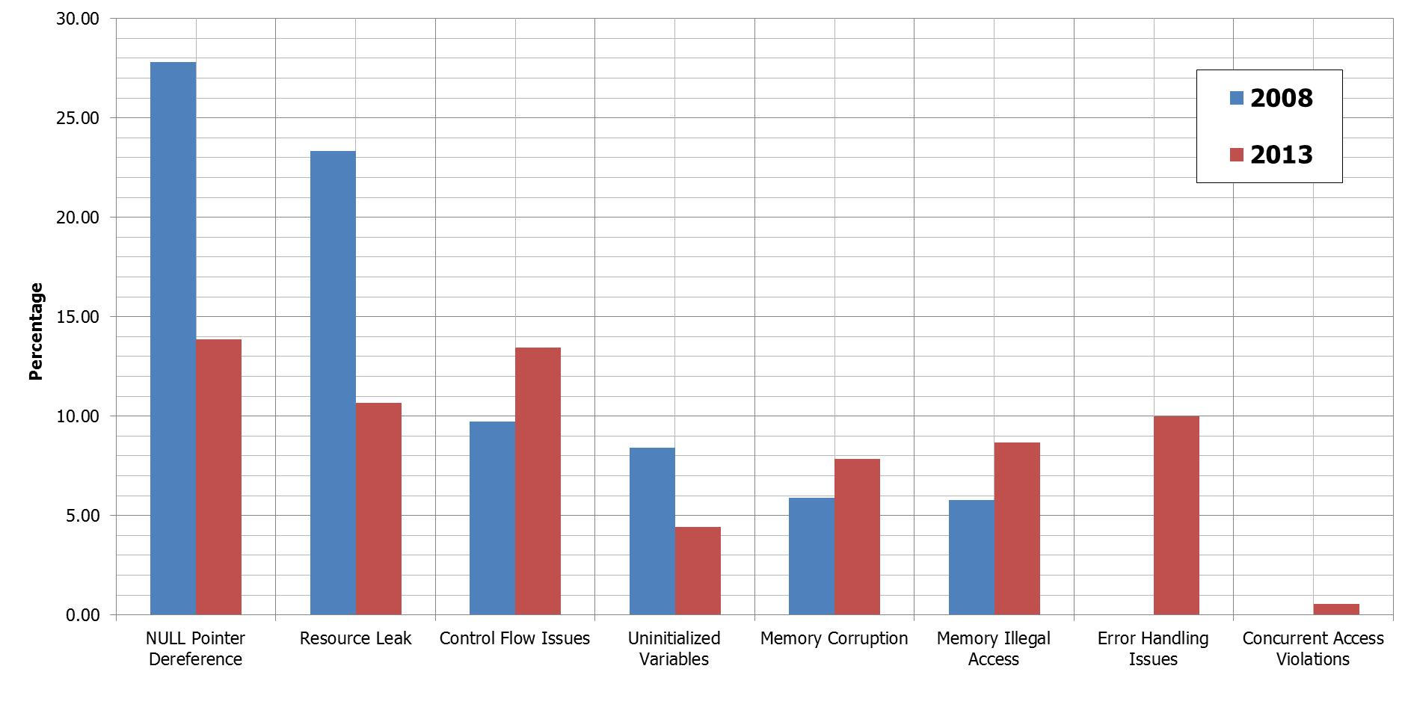
But, bugs still remain difficult to prevent, catch, and repair
Average defect density is 2.3x greater in 2013 (.69) than in 2008 (.3)
    Defect Density = # of bugs/KLoC
    Source: Coverity, Open Source Report, 2013
Distribution Statement A - Approved for Public Release, Distribution Unlimited

Slide 6
From Specifications to Implementations
Specifications may be complex
Specifications may be intensional
Source: Norrish (PiP’14)
Source: Sarkar et. al (PLDI’12
Sel4 architecture: Specification defined across multiple abstraction layers which include various untrusted translation phases.
Power relaxed-memory model: Allowed program behaviors depend on visibility and ordering guarantees of underlying processor.
Specifications may express non-local (global)
and inter-related invariants
Source: Lin et. al (PLDI’11)
Afix: Two atomicity violations, but treating the fixes independently can lead to deadlock
Distribution Statement A - Approved for Public Release, Distribution Unlimited

Slide 7
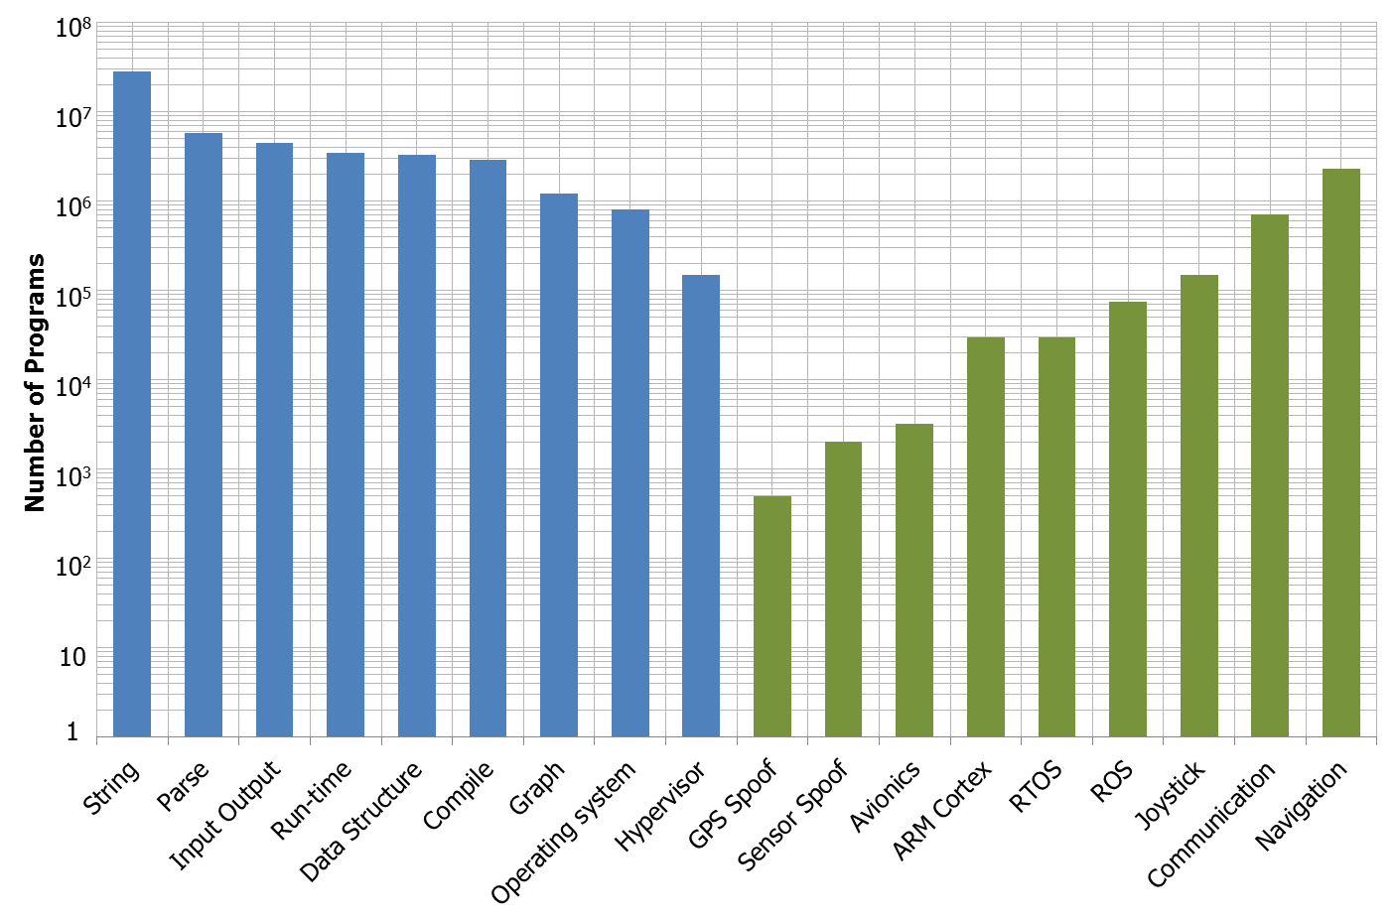
Knowledge extraction and redundancy in software
Generic Program Properties
Specialized Domain Properties
Source: ohloh.net
Distribution Statement A - Approved for Public Release, Distribution Unlimited

Slide 8
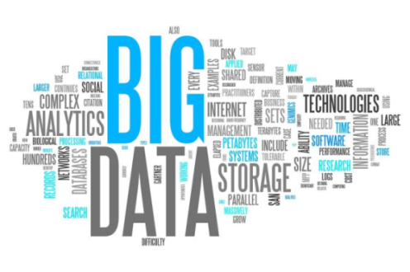
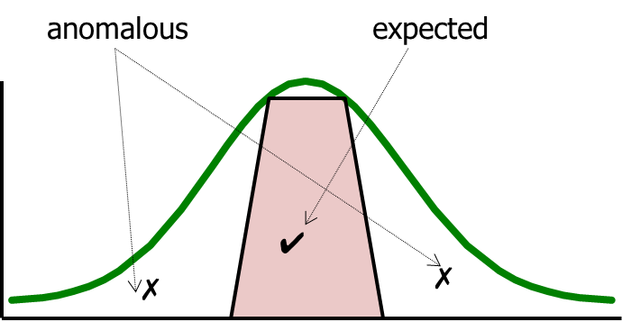
Exploiting redundancy: Big Data for Software Analytics
Data Stream
and Signals
Observations
Probability
Distribution
function
count
Analytics
Inferences
Distribution Statement A - Approved for Public Release, Distribution Unlimited

Slide 9
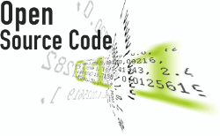
Big Data for Software Analytics
Apply principles of Big Data Analytics to a large corpus of Open-Source Multi-Lingual Software
Data Stream
and Signals
Observations
Probability
Distribution
function
count
Programs
Analytics
Inferences
Program Properties,
Behaviors, and Vulnerabilities
Treat programs (more precisely, semantic objects extracted from programs) as data
Observations and inferences applied to program properties
Distribution Statement A - Approved for Public Release, Distribution Unlimited

Slide 10
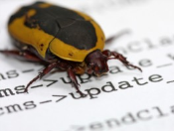
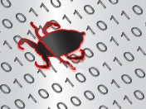
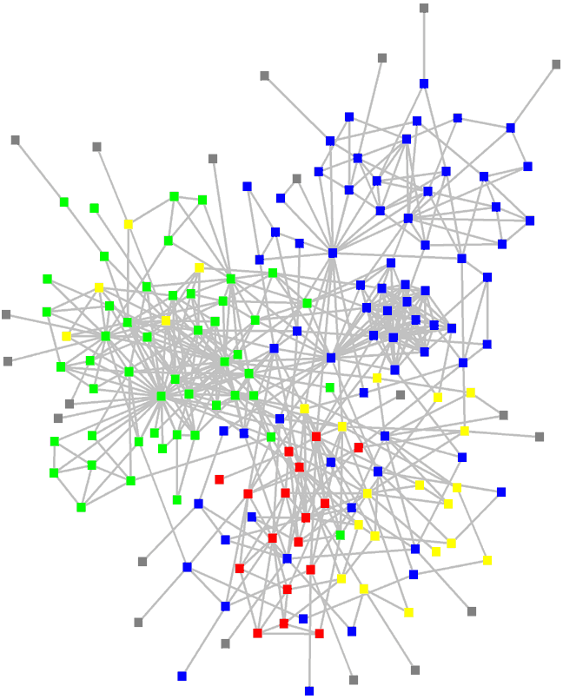
Design
Source
Binary
Paradigm shift: replace costly and laborious test/debug/validate cycle with “always on” program analysis, mining, inspection, & discovery
OR
Graph Database and
Mining Engine
Analytics
Inspection
α₁
α₂
Property Checking
and Repair
Source
Binary
Artifact
Generation
X
X
α₃
OR
Program Analysis, Theorem Proving, Testing
β₃
Discovery
β₂
λ₃
Learning and Synthesis
Program that satisfies X:
f(α₁) ◦ g(β₂) ◦ h(λ₃)
β₁
λ₂
λ₁
Query: “Synthesize a program that does X”
Distribution Statement A - Approved for Public Release, Distribution Unlimited

Slide 11
Enclaves
Redundancies in the corpus exposed as dense components (enclaves) in the mined network
Nodes represent properties facts, claims, and evidence
Edges connect related properties
Anomalous properties have small number of connections
Likely invariants have large number of connections
Distribution Statement A - Approved for Public Release, Distribution Unlimited

Slide 12
Challenges: Big Code Front-End
Distribution Statement A - Approved for Public Release, Distribution Unlimited

Slide 13
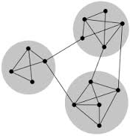
Challenges: Big Code Back-End
Mining
Inference
Engine
Distributed
Graph Database
Property
Checking
Navigation and
Search
DSLs
Query
Language
Specification Language
Queries
Queries
Learning and
Model Generation
Protocol
Discovery
Synthesis Framework
Distribution Statement A - Approved for Public Release, Distribution Unlimited

Slide 14
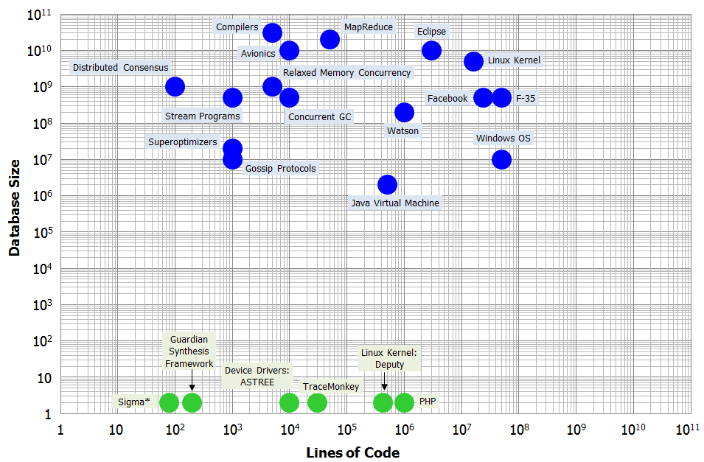
If this technology is wildly successful…
5
1 | Automated Defect Identification
2 | Specification Inference
3 | Intensional Reasoning
4 | Automated Repair
5 | Discovery
6 | Model Generation
5
5
4
4
6
4
6
4
2
2
2
3
1
3
1
6
5
2
3
1
4
Distribution Statement A - Approved for Public Release, Distribution Unlimited

Slide 15
Program Structure
Technical Area 1: Evaluator
Corpus Integrity and Challenge Problems
Software Engineering &
Domain Experts
Technical Area 2: Artifact Generators
Analysis
Compilation and Models
Runtime
Monitoring
Programming Language (PL) & Compilation Experts
Technical Area 3: Mining Engine
Intermediate Representations
Query Language
Big Data, Machine Learning, & Database Experts
Technical Area 4: Analytics
Inspection:
Property Checking
and Repair
Discovery:
Learning
and Synthesis
PL, Algorithms, Statistics, & Domain Experts
Technical Area 5: Infrastructure
Visualization
Cloud Environment
VM Environment
Systems Experts
Distribution Statement A - Approved for Public Release, Distribution Unlimited

Slide 16
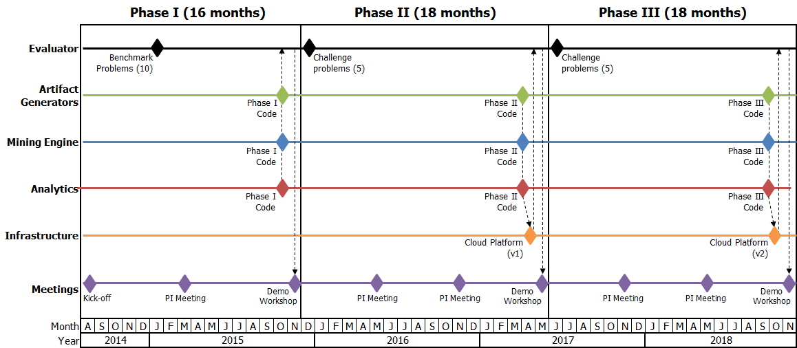
Schedule, Products, & Transition Plan
Products
Mining engine
Large semantic corpus
Repair and discovery analytics
Multi-lingual support for program analysis
Supporting community
Distribution Statement A - Approved for Public Release, Distribution Unlimited

Slide 17
Programmatics
Three planned phases: Phase I (16 months); Phases II & III (18 months each)
Five Technical Areas (TAs)
  TA1 - Evaluator
  TA2 - Artifact Generators
  TA3 - Mining Engine
  TA4 - Analytics
  TA5 - Infrastructure
  Anticipate one award for TA1 and TA5 and multiple awards in each of TA2-4
    If selected for TA1 and TA5, cannot be selected for any portion of the other TAs
  Performers in TA2-4 will be grouped into one or more design teams
    Each team led by a TA4 performer
    Each team will have one TA3 performer and one or more TA2 performers
  Each team will produce a working end-to-end Analytic and Artifact System (AAS)
  Teams will not be competitively evaluated; no anticipated down-selection
Strong interaction among all performers is critical to program success
  Associate Contractor Agreement (ACA)
Distribution Statement A - Approved for Public Release, Distribution Unlimited

Slide 18

Technical Area 1 – Evaluator
Develop benchmarks and Challenge Problems (CPs) for TA2-4 performers
  10 benchmarks due 6 months after kickoff
  At least 5 CPs due 1 month after start of Phases II and III
    Grow in complexity throughout program
Develop rich corpus of open source and open binary software for TA2 and TA4 performers
Evaluate performance of each AAS on each benchmark and CP
  Quality of the solution
  Run-time performance is secondary
  Present results at Demo Workshops
Lead Demo Workshops (end of each phase)
  Focus on strengths and weaknesses of existing implementation approaches w.r.t. tackling proposed problems
  Provide retrospective analysis on the effectiveness of strategies on the problems presented at the beginning of the phase
TEAM
WORK
Consult with the Government Team and TA2-4 performers in selecting benchmarks and CPs
Regarding the CPs, make available to TA2-4 performers any reference material to measure the effectiveness of their approaches
Regarding the corpus, make available to TA2-4 performers any test scripts or other information
Work with performers from all TAs to identify critical research challenges and issues
Distribution Statement A - Approved for Public Release, Distribution Unlimited

Slide 19
Technical Area 2 – Artifact Generators
Design and build “front-end” of a AAS
  Populate the database with facts, evidence, conjectures, and inferences about the programs (and the properties they satisfy) comprising the corpus
    Program analyses, both static and dynamic, tests, expressive type checking and inference tools, automated verification tools (e.g., constraint, SMT, or SAT solvers), model checking, abstract interpretation, shape analysis, effect analysis, concurrency analysis, mechanized proof assistants, etc.
  Provide support for binary analysis and decompilation for binary code in the corpus
  Provide a sufficiently detailed understanding of input programs to allow effective mining and inference generation by backend analytic frameworks
WORK
TEAM
Participate in one AAS design team, led by a TA4 performer
Work with both TA3 and TA4 performers to incorporate novel analyses, algorithms, and representations to support the models and inference strategies adopted by TA4 performers
Use the benchmarks and CPs developed by the TA1 performers and the Team CP to evaluate and drive research
Work with performers from all TAs to identify critical research challenges and issues
Distribution Statement A - Approved for Public Release, Distribution Unlimited

Slide 20
Technical Area 3 – Mining Engine
Build and maintain a persistent graph database store
  Output of analyses developed in TA2
  Input to analytics developed in TA4
  Provide efficient and scalable access to TA2 and TA4 performers to populate, refine, mine, and navigate the database
  Develop new APIs and interfaces, query and specification languages, and representation schemes that accommodate the varied analyses and analytics developed by TA2 and TA4 performers
Not required to implement the graph database from scratch; allowed to use and customize open-source database engines (e.g., Titan or Neo4j)
WORK
TEAM
Participate in one or more AAS design teams, led by a TA4 performer
Work with both TA2 and TA4 performer to tailor the structure of the interfaces they provide to best reflect the needs of the particular analyses developed in TA2 and analytics developed in TA4
Use the CPs developed by the TA1 performers and the Team CP to evaluate and drive research
Work with performers from all TAs to identify critical research challenges and issues
Distribution Statement A - Approved for Public Release, Distribution Unlimited

Slide 21
Technical Area 4 – Analytics
Design and build the “back-end” of a AAS
  Generate global inferences from the data captured within the database
  Apply these inferences on problems related to property checking, repair, learning, and synthesis, among others
  Apply deep inspection of the database to establish relations among components derived from a multitude of programs
    association rule mining
    frequent itemset mining
    clustering techniques
    classification strategies
    online learning algorithms like L*
    etc.
Demonstrate the AAS applied to the Team CP and benchmarks at the Demo Workshop
WORK
TEAM
Lead a AAS design team
  One TA3 performer
  One or more TA2 performers
  Develop Team CP
Propose one or more benchmarks and CPs to the TA1 performer
Deliver AAS to TA1 performer one month before each Demo Workshop
Serve as primary point of contact for technical support to the TA1 performer during the evaluation of the AAS on program-wide as well as team specific benchmarks and CPs
Work with performers from all TAs to identify critical research challenges and issues
Distribution Statement A - Approved for Public Release, Distribution Unlimited

Slide 22
Technical Area 5 – Infrastructure
Overall integrator for the program
  Provide facilities to house the corpus, and the tools, implementations, and systems developed by the AAS teams
  Phase I: handle storage needs for the corpus
  Phases II and III: provide a cloud infrastructure that the TA1 performer and AAS teams will use to manage development and data warehousing needs
Provide a virtualization environment that allows corpus programs to be executed within the appropriate environment
Produce visualization tools that AAS teams can use to understand the structure of the graph produced by their analysis and analytic techniques
WORK
TEAM
Work closely with performers from all TAs in Phases II and III to ensure code, corpora, documentation, and environments are properly housed and accessible via the cloud infrastructure
Work with performers from all TAs to identify critical research challenges and issues
Distribution Statement A - Approved for Public Release, Distribution Unlimited

