Slide 1
Modeling Adversarial Activity (MAA)
Carey Schwartz
DARPA/I2O
Proposers Day
September 27, 2016
DISTRIBUTION A. Approved for public release: distribution unlimited.

Slide 2
MAA program goal
Goal: Develop mathematical techniques that integrate and analyze heterogeneous data sources to enable high confidence indications and warnings of Weapon of Mass Terrorism (WMT) activities
Hypothesis: Adversaries will leave a trail of observable transactions while they attempt to build or buy a WMT that MAA techniques will be able to detect
DISTRIBUTION A. Approved for public release: distribution unlimited.

Slide 3
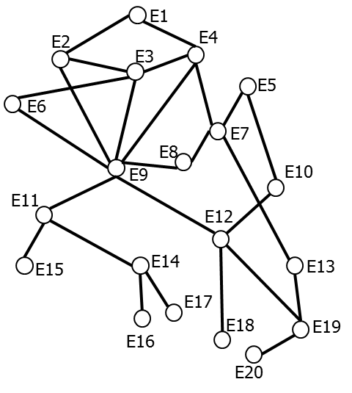
MAA vision
Observe transaction data
Merge into graphs
Detect activity
Combined entity-transaction graphs
E1
E2
E3
E4
E6
E5
Multiple single channel sources
E8
E7
E9
E10
E11
E12
E15
E14
E13
Activity templates
E17
E18
E19
E16
E20
= Transactions associated with multiple channels
=
= Integrated view of all transactions
Challenges:
Real world transaction data has PII & classification issues
WMT activities may not be present in the data
Challenges:
Entities and transactions are often not correctly identified
Product is a set of noisy, incomplete, mischaracterized, and mislabeled data
Challenge:
Adversaries’ malicious activities are actively buried in benign background transactions
Approach:
Create realistic synthetic data for research with benign background activities
Control presence or absence of WMT-related activities
Approach:
Create structure-based merge methods that can exploit relationships in graph topologies
Approach:
Advance state of the art in sub-graph detection and graph isomorphism to improve graph matching
DISTRIBUTION A. Approved for public release: distribution unlimited.

Slide 4
MAA acquisition strategy: Two phases
Phase 1: Mathematical underpinning
TA 1 Synthetic data creation
TA 2 Graph merging
TA 3 Activity detection
Combined entity-transaction graphs
E1
E2
E3
E4
E6
E5
Multiple single
channel sources
E8
E7
E9
E10
E11
E12
E15
E14
E13
Activity templates
E17
E18
E19
E16
E20
TA 4 Adaptive activity recognition
TA 5 System engineering and evaluation
Identify activities that resemble but are not exactly as specified by templates
Reason over events and activity models generating hypothesis, data requests, and alternative explanations of observations
Build integrated MAA system and execute on synthetic transaction data
Provide feedback to TA 1-4 based on performance
Generate Receiver Operating Characteristic
Conduct sensitivity analysis including value of data, quality of data, and instantiation of algorithms
Phase 2: System development
(separate BAA)
DISTRIBUTION A. Approved for public release: distribution unlimited.

Slide 5
TA1 Synthetic data creation
Transaction data
Combined graph
(ground truth)
Channel-specific graphs
(for TA2)
Background activity templates
E1
E2
E3
E4
E5
E6
Combine
E7
Filter
E8
E10
E9
E11
E12
Adversary activity templates
Add noise
E15
E14
E13
E17
E16
E18
E19
E20
SME generated
Channel-specific graphs arising from filtering the integrated view
= Transactions associated with multiple channels
=
= Integrated view of all transactions
Challenges:
Modeling the background and foreground at sufficient realism
Scale of data sets and number of channels
Embedding without trivializing detection
DISTRIBUTION A. Approved for public release: distribution unlimited.

Slide 6
TA2 Graph merging
Channel-specific graphs
(from TA1)
Merged graph
(for TA3)
Merge
Challenges:
Structural graph merging had been considered intractable
Application of graph structure and topology to enhance feature matching
DISTRIBUTION A. Approved for public release: distribution unlimited.

Slide 7
TA3 Activity detection
Activity detected in merged graph
Map
Adversary activity templates
Challenges:
Adaptation of adversary activity templates
Requires application of sub-graph detection, graph isomorphism, community, clique detection in graphs, multi-commodity flow and temporal sequences in activity graphs
DISTRIBUTION A. Approved for public release: distribution unlimited.

Slide 8
MAA Program Evaluation Schedule
MAA Program Schedule
Task Area | FY17 |  |  |  | FY18 |  |  |  | FY19 |  |  |  | FY20
 | Q1 | Q2 | Q3 | Q4 | Q1 | Q2 | Q3 | Q4 | Q1 | Q2 | Q3 | Q4 | Q1 | Q2 | Q3 | Q4
TA 1 Synthetic data creation
TAs 2 Graph merging
TA3 Activity detection
PI meetings
Key
Data or code drop and assessment
PI Meetings
DISTRIBUTION A. Approved for public release: distribution unlimited.

Slide 9
Teaming
For performers seeking to team with others, we have created a MAA Teaming site:
https://www.schafertmd.com/darpa/i2o/maa/teaming/
Account creation is required to participate
Immediate access will be granted to post your teaming information to the site
You can also browse or search the information of others
You may also access the site through the MAA Proposers' Day meeting registration website
Use the "Teaming" link on the site navigation menu.
TEAMING IS NOT REQUIRED
DISTRIBUTION A. Approved for public release: distribution unlimited.

